Slide 1
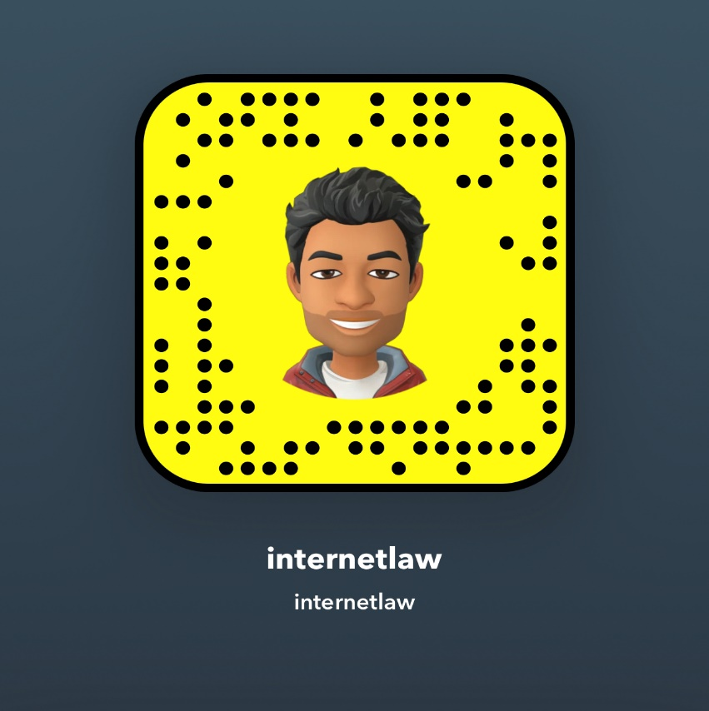

BALLON’S ANNUAL BRIEFING: INTERNET AND MOBILE LAW AND LITIGATION TRENDS – JANUARY 2023
Ian Ballon, JD, LLM, CIPP/US
Co-Chair, Global IP & Technology Practice Group
Greenberg Traurig LLP
(310) 586-6575 (650) 289-7881 (202) 331-3138
Ballon@GTLaw.com
Facebook, Twitter, LinkedIn: Ian Ballon
www.IanBallon.net

Slide 2
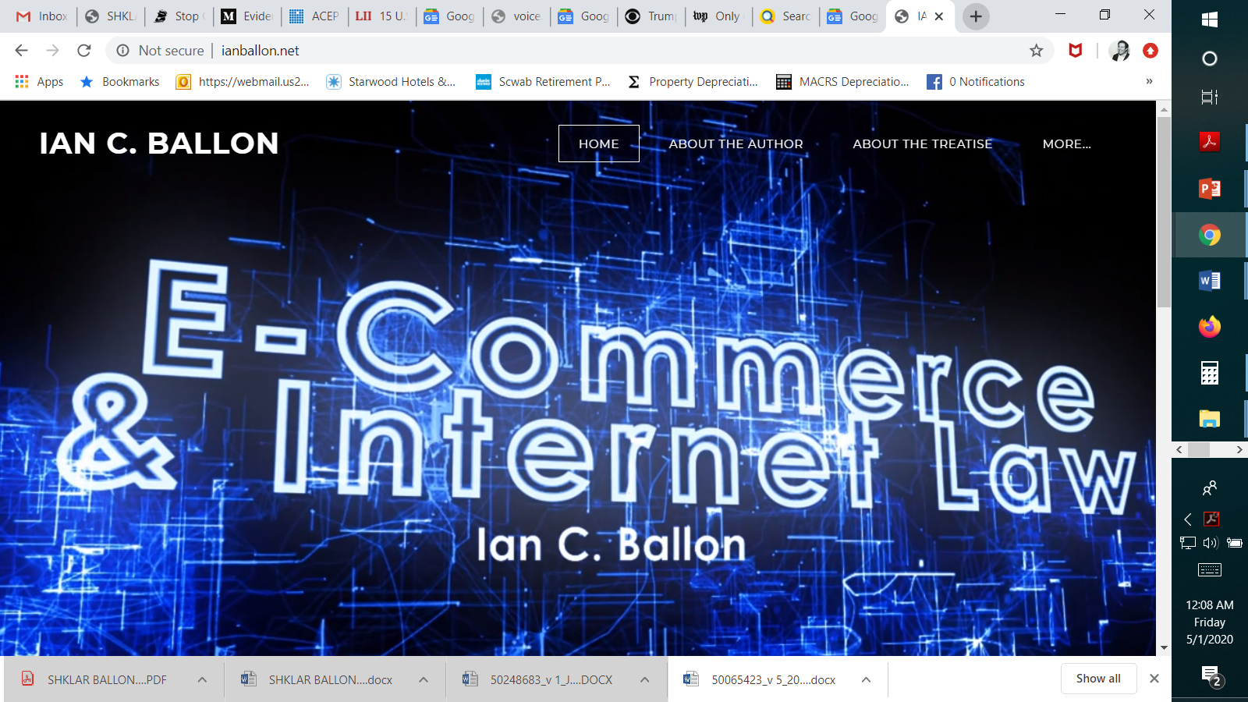

Slide 3
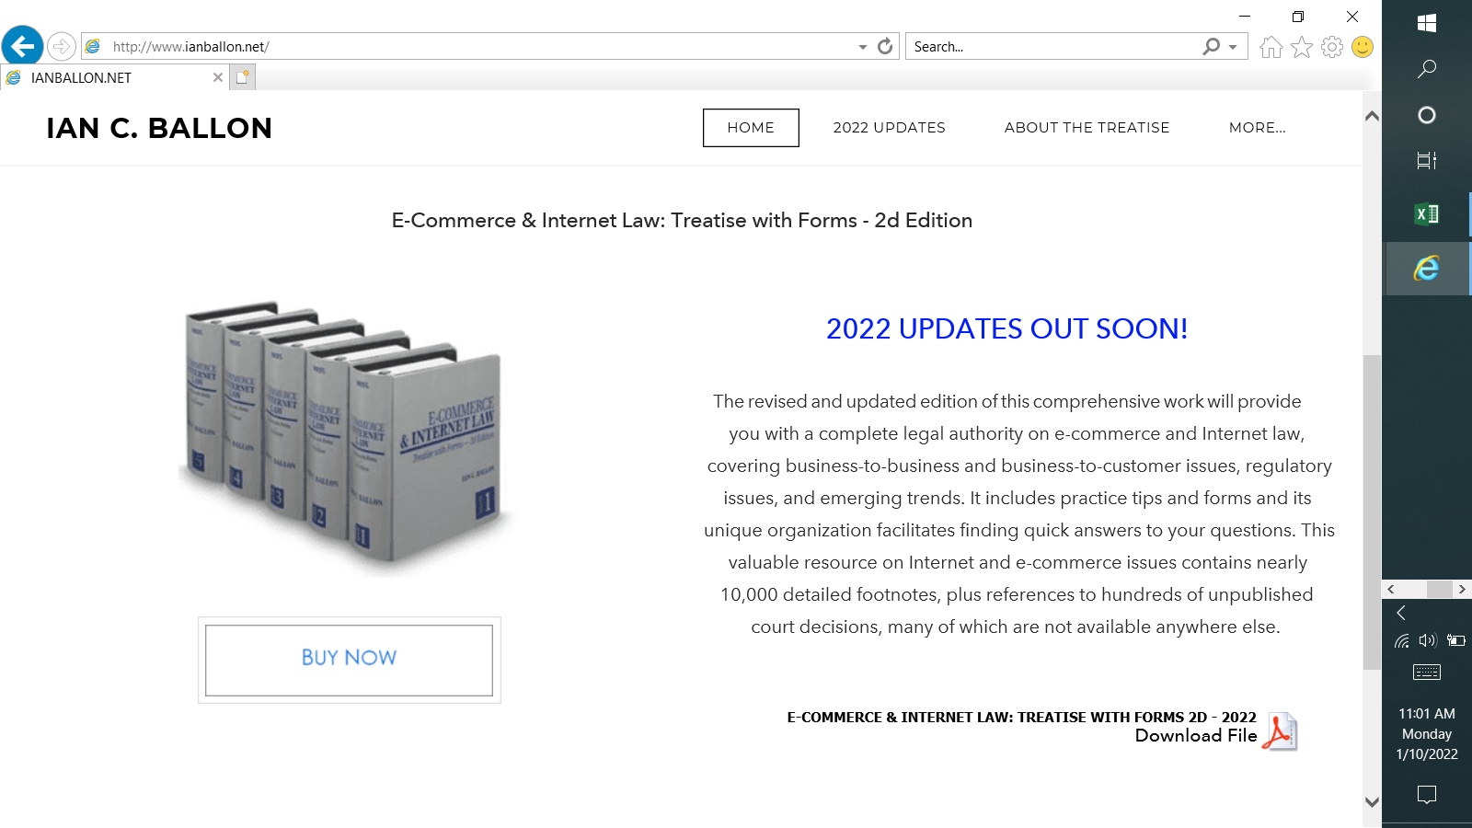

Slide 4
Year in Review and what to expect for 2023….
How the U.S. Supreme Court’s decisions in Warhol, Jack Daniels and Gonzalez will impact Snap, the tech community and innovation in 2023
Copyright Fair Use - AI art, NFT reuse, and other fair use and First Amendment issues
Data reuse and AI - the law and liability issues surrounding machine learning test sets
CPRA privacy litigation – CCPA litigation lessons; strategies to defeat CPRA class actions
State and federal data privacy and cybersecurity breach class action suits
The CDA and other moderation issues in an era of rising hostility toward tech companies
Case law and trends regarding Terms of Use enforcement and mass arbitration
State laws regulating social media companies – headed to the U.S. Supreme Court?
Expanding First Amendment rights (Lanham Act, service providers). But see state social media laws
Trade secrets – will the FTC crack down on noncompete agreements?
CASE Act took effect (“voluntary” copyright small claims tribunal) (17 U.S.C. §§ 1501 to 1511)
Unicolors, Inc. v. H&M Hennes & Mauritz, LP, 142 S. Ct. 941 (2022)
  Section 411(b)(1) Safe harbor: A registration certificate is deemed sufficient even if it contains inaccurate information unless (a) the inaccurate information was included on the application with knowledge that it was inaccurate, and (b) the inaccuracy, if known, would have caused the Registrar of Copyrights to refuse registration
  Unicolors included inaccurate information in its registration
    It filed a single application for 31 separate works in violation of the Copyright Office regulation allowing a single application to cover multiple works only if they were “included in the same unit of production”
  The Court held that because Unicolors did not know when it filed its application that it had failed to satisfy the requirement, Unicolors was entitled to the safe harbor created by section 411(b)(1)(A)
  Held: Section 411(b)(1)(A) provides a safe harbor for either mistakes of law or mistakes of fact (knowledge means “actual subjective awareness” of both the facts and the law)
Data Privacy
  New CPRA-like statutes enacted in Virginia (1/1/23), Colorado (7/1/23), Connecticut (7/1/23) and Utah (12/31/23)
    Other proposed laws not enacted. Federal preemption?
  CCPA litigation track record
  The California Privacy Protection Agency (CPPA) came into existence in 2021
  CPRA implementation and regulations

Slide 5
AI Art and copyrightability

Slide 6
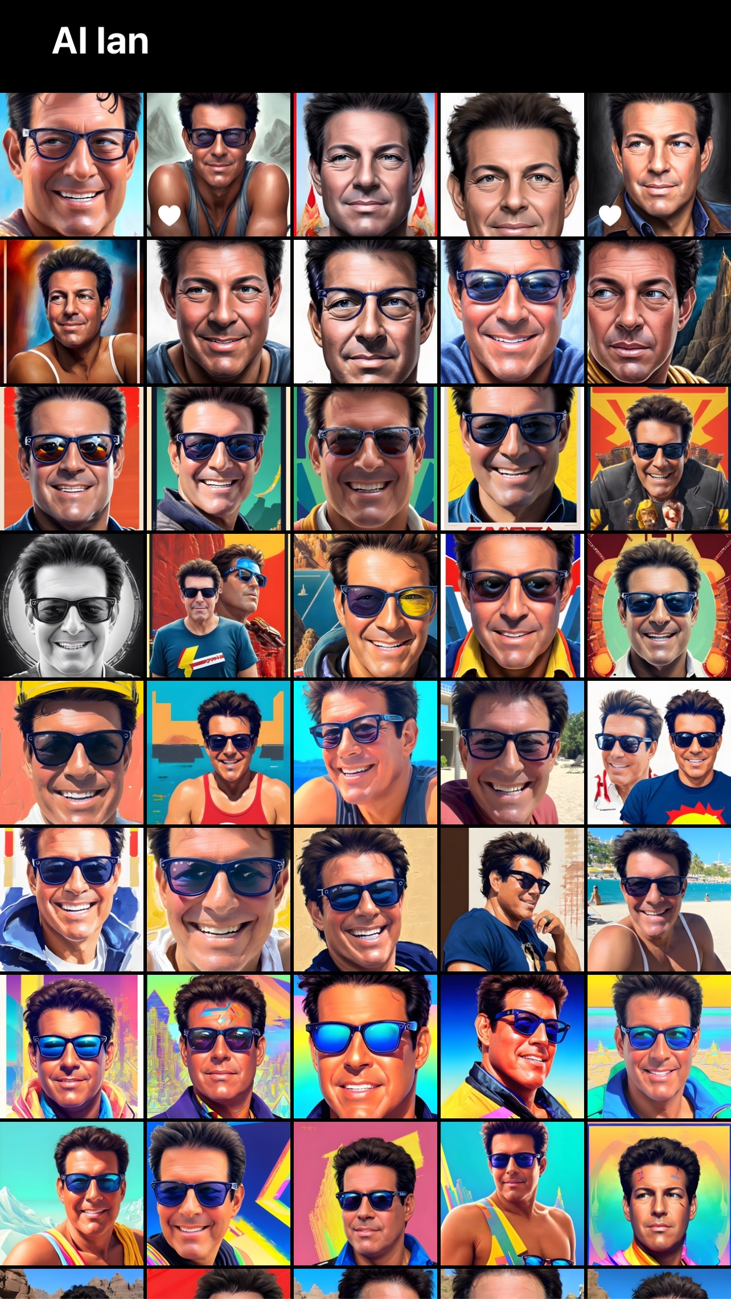

Slide 7
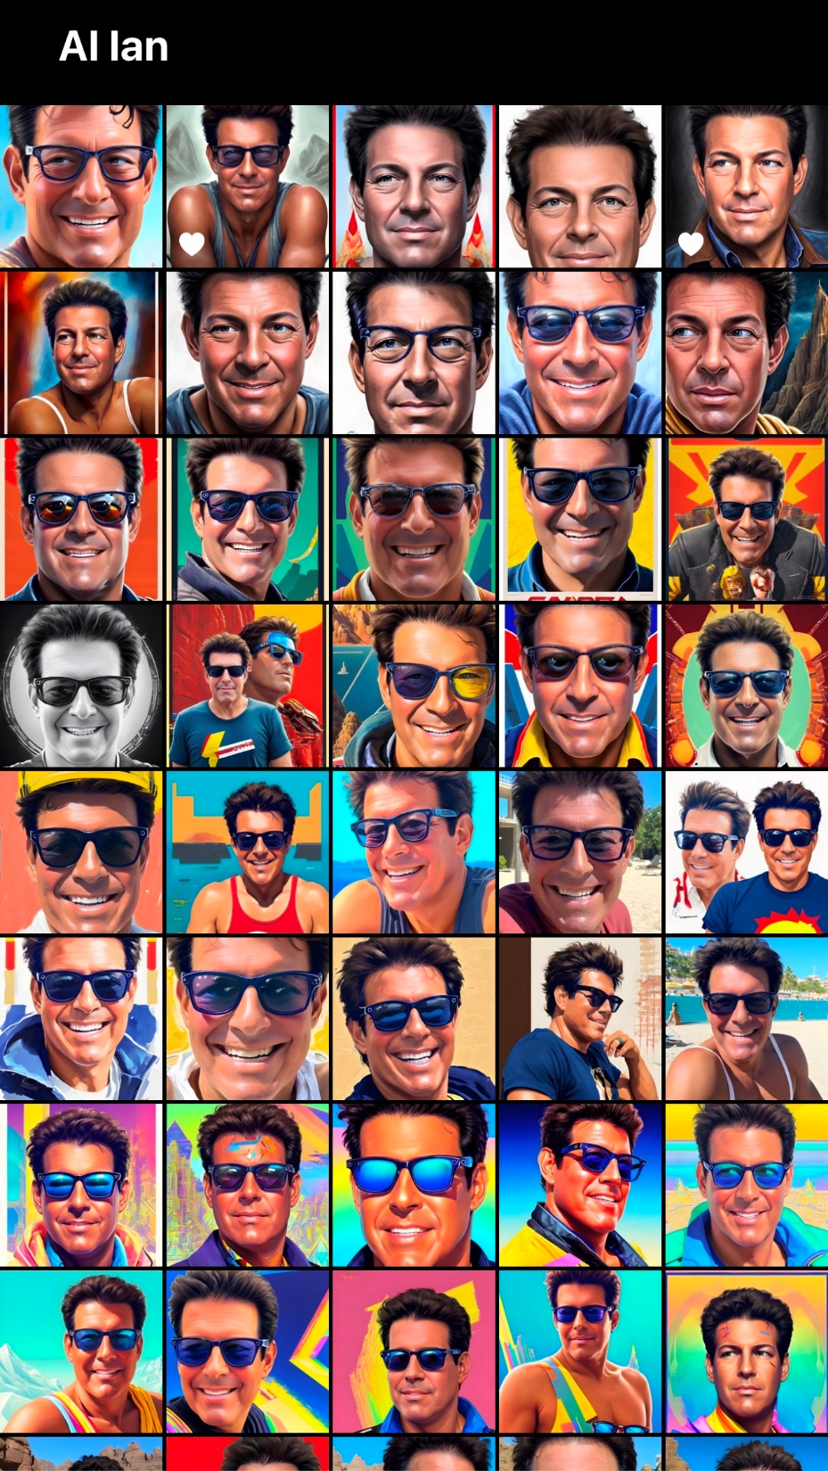

Slide 8

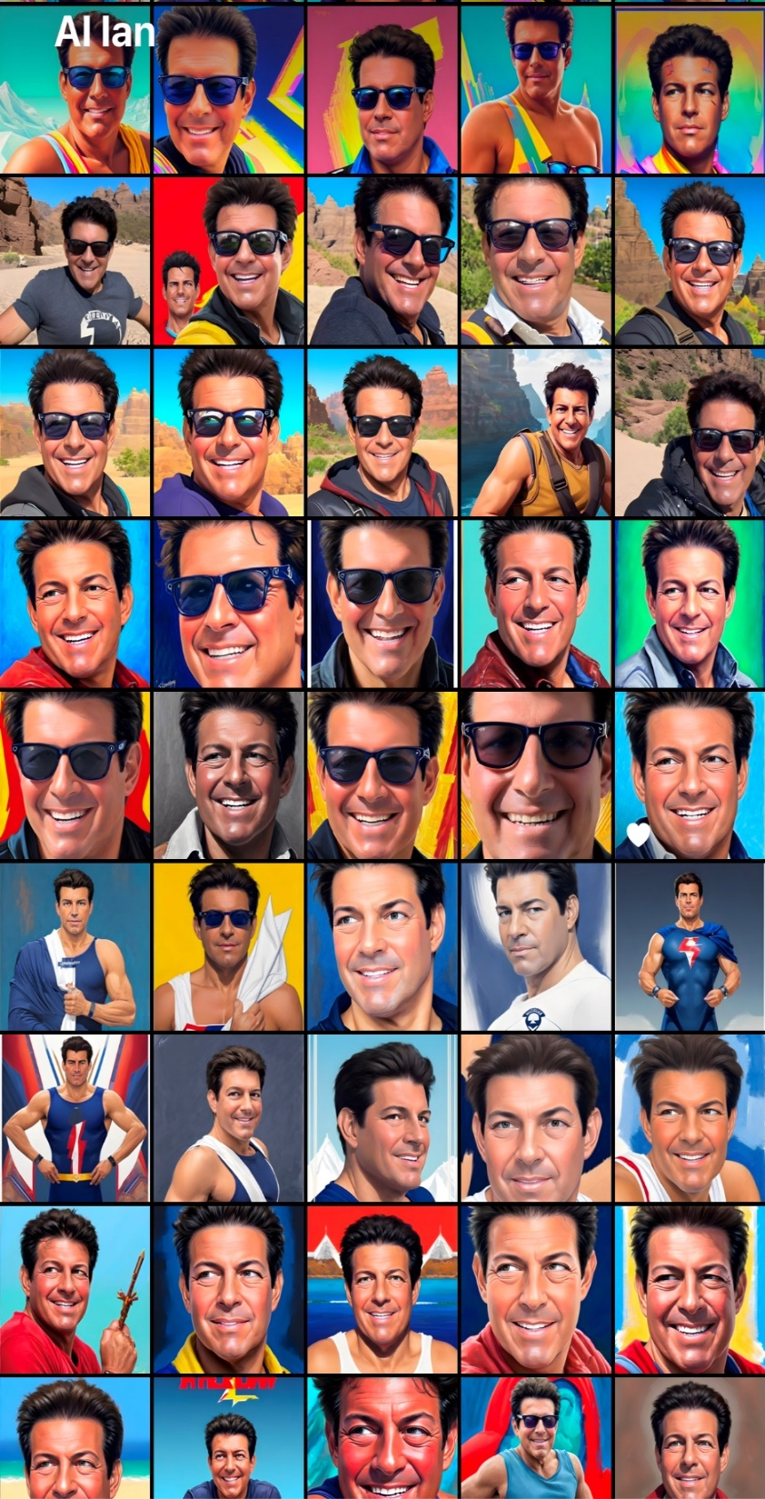
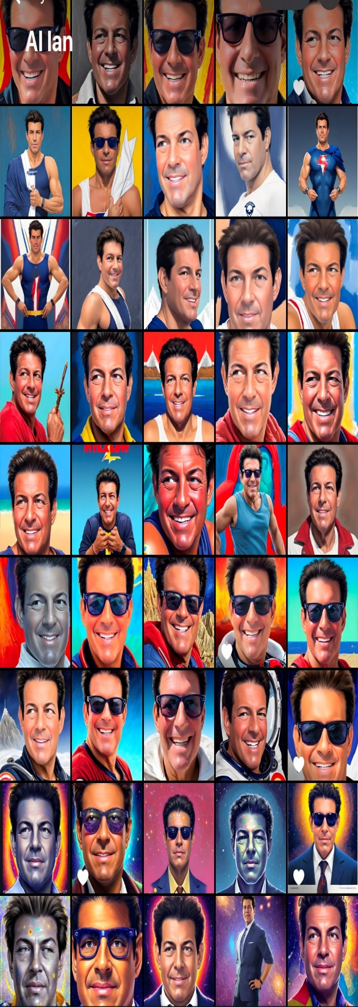

Slide 9


Slide 10


Slide 11


Slide 12
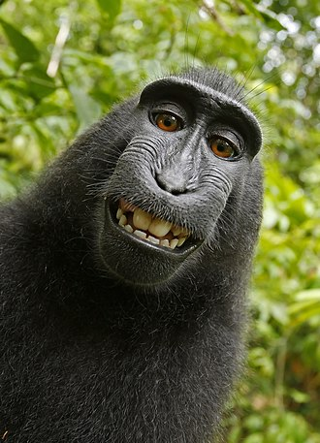
AI Art and Copyrightability
Machines can’t create works
  Naruto v. Slater, 888 F.3d 418, 426 (9th Cir. 2018)
  (holding that “animals other than humans . . . lack
  statutory standing to sue under the Copyright Act.”)
Is machine art infringing or a fair use?
  How many photos used to train the algorithm
  Does the algorithm replicate a specific artist’s style
  What if the algorithm is so good that it independently creates a work that appears to be infringing?
Will AI put independent artists out of business? AI is only as good as the test set data used to train the algorithms

Slide 13
ARTIFICIAL INTELLIGENCE, SCREEN SCRAPING AND data portability

Slide 14
AI/ Screen Scraping/ Data Portability
    Contract/TOU/PP restrictions
      Meta Platforms, Inc. v. BrandTotal Ltd., _ F. Supp. 3d _, 2022 WL 1990225 (N.D. Cal. 2022) (automated access violated TOU)
    Copyright protection
      Facts vs creative expression
        Feist Publications, Inc. v. Rural Telephone Service Co., 499 U.S. 340, 350 (1991)
      Protection for compilations if originality in the selection, arrangement or organization of a database (but thin protection)
      Data mining as a transformative fair use : Author’s Guild, Inc. v. HathiTrust, 755 F.3d 87 (2d Cir. 2014)
      VHT, Inc. v. Zillow Group, Inc., 918 F.3d 723 (9th Cir. 2019) (search function not a fair use)
    Common law claims, such as misappropriation to the extent not preempted by 17 U.S.C. § 301
      International News Service v. Associated Press, 248 U.S. 215 (1918)
      National Basketball Ass'n v. Motorola, Inc., 105 F.3d 841 (2d Cir. 1997)
    Interference with contract or prospective economic advantage
    Unfair competition
    Trespass and Conversion
      trespass to chattels may be based on unauthorized access (plus damage)
        Intel Corp. v. Hamidi, 30 Cal. 4th 1342, 1 Cal. Rptr. 3d 32 (2003)
      conversion usually requires a showing of dispossession or at least substantial interference
    Computer Fraud and Abuse Act - Federal anti-trespass computer crimes statute
      Must establish $5,000 in damages to sue
      Exceeding authorized access may not be based on use (vs access) restrictions: Van Buren v. United States, 141 S. Ct. 1648 (2021)
      hiQ Labs, Inc. v. LinkedIn Corp., 31 F.4th 1180 (9th Cir. 2022) (affirming an injunction prohibiting LinkedIn from blocking hiQ's access, copying or use of public profiles on LinkedIn's website (information which LinkedIn members had designated as public) or blocking or putting in place technical or legal mechanisms to block hiQ's access to these public profiles, in response to LinkedIn’s C&D letter)
    Anti-circumvention provisions of the DMCA, 17 U.S.C. §§ 1201 et seq.
    Removing, altering or falsifying copyright management information (CMI) - 17 U.S.C. § 1202
    California BOT Law - Cal. Bus. & Prof. Code §§ 17940 et seq. prohibits the undisclosed use of bots to communicate or interact with a person in California online, with the intent to mislead the other person about the artificial identity of the bot, to incentivize a purchase or sale of goods or services in a commercial transaction or to influence a vote in an election
    CDA defense: Callahan v. Ancestry.com, Inc., Case No. 20-cv-08437-LB, 2021 WL 783524, at *5-6 (N.D. Cal. Mar. 1, 2021) (holding Ancestry.com to be an interactive computer service provider of yearbook records, in an opinion holding it entitled to CDA immunity for California right of publicity, intrusion upon seclusion, unjust enrichment and unlawful and unfair business practices claims, arising out of defendant’s use of their yearbook photos and related information in its subscription database)
Notes:
14

Slide 15
Copyright fair use AND THE WARHOL CASE

Slide 16
Copyright Fair Use
Multipart balancing test available when a work is used “for purposes such as criticism, comment, news reporting, teaching . . . Scholarship or research”
  Courts must consider:
    The purpose and character of the use, including whether it is of a commercial nature or is for nonprofit educational purposes;
      Commercial
      Transformative
    The nature of the work (creative works are closer to the core of intended copyright protection than informational or functional works)
    The amount and substantiality of the portion used in related to the copyrighted work as a whole
    The effect of the use upon the potential market for or value of the copyrighted work
  Courts may consider other criteria
  VCR recordings
    Sony Corp. of America v. Universal City Studios, Inc., 464 U.S. 417 (1984)
  For security research: Apple Inc. v. Corellium, LLC, 510 F. Supp. 3d 1269, 1285-92 (S.D. Fla. 2020)
  Data mining/ Google books
    Author’s Guild, Inc. v. HathiTrust, 755 F.3d 87 (2d Cir. 2014)
    Author’s Guild, Inc. v. Google Inc., 804 F.3d 202 (2d Cir. 2015), cert. denied, 136 S. Ct. 1658 (2016)
  Use in connection with criticism
    Katz v. Google, Inc., 802 F.3d 1178 (11th Cir. 2015)
Google LLC v. Oracle America, Inc., 141 S. Ct. 1183 (2021) (6-2) (Breyer)
  Google’s reimplementation of 37 of 166 of Java SE application programming interfaces (APIs) in the Android mobile operating system was a fair use
  Declined to address software copyrightability but provided some guidance
Andy Warhol Foundation for the Visual Arts, Inc. v. Goldsmith, 11 F.4th 26 (2d Cir. 2021), cert. granted, 142 S. Ct. 1412 (2022)

Slide 17
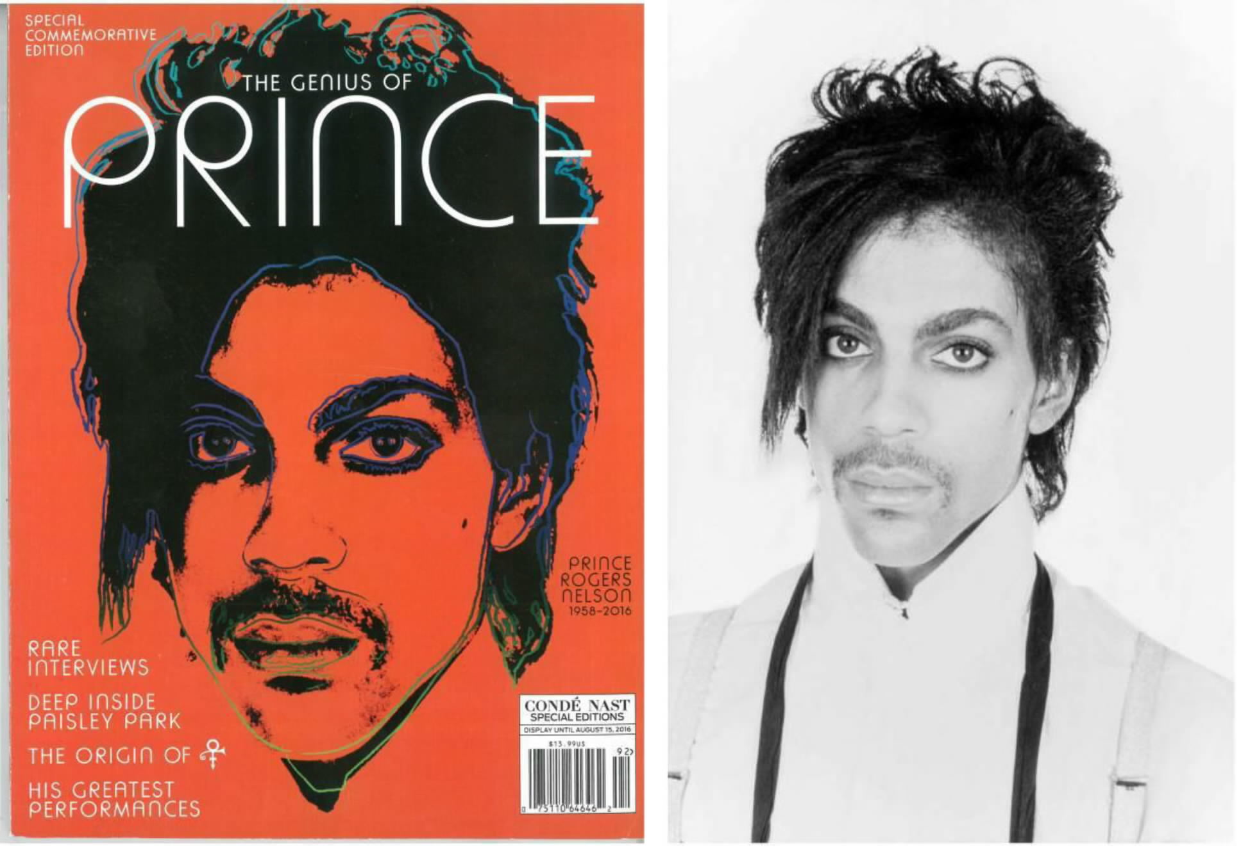
Andy Warhol Foundation for the Visual Arts, Inc. v. Goldsmith, 11 F.4th 26 (2d Cir. 2021), cert. granted, 142 S. Ct. 1412 (2022)

Slide 18

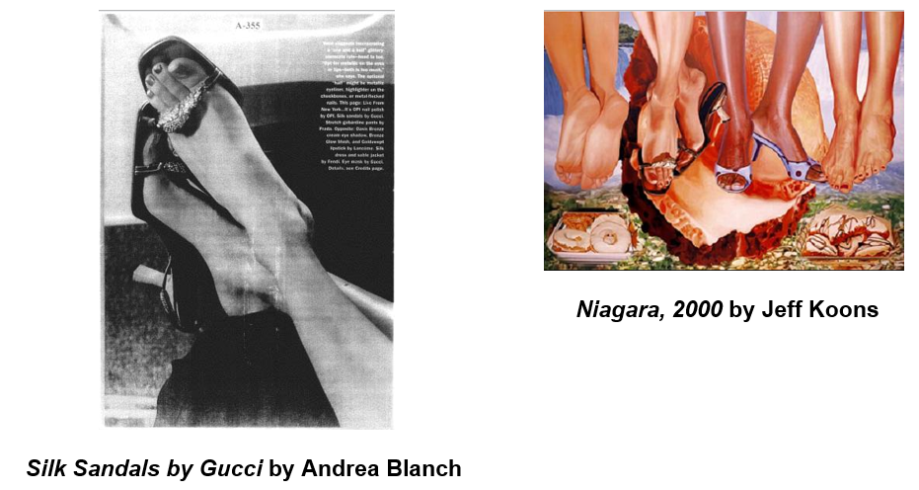
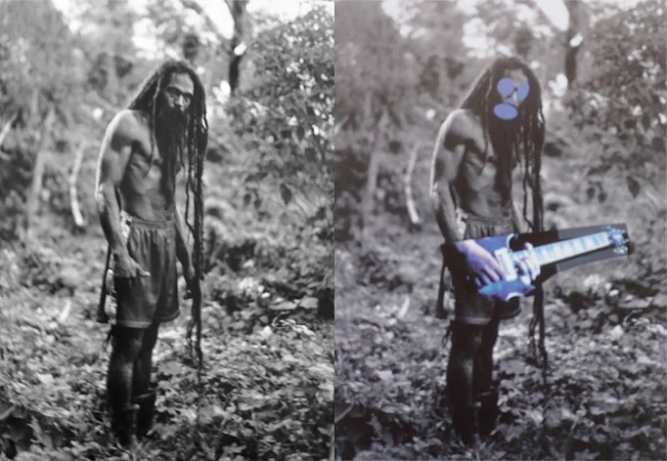
Copyright Fair Use
Rogers v. Koons, 960 F.2d 301 (2d Cir. 1992)
Blanch v. Koons, 467 F.3d 244 (2d Cir. 2006)
Cariou v. Prince, 714 F.3d 694 (2d Cir. 2013)

Slide 19
Andy Warhol Foundation for the Visual Arts, Inc. v. Goldsmith, 11 F.4th 26 (2d Cir. 2021), cert. granted, 142 S. Ct. 1412 (2022)

Slide 20
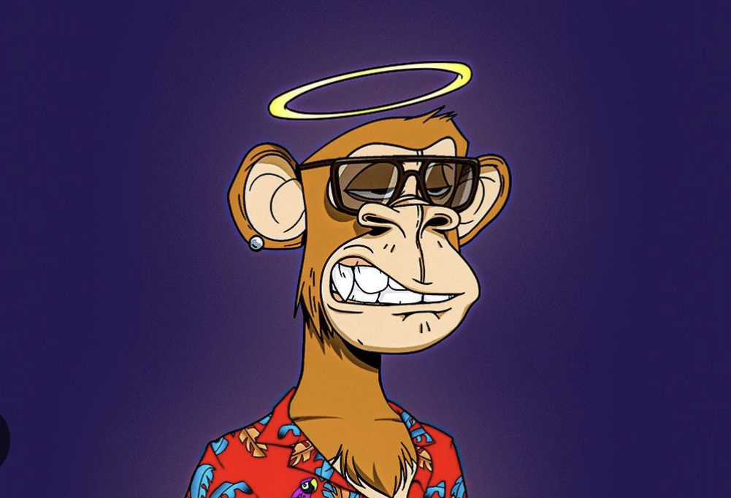
NFTs

Slide 21
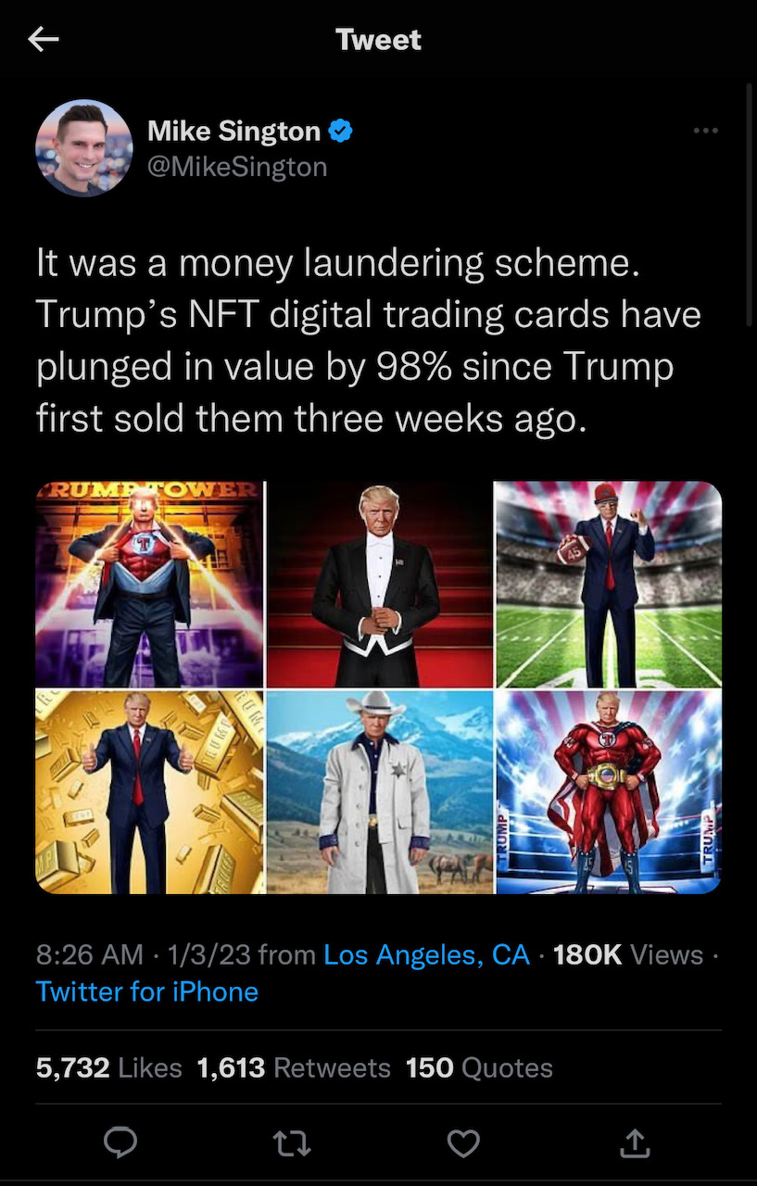

Slide 22
NFTs and copyright law
An NFT may be reproduced, distributed or publicly displayed, implicating copyright rights
If you buy an NFT you don’t necessarily acquire underlying IP rights to exploit the work (beyond being able to resell the NFT)
Miramax, LLC v. Tarantino, Case No. 2:21-cv-08979 (C.D. Cal.) (contract dispute over rights to pulp fiction; Quentin Tarantino issued NFTs containing portions of the handwritten version of the screenplay; Tarantino assigned all rights to Miramax but retained rights to the print version)
Hermes Int’l v. Rothschild, _ F. Supp. 3d _, 2022 WL 1564597 (S.D.N.Y. 2022) (denying MTD claims that defendant’s NFTs of Birkin handbags infringed plaintiff’s trademarks)
  Hermes Int’l v. Rothschild, 590 F. Supp. 3d 647 (S.D.N.Y. 2022) (denying motion for interlocutory appeal)

Slide 23
FIRST AMENDMENT LIMITATIONS ON Lanham act ENFORCEMENT AND THE JACK DANIELS CASE

Slide 24
Lanham Act Fair Use and the First Amendment
Artistic, creative and expressive uses:
  Rogers v. Grimaldi, 875 F.2d 994 (2d Cir. 1989)
  Dr. Seuss Enterprises, L.P. v. ComicMix LLC, 983 F.3d 443 (9th Cir. 2020), cert. denied, 141 S. Ct. 2803 (2021)
  VIP Productions LLC v. Jack Daniel's Properties, Inc., 953 F.3d 1170, 1174-76 (9th Cir. 2020), cert. granted, 143 S. Ct. 476 (Nov. 21, 2022)
  Twentieth Century Fox Television v. Empire Distribution, Inc., 875 F.3d 1192, 1196-1200 (9th Cir. 2017)
  Punchbowl, Inc. v. AJ Press LLC, 52 F.4th 1091 (9th Cir. 2022)
  If applicable (i.e., expressive or creative use), the test asks –
    (1) Does the junior user’s use have some artistic relevance to the mark?
    (2) Does the secondary use “explicitly mislead as to the source or the content of the work”?
    If yes/no suit will be dismissed without consideration of Sleekcraft/ Polaroid factors

Slide 25
Is the plaintiff’s mark used as part of an expressive work protected by the First Amendment?
No
Yes
Does the secondary use have some artistic relevance
No
Yes
Is the use explicitly misleading? *
Yes
No
Apply traditional trademark/dilution/unfair competition analysis
The secondary use is protected by the First Amendment
Courts consider:
The degree to which the junior user uses the mark in the same way as the senior user
The degree to which the junior has added his or her own expressive content to the work beyond the mark itself
Dr. Seuss Enterprises, L.P. v. ComicMix LLC, 983 F.3d 443, 463 (9th Cir. 2020), cert. denied, 141 S. Ct. 2803 (2021)

Slide 26

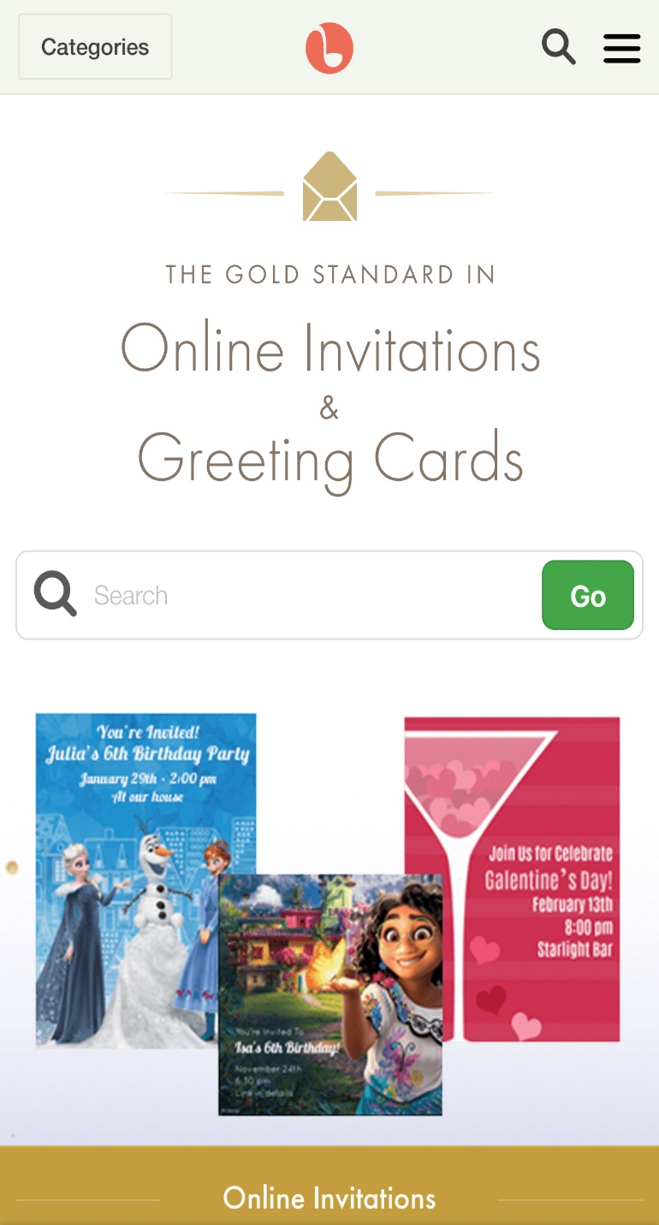
Punchbowl, Inc. v. AJ Press, 52 F.4th 1091(9th Cir. 2022)

Slide 27
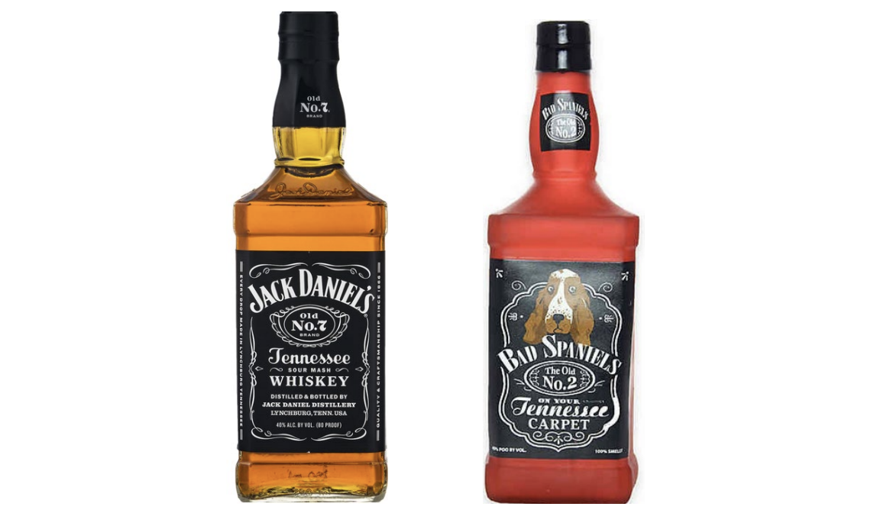
VIP Productions LLC v. Jack Daniel's Properties, Inc.

Slide 28
THE CDA: Gonzalez v. google and twitter, inc. v. taamneh

Slide 29
230 – Intellectual Property
47 U.S.C. § 230 (the Communications Decency Act) and IP claims
  230(c)(1): No provider or user of an interactive computer service shall be treated as the publisher or speaker of any information provided by another information content provider
  Preempts inconsistent state laws (including defamation, privacy) and some federal claims
  Excludes: FOSTA/SESTA; Does 1-6 v. Reddit, Inc., 51 F.4th 1137 (9th Cir. 2022) (a website’s own conduct, not that of a user, must violate child trafficking laws, for the exception to apply)
  Excludes: federal criminal claims; claims under ECPA or “any similar state law”; “any law pertaining to intellectual property.”
  What is a law “pertaining to intellectual property”?
    Perfect 10, Inc. v. Ccbill, 488 F.3d 1102 (9th Cir. 2007) (right of publicity preempted)
    Enigma Software Group, LLC v. Malwarebytes, Inc., 946 F.3d 1040 (9th Cir. 2019)
    (Lanham Act false advertising - not a law “pertaining to intellectual property”), cert. denied, 140 S. Ct. 2761 (2020)
    Hepp v. Facebook, Inc., 14 F.4th 204 (3d Cir. 2021) (right of publicity claim not preempted)
    Doe v. Friendfinder Network, Inc., 540 F. Supp. 2d 288 (D.N.H. 2008)
    Atlantic Recording Corp. v. Project Playlist, Inc., 603 F. Supp. 2d 690 (S.D.N.Y. 2009) (Chin)
    Marshall’s Locksmith Service Inc. v. Google, LLC, 925 F.3d 1263 (D.C. Cir. 2019) (affirming dismissal of the Lanham Act false advertising claims of 14 locksmith companies, where plaintiffs’ theory of liability was premised on third party content (from the scam locksmiths) and defendants merely operated neutral map location services that listed companies based on where they purported to be located)
  Defend Trade Secrets Act – not a “law pertaining to intellectual property”
  Orrin G. Hatch–Bob Goodlatte Music Modernization Act of 2018: 17 U.S.C. § 1401(a) is a “law pertaining to intellectual property” within the meaning of 47 U.S.C. § 230(e)(2)

Slide 30
230 & Related Speech Cases
Plaintiff friendly (9th and 10th Circuits and maybe the 7th Circuit):
  Fair Housing Council v. Roommate.com, LLC, 521 F.3d 1157 (9th Cir. 2008) (en banc)
  FTC v. Accusearch Inc., 570 F.3d 1187 (10th Cir. 2009)
Defendant friendly (1st, 2d, 4^{th,} 6th and D.C. Circuits):
  Doe No. 1 v. Backpage.com, LLC, 817 F.3d 12 (1st Cir. 2016)
  Nemet Chevrolet, Ltd. v. Consumeraffairs.com, Inc., 591 F.3d 250 (4th Cir. 2009) (affirming dismissal)
  Jones v. Dirty World Entertainment Recordings LLC, 755 F.3d 398 (6th Cir. 2014)
  Force v. Facebook, Inc., 934 F.3d 53 (2d Cir. 2019)
  Marshall’s Locksmith Service, Inc., 925 F.3d 1263 (D.C. Cir. 2019)
Algorithms used to amplify content or direct users to content doesn’t make an ICS provider a publisher
  In re Apple App Store, _ F. Supp. 3d _, 2-22 WL 4009918 (N.D. Cal. Sept 2, 2022)
  Prager University v. Google, 85 Cal. App. 5th 1022 (6th Dist. 2022)
Conduct as content
  Gonzalez v. Google LLC, 2 F.4th 871, 890 (9th Cir. 2021), cert. granted, 143 S. Ct. 81 (2022)
    Claims brought under Justice Against Sponsors of International Terrorism Act (JASTA) were barred by the CDA
    CDA didn’t bar claim based on sharing ad revenue, but plaintiff failed to state a claim
    Concurrences argued that courts should limit who is a publisher or Congress should take action
  Force v. Facebook, Inc., 934 F.3d 53 (2d Cir. 2019) (victims of Hamas)
  Dyroff v. Ultimate Software Group, Inc., 934 F.3d 1093 (9th Cir. 2019) (No development where the decedent used defendant’s neutral tools to discuss drug use and meet up with a dealer who sold him fentanyl laced heroin)
  Herrick v. Grindr LLC, 765 F. App’x 586 (2d Cir. 2019) (product liability – app)
  Anderson v. TikTok, Inc., _ F. Supp. 3d _, 2022 WL 14742788 (E.D. Pa. 2022) (dismissing the claims of the mother of a social media user who died participating in a strangling challenge)
  G.G. v. SalesForce.com, Inc., _ F. Supp. 3d _, 2022 WL 1541408 (N.D. Ill. 2022) (dismissing claim against provider of customer management software and support for a website that posted advertisements for sex with plaintiff, a minor)
Possible outcomes of Gonzalez and Taamneh
  CDA inapplicable
  A narrow exception
  A reinterpretation of 26 years of case law
Preventing Online Censorship, Executive Order No. 13,925 of May 28, 2020, 85 Fed. Reg. 34079 (June 2, 2020), revoked by, Revocation of Certain Presidential Actions and Technical Amendment, Executive Order 14029 of May 14, 2021, 86 Fed. Reg. 27025 (May 19, 2021)

Slide 31
Marketplaces
Amazon.com, Inc. v. McMillan, 2 F.4th 525 (5th Cir. 2021) (Amazon was not a “seller” under Texas product liability law because sellers using its marketplace don’t relinquish title to their products; relying on Amazon.com, Inc. v. McMillan, 625 S.W.3d 101, 103-04 (Tex. 2021) (holding that “potentially liable sellers are limited to those who relinquished title to the product at some point in the distribution chain.”))
State Farm Fire and Casualty Co. v. Amazon Services, Inc., 835 F. App’x 213 (9th Cir. 2020) (holding Amazon could not be held liable for damages caused by explosion of batteries, because it was not “seller” of the hoverboards which had been purchased on its site)
Erie Insurance Co. v. Amazon.com, Inc., 925 F.3d 125, 141-44 (4th Cir. 2019) (holding that, where Amazon did not obtain title to the headlamp shipped to its warehouse by Dream Light and Dream Light (the seller) set the price, designed the product description, paid Amazon for fulfillment services, and ultimately received the purchase price paid by the seller, Amazon was not a seller — one who transfers ownership of property for a price — and therefore did not have liability under Maryland law as a seller; “when Amazon sells its own goods on its website, it has the responsibility of a ‘seller,’ just as any other retailer, . . . But when it provides a website for use by other sellers of products and facilitates those sales under its fulfillment program, it is not a seller, and it does not have the liability of a seller.”)
Fox v. Amazon.com, Inc., 930 F.3d 415, 422-25 (6th Cir. 2019) (holding that Amazon was not a seller within the meaning of the Tennessee Products Liability Act – which the court defined as “any individual regularly engaged in exercising sufficient control over a product in connection with its sale, lease, or bailment, for livelihood or gain” – where Amazon.com “did not choose to offer the hoverboard for sale, did not set the price of the hoverboard, and did not make any representations about the safety or specifications of the hoverboard on its marketplace.”)
Oberdorf v. Amazon.com, Inc., 930 F.3d 136 (3d Cir. 2019), vacated, 936 F.3d 182 (3d Cir. 2019) (vacating the opinion and granting en banc review)
Loomis v. Amazon.com, LLC, 63 Cal. App. 5th 466, 277 Cal. Rptr. 3d 769 (2d Dist. 2021)
Bolger v. Amazon.com, LLC, 53 Cal. App. 5th 431 (4th Dist. 2020) (imposing strict product liability on a platform, rejecting the applicability of the CDA)
Stiner v. Amazon.com, Inc., 162 Ohio St. 3d 128, 131-35, 164 N.E.3d 394, 397-401 (Ohio 2020) (Amazon was not a “supplier” within meaning of the Products Liability Act)

Slide 32
State Laws to Restrict Social Media Speech
Florida and Texas have enacted laws to restrict speech by social media companies
State Laws to Restrict Social Media Speech and the First Amendment
  NetChoice, LLC v. Paxton, 142 S. Ct. 1715 (U.S. May 31, 2022) (staying enforcement of Texas H.B. 20) (Alito, Thomas and Gorsuch, dissenting) (“This application concerns issues of great importance that will plainly merit this Court's review. Social media platforms have transformed the way people communicate with each other and obtain news. At issue is a ground-breaking Texas law that addresses the power of dominant social media corporations to shape public discussion of the important issues of the day.”)
  NetChoice, LLC v. Paxton, 49 F.4th 439 (5th Cir. 2022)
  NetChoice LLC v. Attorney General of Florida, 34 F.4th 1196 (11th Cir. 2022) (affirming in part preliminarily injunction enjoining Fla. Stat. Ann. §§ 106.072 to 501.2041, which the district court had characterized as legislation that imposed “sweeping requirements on some but not all social-media providers”)
    platforms were likely to succeed on claim that prohibitions against deplatforming candidates, deprioritizing and “shadow-banning” content, and censoring “journalistic enterprises” violated First Amendment;
    platforms were likely to succeed on claim that requiring them to apply their standards in consistent manner, and to allow users to opt out of their algorithms, and limiting changes to their user agreements violated First Amendment;
    7 platforms failed to establish likelihood of success on claim that requiring them to publish their standards, inform users about changes, provide users with view counts, and inform candidates about free advertising violated First Amendment; and
    8 platforms were likely to succeed on claim that requirement that they provide notice and detailed justification for every content-moderation action was unduly burdensome.
  Trump v. Twitter Inc., _ F. Supp. 3d _, 2022 WL 1443233 (N.D. Cal. 2022) (dismissing civil Stop Social Media Censorship Act claim where only one plaintiff was a Florida resident with an active Twitter account, and she alleged conduct that predated SSMCA’s effective date)
  Biden v. Knight First Amendment Institute, 141 S. Ct. 1220, 1221 (2021) (Thomas, J. concurring) (“applying old doctrines to new digital platforms is rarely straightforward. Respondents have a point, for example, that some aspects of Mr. Trump's account resemble a constitutionally protected public forum. But it seems rather odd to say that something is a government forum when a private company has unrestricted authority to do away with it.” )
  The First Amendment applies to government entities, not private companies:
    Prager University v. Google LLC, 951 F.3d, 991, 999-1000 (9th Cir. 2020)
    Lewis v. Google LLC, 851 F. App’x 723 (9th Cir. 2021) (applying Prager )
California child protection law – AB 2273
  NetChoice v. Bonta

Slide 33
SECONDARY IP LIABILITY AND THE CDA

Slide 34
Secondary IP Liability
Copyright Litigation
DMCA
  Copyright Office Section 512 Report (May 2020)
CASE Act small claims resolution
  Available June 2022 or sooner
  $30,000 cap per proceeding (plus fees and costs)
  Voluntary but bound if you fail to opt-out within 60 days
Trademark Litigation
Counterfeiting –
  A counterfeit is “identical with, or substantially indistinguishable from, a registered mark”
  While all counterfeits infringe a trademark, not all trademarks are counterfeits
Direct Infringement
  Print-on-Demand: Ohio State University v. Redbubble, Inc., 989 F.3d 435 (6th Cir. 2021)
    YYGM SA v. Redbubble, Inc., 2020 WL 3984528 (C.D. Cal. 2020) (SJ for Redbubble on direct and vicarious liability claims)
    Atari Interactive, Inc. v. Redbubble, Inc., 2021 WL 706790 (N.D. Cal 2021)
Contributory and vicarious liability
Publisher’s exemption - 15 U.S.C. § 1114(2)(B)-(C)
No DMTA, but courts generally require notice and takedown
  Tiffany (NJ) Inc. v. eBay Inc., 600 F.3d 93 (2d Cir.), 562 U.S. 1082 (2010)
Patent Litigation
Blazer v. eBay, Inc., Case No. 1:15-CV-01059-KOB, 2017 WL 1047572 (N.D. Ala. 2017)
The Communications Decency Act
47 U.S.C. § 230 (the Communications Decency Act) and IP claims
  230(c)(1): No provider or user of an interactive computer service shall be treated as the publisher or speaker of any information provided by another information content provider
  Preempts inconsistent state laws (including defamation, privacy) and some federal claims
  Excludes: FOSTA/SESTA
  Excludes: federal criminal claims; claims under ECPA or “any similar state law”; “any law pertaining to intellectual property.”
    State right of publicity, trademark trade secret and other IP claims?

Slide 35
CPRA AND RELATED DATA PRIVACY, CYBERSECURITY BREACH & AdTech PUTATIVE CLASS ACTION LITIGATION

Slide 36
Cybersecurity/Data Privacy Class Action Litigation
Cybersecurity claims
  Breach of contract (if there is a contract)
  Breach of the covenant of good faith and fair dealing (if the contract claim isn’t on point)
  Breach of implied contract (if there is no express contract)
  Breach of fiduciary duty, Negligence, Fraud, unfair competition
    Tamraz v. Bakotic Pathology Associates, LLC, 2022 WL 16985001 (S.D. Cal. Nov. 16, 2022) (datasecurity not part of bargained for exchange
  State cybersecurity statutes (especially those that provide for statutory damages and attorneys’ fees)
  California (and potentially Oregon) IoT Law, CPRA
Securities fraud
  In re Alphabet, Inc. Securities Litigation, 1 F.4th 687 (9th Cir. 2021)
  In re Facebook, Inc. Securities Litigation, 477 F. Supp. 3d 980 (N.D. Cal. 2020) (dismissing plaintiffs' amended complaint for lack of causation and reliance)
Data privacy claims
  Electronic Communications Privacy Act
    Wiretap Act
    Stored Communications Act
  Computer Fraud and Abuse Act
    $5,000 minimum injury
    Van Buren v. United States, 141 S. Ct. 1648 (2021)
  Video Privacy Protection Act
  State laws
    Illinois Biometric Information Privacy Act (recently adopted in other states)
    Michigan’s Preservation of Personal Privacy Act
    California laws including the California Privacy Rights Act (CPRA)
      Other claims are preempted by the CPRA only if based on a violation of the CPRA
  Breach of contract/ privacy policies
    Bass v. Facebook, Inc., 394 F. Supp. 3d 1024, 1037-38 (N.D. Cal. 2019) (dismissing claims for breach of contract, breach of implied contract, breach of the implied covenant of good faith and fair dealing, quasi contract, and breach of confidence in a putative data security breach class action suit, where Facebook’s Terms of Service included a limitation-of-liability clause)
  Regulatory enforcement – the FTC and the California Privacy Protection Agency (CPPA)
    Coordinate litigation and regulatory enforcement (usually confidential)

Slide 37
Defense Strategies for Data Privacy & Cybersecurity litigation
Can you compel arbitration?
If there are multiple suits – is MDL consolidation possible or desirable?
  Security breach cases are often consolidated in the district where the defendant is located
  In re Dickey’s Barbecue Restaurants, Inc., Customer Data Security Breach Litigation, 521 F. Supp. 3d 1355 (J.P.M.D.L. 2021) (denying consolidation)
Motions to Dismiss
  Rule 12(b)(1) standing – circuit split - 6th, 7th, 9th, DC vs. high threshold: 2d, 4th, 8th (3d)
  Rule 12(b)(6) motion to dismiss for failure to state a claim
Summary judgment
Class Certification
Work Product and other privileges
  In re: Capital One Consumer Data Security Breach Litig., MDL No. 1:19md2915, 2020 WL 3470261 (E.D. Va. June 25, 2020) (Ordering production of the Mandiant Report)
    Applied the 4th Circuit’s “driving force” test – (1) was the report prepared when the litigation was a real likelihood (yes); (2) would it have been created anyway in the absence of litigation (yes)
    Capital One had a preexisting contractual relationship with Mandiant for similar reports and could not show that, absent the breach, the report would have been any different in addressing business critical issues (and the report was widely distributed to 50 employees, 4 different regulators and an accountant)
    Footnote 8: use different vendors, scopes of work and/or different investigation teams
  In re: Capital One Consumer Data Security Breach Litig., MDL No. 1:19md2915, 2020 WL 5016930 (E.D. Va. Aug. 21, 2020) (Price Waterhouse – not produced)
  The Ninth Circuit does not weigh motivations where documents may be used both for business purposes and litigation: In re Grand Jury Subpoena, 357 F.3d 900, 908 (9th Cir. 2004)
    Cf. In re Grand Jury Subpoena, 13 F.4th 710 (9th Cir. 2021)
Settlement

Slide 38
Cybersecurity Breach Class Action Litigation - Standing
Circuit split on Article III standing: Low threshold: 6th, 7th, 9th, DC vs. higher: 2d, 4th, 8th, 11th (3d)
TransUnion LLC v. Ramirez, 141 S. Ct. 2190 (2021)
Remijas v. Neiman Marcus Group, 794 F.3d 688 (7th Cir. 2015)
Lewert v. P.F. Chang’s China Bistro Inc., 819 F.3d 963 (7th Cir. 2016)
Galaria v. Nationwide Mut. Ins. Co., 663 F. App’x 384 (6th Cir. 2016) (2-1)
Reilly v. Ceridian Corp., 664 F.3d 38 (3d Cir. 2011), cert. denied, 566 U.S. 989 (2012)
Beck v. McDonald, 848 F.3d 262 (4th Cir. 2017)
  Allegation that data breaches created an enhanced risk of future identity theft was too speculative
    Rejected evidence that 33% of health related data breaches result in identity theft
    Rejected the argument that offering credit monitoring services evidenced a substantial risk of harm (rejecting Remijas)
  Mitigation costs in response to a speculative harm do not qualify as injury in fact
Whalen v. Michael’s Stores, Inc., 689 F. App’x. 89 (2d Cir. 2017)
  The theft of plaintiff’s credit card numbers was not sufficiently concrete or particularized to satisfy Spokeo (name, address, PIN not exposed)
  credit card was presented for unauthorized charges in Ecuador, but no allegation that fraudulent charges actually were incurred
McMorris v. Carlos Lopez & Associates, LLC, 995 F.3d 295 (2d Cir. 2020)
  Plaintiffs may establish Article III standing based on an increased risk of identity theft or fraud following the unauthorized disclosure of their data, but employee was not at substantial risk of future identity theft
Attias v. Carefirst, Inc., 865 F.3d 620 (D.C. Cir. 2017), cert. denied, 138 S. Ct. 981 (2018)
  following Remijas v. Neiman Marcus Group, LLC in holding that plaintiffs, whose information had been exposed but who were not victims of identity theft, had plausibly alleged a heightened risk of future injury because it was plausible to infer that a party accessing plaintiffs’ personal information did so with “both the intent and ability to use the data for ill.”
In re U.S. Office of Personnel Management Data Security Breach Litig., 928 F.3d 42 (D.C. Cir. 2019) (21M records)
In re SuperValu, Inc., Customer Data Security Breach Litig., 870 F.3d 763 (8th Cir. 2017)
  Affirming dismissal for lack of standing of the claims of 15 of the 16 plaintiffs but holding that the one plaintiff who alleged he suffered a fraudulent charge on his credit card had standing
  Rejected cost of mitigation (Clapper) (Cf. P.F. Chang’s)
In re Zappos.com, Inc., 888 F.3d 1020 (9th Cir. 2018), cert. denied, 139 S. Ct. 1373 (2019)
  Merely having personal information exposed in a security breach constitutes sufficient harm to justify Article III standing in federal court, regardless of whether the information in fact is used for identity theft or other improper purposes
  Bootstrapping - Because other plaintiffs alleged that their accounts or identities had been commandeered by hackers, the court concluded that the appellants in Zappos – who did not allege any such harm – could be subject to fraud or identity theft
Tsao v. Captiva MVP Restaurant Partners, LLC, 986 F.3d 1332 (11th Cir. 2021)
  No Article III standing for mitigation injuries (lost time, lost reward points, lost access to accounts) or potential future injury, where plaintiff’s credit card was exposed when a restaurant’s point of sale system was breached

Slide 39
AdTech Cases Involving Replay Software and Chat
California law
  Massie v. General Motors LLC, Civil Action No. 21-787-RGA2022 WL 534468 (D. Del. Feb. 17, 2022) (dismissing plaintiffs’ Wiretap Act and CIPA claims, arising out of GM's use of Decibel's Session Replay software on GM's websites, for lack of Article III standing)
    Massie v. General Motors LLC, 2021 WL 2142728 (E.D. Cal. May 26, 2021) (dismissing and transferring the case to the District of Delaware)
  Saleh v. Nike, Inc., _ F. Supp. 3d _, 2021 WL 4437734, at *12-14 (C.D. Cal. Sept. 27, 2021) (dismissing plaintiff’s CIPA section 635 claim, alleging use of FullStory session replay software, because “[c]ontrary to Plaintiff's argument, § 635 does not prohibit the ‘implementation’ or ‘use’ of a wiretapping device; instead, it prohibits the manufacture, assembly, sale, offer for sale, advertisement for sale, possession, transport, import, or furnishment of such device” and ruling, by analogy to ECPA, that a private cause of action may not be premised on mere possession and therefore plaintiff lacked Article III standing)
  Graham v. Noom, Inc., No. 3:20-cv-6903, 2021 WL 1312765, at *7-8 (N.D. Cal. Apr. 8, 2021) (dismissing plaintiffs’ 635(a) CIPA claim because plaintiffs could not allege eavesdropping where FullStory merely provided a cloud-based software tool and acted as “an extension of Noom[,]” and thus there could be no section 635 violation and plaintiffs lacked Article III standing)
  Yale v. Clicktale, Inc., No. 3:20-cv-7575, 2021 WL 1428400, at *3 (N.D. Cal. Apr. 15, 2021) (applying Noom to reach the same result); Johnson v. Blue Nile, Inc., No. 3:20-cv-8183, 2021 WL 1312771, at *3 (N.D. Cal. Apr. 8, 2021) (applying Noom to reach the same result)
Florida law
  Jacome v. Spirit Airlines Inc., No. 2021-000947-CA-01, 2021 WL 3087860, at *2 (Fla. Cir. June 11, 2021) (holding that sections 934.03(1)(a) and 934.03(1)(d) of the Florida Security of Communications Act’s purpose was “to address eavesdropping and illegal recordings regarding the substance of communications or personal and business records . . . and not to address the use by a website operator of analytics software to monitor visitors' interactions with that website operator's own website. . . . [T]he FSCA does not cover Plaintiff's claims seeking to penalize Spirit's use of session replay software on its Website.”)

Slide 40
Illinois Biometric Information Privacy Act
A private cause of action for "any person aggrieved by a violation" of BIPA
  Rosenbach v. Six Flags Entertainment Corp., 129 N.E.3d 1197 (Ill. 2019) (holding that a person need not have sustained actual damage beyond violation of his or her rights under the statute to be aggrieved by a violation)
  A plaintiff may recover the greater of
    (1) actual damages or
    (2) $1,000 in liquidated damages for negligent violations or $5,000 if intentional or reckless
  The statute also authorizes recovery of attorneys' fees
Patel v. Facebook, 932 F.3d 1264 (9th Cir. 2019) (affirming certification of a class of Illinois users of Facebook’s website for whom the website created and stored a face template during the relevant time period) (petition for cert. filed Dec. 4, 2019)
In re: Facebook Biometric Information Privacy Litigation, No. 21-15553, 2022 WL 822923 (9th Cir. Mar. 17, 2022) (affirming a $650 Million settlement, approved after the district court had earlier rejected a $550 Million settlement, over objections to the $97.5 Million attorneys fee award)
Johnson v. Mitek Systems, Inc., 55 F.4th 1122 (7th Cir. 2022) (declining to compel arbitration where HyreCar, an intermediary between people who own vehicles and other people who would like to drive for services such as Uber and GrubHub, provided personal information to Mitek for background verification where plaintiff’s contract with HyreCar required arbitration “with a long list of entities” including “all authorized or unauthorized users or beneficiaries of services or goods provided under the Agreement.”)
Standing arguments
2022: 90 opinions referencing BIPA. Approved class settlements ranged from $250,000 to $100 Million (Rivera v. Google). First jury trial resulted in a $228 Million verdict (Rogers v. BNSF Ry. Co.).

Slide 41
LITIGATION UNDER THE California Privacy Rights and Enforcement Act of 2020 (CPRA)

Slide 42
CPRA Putative Class Action Litigation
The private right of action narrowly applies only to security breaches and the failure to implement reasonable measures, not other CPRA provisions
  Regulatory enforcement of the rest of the Act is by the California Privacy Protection Agency (CPPA).
  Sephora (August 2022) ($1.2 M penalty, 2 years of compliance monitoring)
But plaintiffs may recover statutory damages of between $100 and $750
The CPRA creates a private right of action for [1] consumers [2] “whose nonencrypted or nonredacted [3] personal information [within the meaning of Cal. Civ. Code §§ 1798.150(a)(1) and 1798.81.5] . . . [4] is subject to an unauthorized access and exfiltration, theft, or disclosure [5] as a result of the business’s [6] violation of the duty to implement and maintain reasonable security procedures and practices . . . .”
What is reasonable will be defined by case law
$100 - $750 “per consumer per incident or actual damages, whichever is greater, injunctive or declaratory relief, and any other relief that a court deems proper.”
30 day notice and right to cure as a precondition to seeking statutory damages (modeled on the Consumer Legal Remedies Act)
  If cured, a business must provide “an express written statement” (which could later be actionable)
  Notice and an opportunity to cure only applies for private litigation, not regulatory enforcement by the California Privacy Protection Agency (CPPA)
In assessing the amount of statutory damages, the court shall consider “any one or more of the relevant circumstances presented by any of the parties to the case, including, but not limited to, the nature and seriousness of the misconduct, the number of violations, the persistence of the misconduct, the length of time over which the misconduct occurred, the willfulness of the defendant’s misconduct, and the defendant’s assets, liabilities, and net worth”
CPRA claims typically are joined with other cybersecurity breach or data privacy claims in civil litigation

Slide 43
Defense Strategies for CPRA & Other Cybersecurity litigation
Many “CPRA claims” aren’t actually actionable under the CPRA
The CPRA creates a private right of action for
  [1] consumers
  [2] “whose nonencrypted or nonredacted
  [3] personal information [within the meaning of Cal. Civ. Code §§ 1798.150(a)(1) and 1798.81.5] . . .
  [4] is subject to an unauthorized access and exfiltration, theft, or disclosure
  [5] as a result of the business’s
  [6] violation of the duty to implement and maintain reasonable security procedures and practices . . . .”
Cal. Civ. Code § 1798.150(c) (“Nothing in this title shall be interpreted to serve as the basis for a private right of action under any other law.”)
Should you respond to a CPRA 30 day cure notice and if so how?
Court opinions
  Rahman v. Marriott International, Inc., Case No. SA CV 20-00654-DOC-KES, 2021 WL 346421 (C.D. Cal. Jan. 12, 2021) (dismissing CCPA, breach of contract, breach of implied contract, unjust enrichment and unfair competition claims, for lack of Article III standing, in a suit arising out of Russian employees accessing putative class members’ names, addresses, and other publicly available information, because the sensitivity of personal information, combined with its theft, are prerequisites to finding that a plaintiff adequately alleged injury in fact)
  Gardiner v. Walmart Inc., Case No. 20-cv-04618-JSW, 2021 WL 2520103, at *2-3 (N.D. Cal. Mar. 5, 2021) (dismissing plaintiff’s CCPA claim for failing to allege that the breach occurred after January 1, 2020, when the CCPA took effect, and failing to adequately allege the disclosure of personal information as defined by the statute)
  Gershfeld v. Teamviewer US, Inc., 2021 WL 3046775 (C.D. Cal. June 24, 2021) (dismissing claim)
  Silver v. Stripe Inc., 2021 WL 3191752 (N.D. Cal. July 28, 2021) (no UCL claim based on CCPA)
  In re Blackbaud, Inc., Customer Data Breach Litig., 2021 WL 3568394, at *4-6 (D.S.C. Aug. 12, 2021) (denying motion to dismiss where plaintiff adequately alleged d a business)
  Atkinson v. Minted, Inc., 2021 WL 6028374 (N.D. Cal. Dec. 17, 2021)
  Kostka v. Dickey’s Barbecue Restaurants, Inc., 2022 WL 16821685 (N.D. Tex. Oct. 14, 2022)

Slide 44
How will litigation change under the CPRA?
CPRA litigation commenced 1/1/23; regulatory enforcement begins 7/1/23
The litigation remedies are largely the same except:
  New thresholds for CPRA applicability for a business (and covers sharing)
  Expanded to cover anyone whose email address in combination with a password or security question and answer that would permit access to the account was subject to an unauthorized access and exfiltration, theft, or disclosure
  The CPRA will apply to businesses engaged in consumer credit collection and reporting
  New caveat on what constitutes a cure
  Online contract formation
  Representative action nonwaiver
New threshold: The CPRA applies to businesses with (1) annual gross revenue > $25 M; (2) that buy, sell or receive for commercial purposes personal information of (50,000) 100,00 or more consumers, households or devices, and (3) businesses that derive 50% or more of their annual revenue from selling (buying or sharing) consumers’ personal information (excludes entities subject to federal regulation)
New Civil Code § 1798.150 - implementation and maintenance of reasonable security procedures and practices does not amount to a cure (in response to a 30 day letter)
New Civil Code § 1798.140(h) - Consent does not include "acceptance of a general or broad terms of use" that describes "personal information processing along with other, unrelated
information . . . .“
New Civil Code § 1798.192 – prohibits and renders void “a representative action waiver”

Slide 45
MITIGATING RISK

Slide 46
Litigation - Risk Mitigation
    Businesses that seek to limit their liability to consumers may be able to do so to the extent an end user must sign on to a website or access an App to operate a device, at which point the user may be required to assent to Terms of Use, including potentially a binding arbitration agreement
    Where there is no privity of contract, a business cannot directly limit its potential exposure to consumers, but it may --
      seek indemnification from others
      contractually require that a business partner make it an intended beneficiary of an end user agreement (including an arbitration agreement), or
      obtain insurance coverage
    If there is no enforceable contract, a business may be unable to avoid class action litigation in the event of a security breach, system failure, or alleged privacy violation, through binding arbitration, except in narrow circumstances where equitable estoppel may apply
    The best way to mitigate the risk of class action litigation is to have an enforceable arbitration agreement (or be an intended beneficiary of a party that does) --
      You must have an enforceable online or mobile contract (or be an intended beneficiary of one)
      You must have an enforceable arbitration provision (or be an intended beneficiary of one)
      You should review your contract formation and arbitration provisions (or those of your business partners) every 6-12 months

Slide 47
ONLINE AND MOBILE CONTRACT FORMATION

Slide 48
Online and Mobile Contract Formation
Trend: Continued hostility to implied contracts
  Roley v. Google LLC, 40 F.4th 903 (9th Cir. 2022) (ad that contributing to Google Maps could “unlock cool benefits like . . . 1TB of Google Drive storage” not a contract offer)
  Berman v. Freedom Financial Network, LLC, 30 F.4th 849 (9th Cir. 2022)
    Sifuentes v. Dropbox, Inc., 2021 WL 2673080 (N.D. Cal. June 29, 2022)
  Emmanuel v. Handy Technologies, Inc., 992 F.3d 1 (1st Cir. 2021) (enforcing ToS and arbitration provision under Mass law where plaintiff selected ‘Accept’ in a mobile app)
  Nguyen v. Barnes & Noble Inc., 763 F.3d 1171, 1175-79 (9th Cir. 2014)
    declining to enforce an arbitration clause
    “where a website makes its terms of use available via a conspicuous hyperlink on every page of the website but otherwise provides no notice to users nor prompts them to take any affirmative action to demonstrate assent, even close proximity of the hyperlink to relevant buttons users must click on—without more—is insufficient to give rise to constructive notice”
    Wilson v. Huuuge, Inc., 944 F.3d 1212 (9th Cir. 2019) (declining to enforce arbitration clause in mobile ToS)
  Dohrmann v. Intuit, Inc., 823 F. App’x 482 (9th Cir. 2020)
    Reversing the denial of a motion to compel arbitration
    Holding the arbitration provision in Intuit’s Terms of Use enforceable where a user, to access a TurboTax account, was required, after entering a user ID and password, to click a “Sign In” button, directly above the following language: “By clicking Sign In, you agree to the Turbo Terms of Use, TurboTax Terms of Use, and have read and acknowledged our Privacy Statement,” where each of those documents was highlighted in blue hyperlinks which, if clicked, directed the user to a new webpage containing the agreement
  Nicosia v. Amazon.com, Inc., 834 F.3d 220 (2d Cir. 2016)
    Reversing the lower court's order dismissing plaintiff's complaint, holding that whether the plaintiff was on inquiry notice of contract terms, including an arbitration clause, presented a question of fact where the user was not required to specifically manifest assent to the additional terms by clicking "I agree" and where the hyperlink to contract terms was not "conspicuous in light of the whole webpage."
  Meyer v. Uber Technologies, Inc., 868 F.3d 66 (2d Cir. 2017)
    (1) Uber’s presentation of its Terms of Service provided reasonably conspicuous notice as a matter of California law and (2) consumers’ manifestation of assent was unambiguous
    “when considering the perspective of a reasonable smartphone user, we need not presume that the user has never before encountered an app or entered into a contract using a smartphone. Moreover, a reasonably prudent smartphone user knows that text that is highlighted in blue and underlined is hyperlinked to another webpage where additional information will be found.”
    “[T]here are infinite ways to design a website or smartphone application, and not all interfaces fit neatly into the clickwrap or browsewrap categories.”
  Cullinane v. Uber Technologies, Inc., 893 F.3d 53 (1st Cir. 2018)
    Displaying a notice of deemed acquiescence and a link to the terms is insufficient to provide reasonable notice to consumers
    Ways to make future amendments enforceable

Slide 49
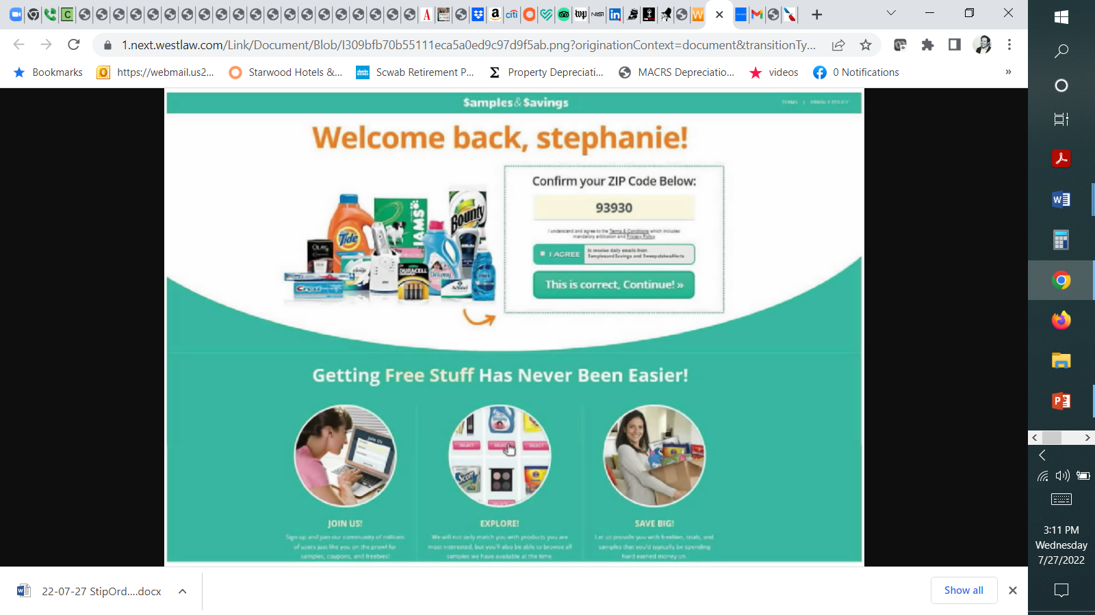

Slide 50
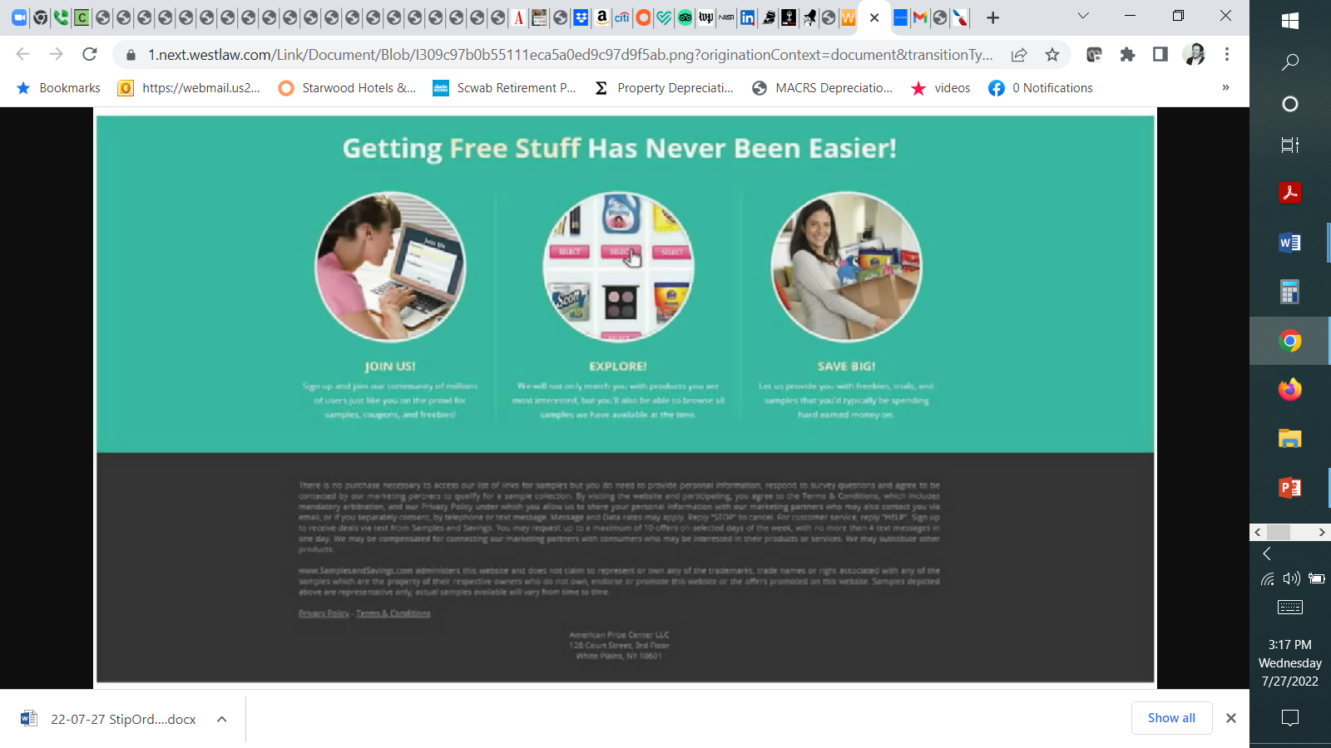

Slide 51
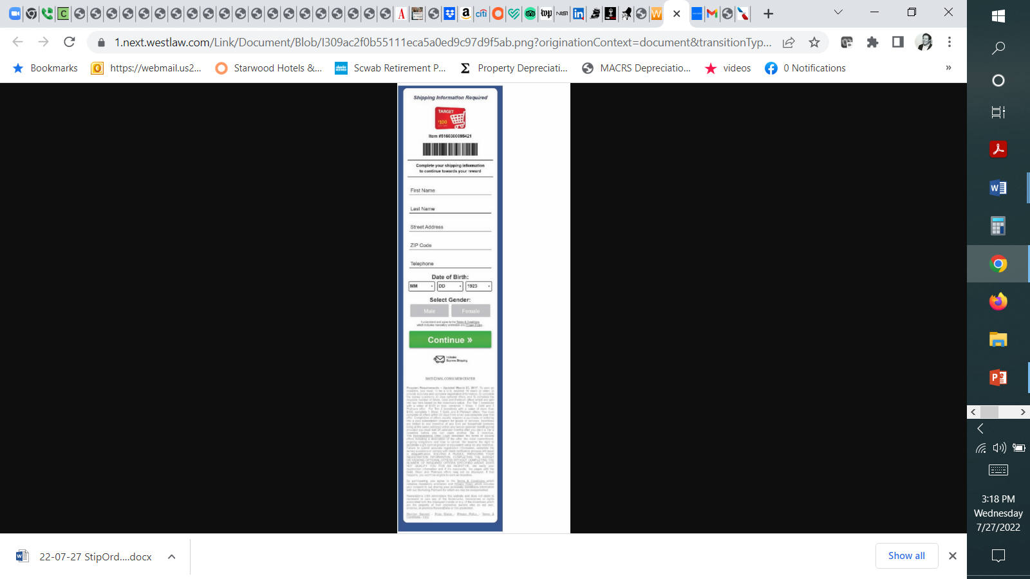

Slide 52
Online and Mobile Contract Formation
Trend: Continued hostility to implied contracts
  Roley v. Google LLC, 40 F.4th 903 (9th Cir. 2022) (ad that contributing to Google Maps could “unlock cool benefits like . . . 1TB of Google Drive storage” not a contract offer)
  Berman v. Freedom Financial Network, LLC, 30 F.4th 849 (9th Cir. 2022)
    Sifuentes v. Dropbox, Inc., 2021 WL 2673080 (N.D. Cal. June 29, 2022)
  Emmanuel v. Handy Technologies, Inc., 992 F.3d 1 (1st Cir. 2021) (enforcing ToS and arbitration provision under Mass law where plaintiff selected ‘Accept’ in a mobile app)
  Nguyen v. Barnes & Noble Inc., 763 F.3d 1171, 1175-79 (9th Cir. 2014)
    declining to enforce an arbitration clause
    “where a website makes its terms of use available via a conspicuous hyperlink on every page of the website but otherwise provides no notice to users nor prompts them to take any affirmative action to demonstrate assent, even close proximity of the hyperlink to relevant buttons users must click on—without more—is insufficient to give rise to constructive notice”
    Wilson v. Huuuge, Inc., 944 F.3d 1212 (9th Cir. 2019) (declining to enforce arbitration clause in mobile ToS)
  Dohrmann v. Intuit, Inc., 823 F. App’x 482 (9th Cir. 2020)
    Reversing the denial of a motion to compel arbitration
    Holding the arbitration provision in Intuit’s Terms of Use enforceable where a user, to access a TurboTax account, was required, after entering a user ID and password, to click a “Sign In” button, directly above the following language: “By clicking Sign In, you agree to the Turbo Terms of Use, TurboTax Terms of Use, and have read and acknowledged our Privacy Statement,” where each of those documents was highlighted in blue hyperlinks which, if clicked, directed the user to a new webpage containing the agreement
  Nicosia v. Amazon.com, Inc., 834 F.3d 220 (2d Cir. 2016)
    Reversing the lower court's order dismissing plaintiff's complaint, holding that whether the plaintiff was on inquiry notice of contract terms, including an arbitration clause, presented a question of fact where the user was not required to specifically manifest assent to the additional terms by clicking "I agree" and where the hyperlink to contract terms was not "conspicuous in light of the whole webpage."
  Meyer v. Uber Technologies, Inc., 868 F.3d 66 (2d Cir. 2017)
    (1) Uber’s presentation of its Terms of Service provided reasonably conspicuous notice as a matter of California law and (2) consumers’ manifestation of assent was unambiguous
    “when considering the perspective of a reasonable smartphone user, we need not presume that the user has never before encountered an app or entered into a contract using a smartphone. Moreover, a reasonably prudent smartphone user knows that text that is highlighted in blue and underlined is hyperlinked to another webpage where additional information will be found.”
    “[T]here are infinite ways to design a website or smartphone application, and not all interfaces fit neatly into the clickwrap or browsewrap categories.”
  Cullinane v. Uber Technologies, Inc., 893 F.3d 53 (1st Cir. 2018)
    Displaying a notice of deemed acquiescence and a link to the terms is insufficient to provide reasonable notice to consumers
    Ways to make future amendments enforceable

Slide 53
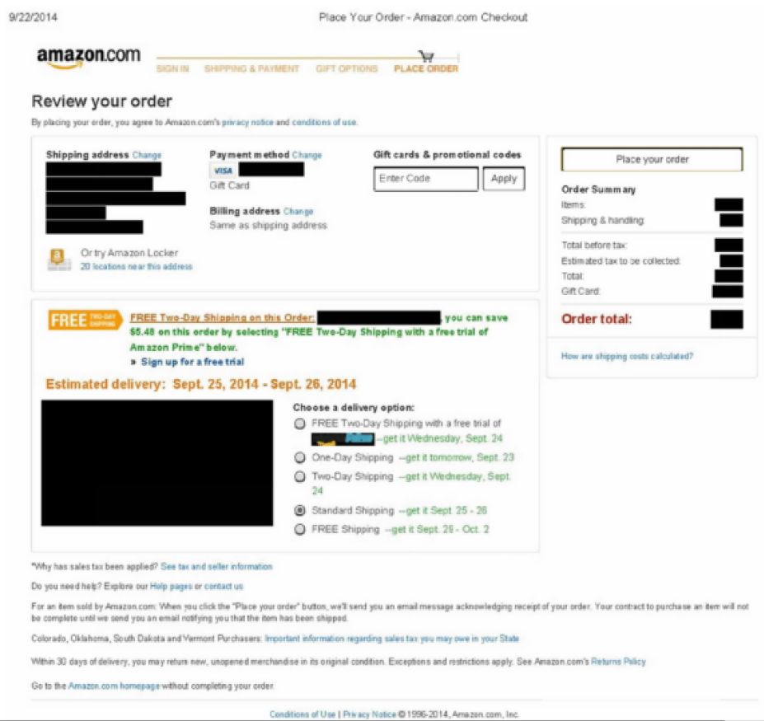

Slide 54
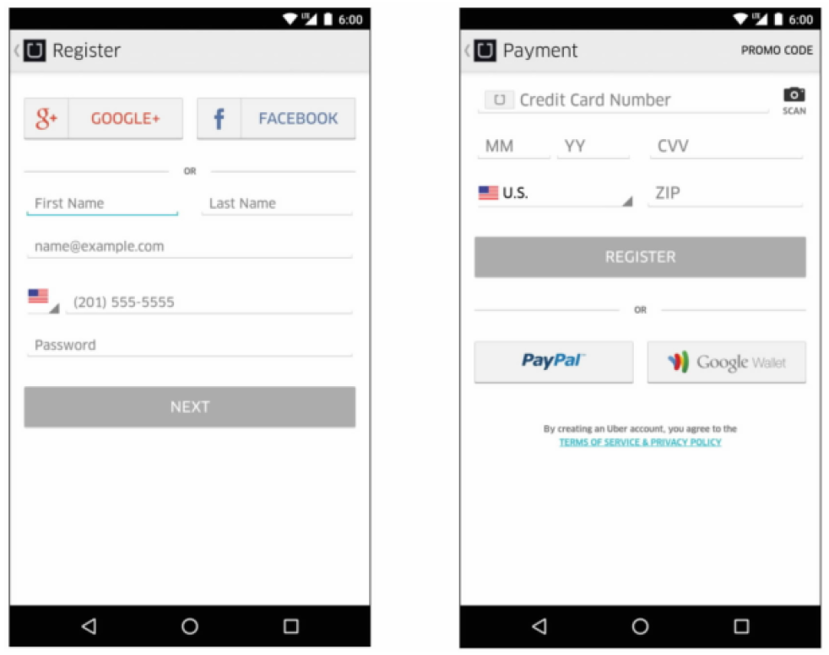

Slide 55
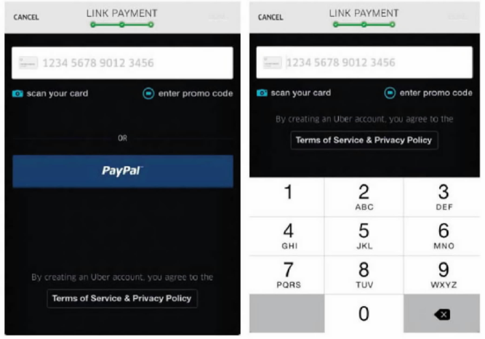

Slide 56
Online and Mobile Contract Formation
Trend: Continued hostility to implied contracts
  Roley v. Google LLC, 40 F.4th 903 (9th Cir. 2022) (ad that contributing to Google Maps could “unlock cool benefits like . . . 1TB of Google Drive storage” not a contract offer)
  Berman v. Freedom Financial Network, LLC, 30 F.4th 849 (9th Cir. 2022)
    Sifuentes v. Dropbox, Inc., 2021 WL 2673080 (N.D. Cal. June 29, 2022)
  Emmanuel v. Handy Technologies, Inc., 992 F.3d 1 (1st Cir. 2021) (enforcing ToS and arbitration provision under Mass law where plaintiff selected ‘Accept’ in a mobile app)
  Nguyen v. Barnes & Noble Inc., 763 F.3d 1171, 1175-79 (9th Cir. 2014)
    declining to enforce an arbitration clause
    “where a website makes its terms of use available via a conspicuous hyperlink on every page of the website but otherwise provides no notice to users nor prompts them to take any affirmative action to demonstrate assent, even close proximity of the hyperlink to relevant buttons users must click on—without more—is insufficient to give rise to constructive notice”
    Wilson v. Huuuge, Inc., 944 F.3d 1212 (9th Cir. 2019) (declining to enforce arbitration clause in mobile ToS)
  Dohrmann v. Intuit, Inc., 823 F. App’x 482 (9th Cir. 2020)
    Reversing the denial of a motion to compel arbitration
    Holding the arbitration provision in Intuit’s Terms of Use enforceable where a user, to access a TurboTax account, was required, after entering a user ID and password, to click a “Sign In” button, directly above the following language: “By clicking Sign In, you agree to the Turbo Terms of Use, TurboTax Terms of Use, and have read and acknowledged our Privacy Statement,” where each of those documents was highlighted in blue hyperlinks which, if clicked, directed the user to a new webpage containing the agreement
  Nicosia v. Amazon.com, Inc., 834 F.3d 220 (2d Cir. 2016)
    Reversing the lower court's order dismissing plaintiff's complaint, holding that whether the plaintiff was on inquiry notice of contract terms, including an arbitration clause, presented a question of fact where the user was not required to specifically manifest assent to the additional terms by clicking "I agree" and where the hyperlink to contract terms was not "conspicuous in light of the whole webpage."
  Meyer v. Uber Technologies, Inc., 868 F.3d 66 (2d Cir. 2017)
    (1) Uber’s presentation of its Terms of Service provided reasonably conspicuous notice as a matter of California law and (2) consumers’ manifestation of assent was unambiguous
    “when considering the perspective of a reasonable smartphone user, we need not presume that the user has never before encountered an app or entered into a contract using a smartphone. Moreover, a reasonably prudent smartphone user knows that text that is highlighted in blue and underlined is hyperlinked to another webpage where additional information will be found.”
    “[T]here are infinite ways to design a website or smartphone application, and not all interfaces fit neatly into the clickwrap or browsewrap categories.”
  Cullinane v. Uber Technologies, Inc., 893 F.3d 53 (1st Cir. 2018)
    Displaying a notice of deemed acquiescence and a link to the terms is insufficient to provide reasonable notice to consumers
    Ways to make future amendments enforceable

Slide 57
Arbitration & Mass Arbitration
Arbitration and Class Action Waivers
  AT&T Mobility LLC v. Concepcion, 131 S. Ct. 1740 (2011)
  Henry Schein, Inc. v. Archer & White Sales, Inc., 139 S. Ct. 524 (2019)
  American Express Co. v. Italian Colors Restaurant, 133 S. Ct. 2304 (2013)
  Tompkins v. 23andMe.com. Inc., 840 F.3d 1016 (9th Cir. 2016)
    Abrogating or limiting earlier Ninth Circuit cases that applied pre-Concepcion California unconscionability case law, which had treated arbitration clauses differently from other contracts
    Venue selection, bilateral attorneys’ fee and IP carve out provisions not unconscionable
    Enforcing delegation clause
Mass Arbitration
  Adams v. Postmates, Inc., 823 F. App’x 535 (9th Cir. 2020) (affirming the district court’s holding that the issue of whether mass arbitration claims violated the class action waiver provision of Postmates’ arbitration agreement was an issue that had been delegated to the arbitrator);
  Postmates Inc. v. 10,356 Individuals, CV 20-2783 PSG, 2020 WL 1908302 (C.D. Cal. 2020) (denying injunctive relief)
  MacClelland v. Cellco Partnership, _ F. Supp. 3d _, 2022 WL 2390997 (N.D. Cal. July 1, 2022) (holding unconscionable a mass arbitration clause that provided that if 25 or more customers initiated dispute notices raising similar claims or brought by the same or coordinated counsel the claims would be arbitrated in tranches of 5 bellwether cases at a time, which the court concluded could take 156 years to resolve all claims at issue given the average time of 7 months to resolution of AAA claims)
Public Injunctions (Include? Exclude? Delegation)
  Capriole v. Uber Technologies, Inc., 7 F.4th 854 (9th Cir. 2021) (holding that injunctive relief seeking reclassification of plaintiff Uber drivers’ status from “independent contractors” to “employees” was not public injunctive relief)
  DiCarlo v. MoneyLion, Inc., 988 F.3d 1148, 1152-58 (9th Cir. 2021)
  McGill v. Citibank, N.A., 2 Cal. 5th 945, 216 Cal. Rptr. 3d 627, 393 P.3d 85 (2017)
  CPRA amendment
Drafting Tips
  Rent-A-Center, West, Inc. v. Jackson, 130 S. Ct. 2772 (2010)
    Challenge to the enforceability of an agreement (arbitrable) vs. challenge to the agreement to arbitrate
    Clause: arbitrator, not a court, must resolve disputes over interpretation, applicability, enforceability or formation, including any claim that the agreement or any part of it is void or voidable
  Rahimi v. Nintendo of America, Inc., 936 F. Supp. 2d 1141 (N.D. Cal. 2013)
  Mondigo v. Epson America, Inc., 2020 WL 8839981 (C.D. Cal. Oct. 13, 2020)
  Henry Schein, Inc. v. Archer & White Sales, Inc., 139 S. Ct. 524 (2019)
  Lamps Plus, Inc. v. Varela, 139 S. Ct. 1407 (2019) (holding that ambiguity in an arbitration agreement does not provide sufficient grounds for compelling classwide arbitration)
  AAA – registration requirement
  Address “mass arbitration” – JAMS vs AAA vs. FedArb
  Review and update frequently

Slide 58
BALLON’S ANNUAL BRIEFING: INTERNET AND MOBILE LAW AND LITIGATION TRENDS – JANUARY 2023
Ian Ballon, JD, LLM, CIPP/US
Co-Chair, Global IP & Technology Practice Group
Greenberg Traurig LLP
(310) 586-6575 (650) 289-7881 (202) 331-3138
Ballon@GTLaw.com
Facebook, Twitter, LinkedIn: Ian Ballon
www.IanBallon.net

