Slide 1
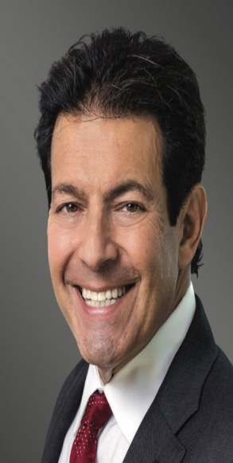
BALLON’S 2024 ANNUAL ACC BRIEFING: INTERNET, AI and privacy law year in review
Ian Ballon, JD, LLM, CIPP/US
Co-Chair, Global IP & Technology Practice Group
Greenberg Traurig LLP
(650) 289-7881 (310) 586-6575 (202) 331-3138
Ballon@GTLaw.com
Facebook, Threads, LinkedIn, Bluesky: Ian Ballon
www.IanBallon.net

Slide 2
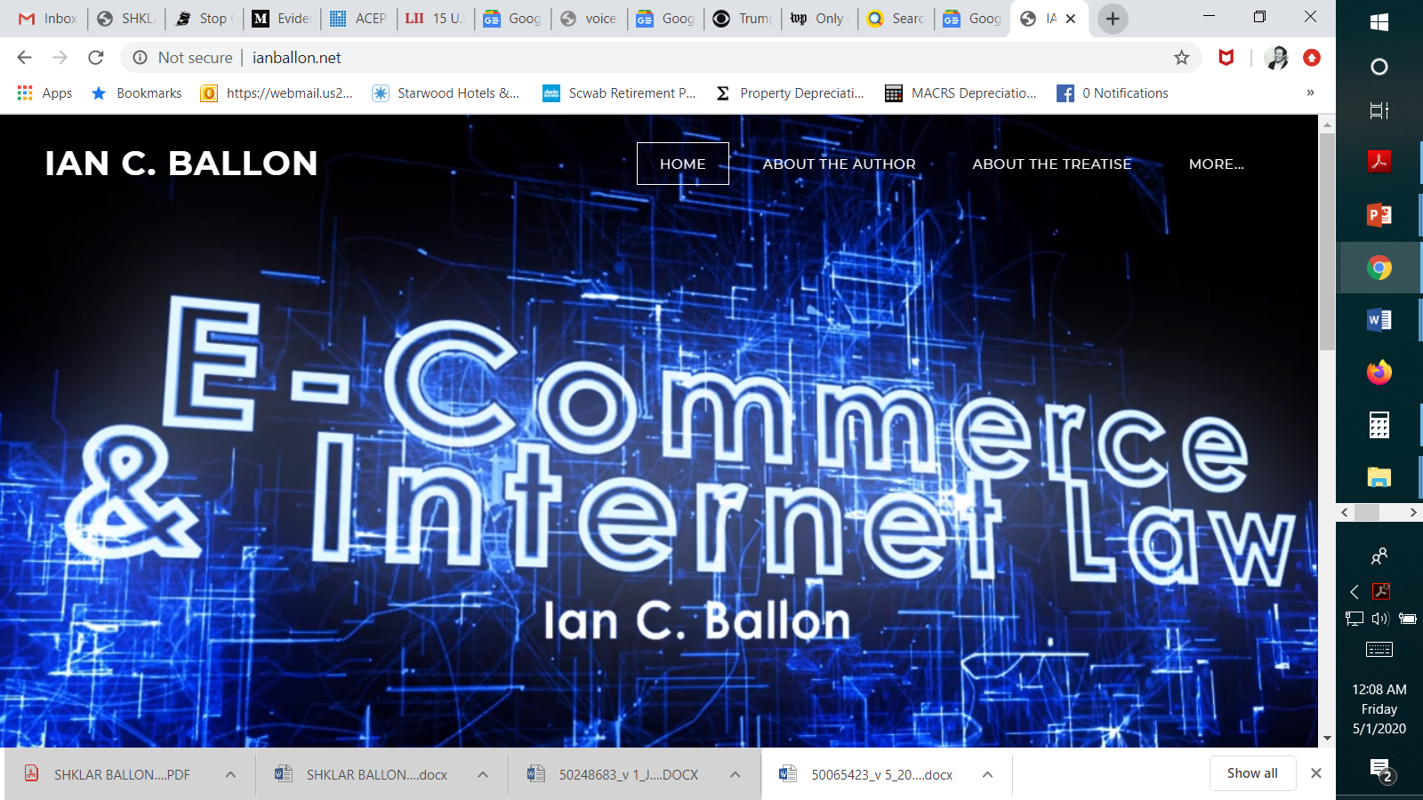

Slide 3
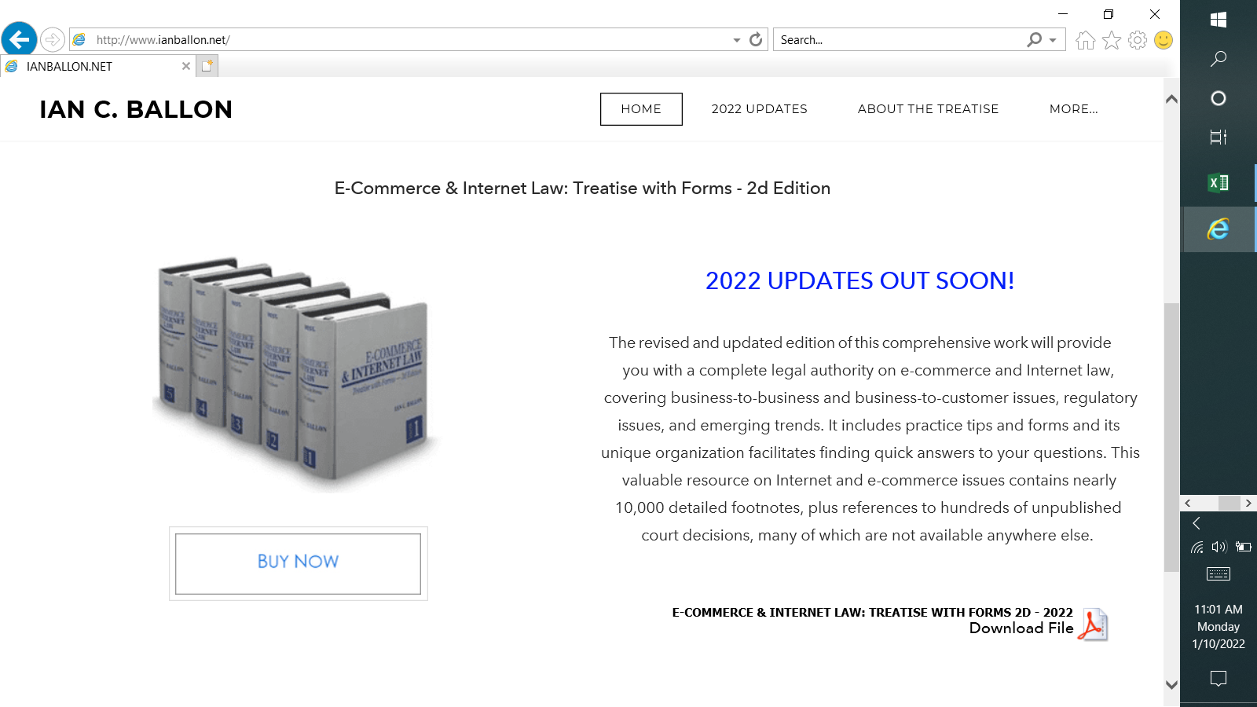

Slide 4
Year in review

Slide 5
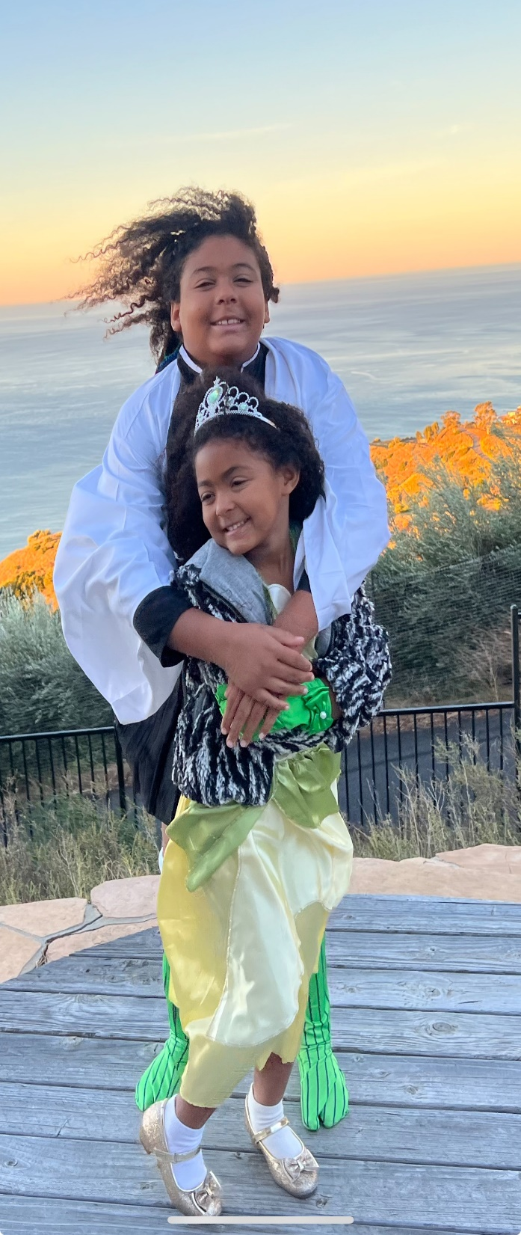
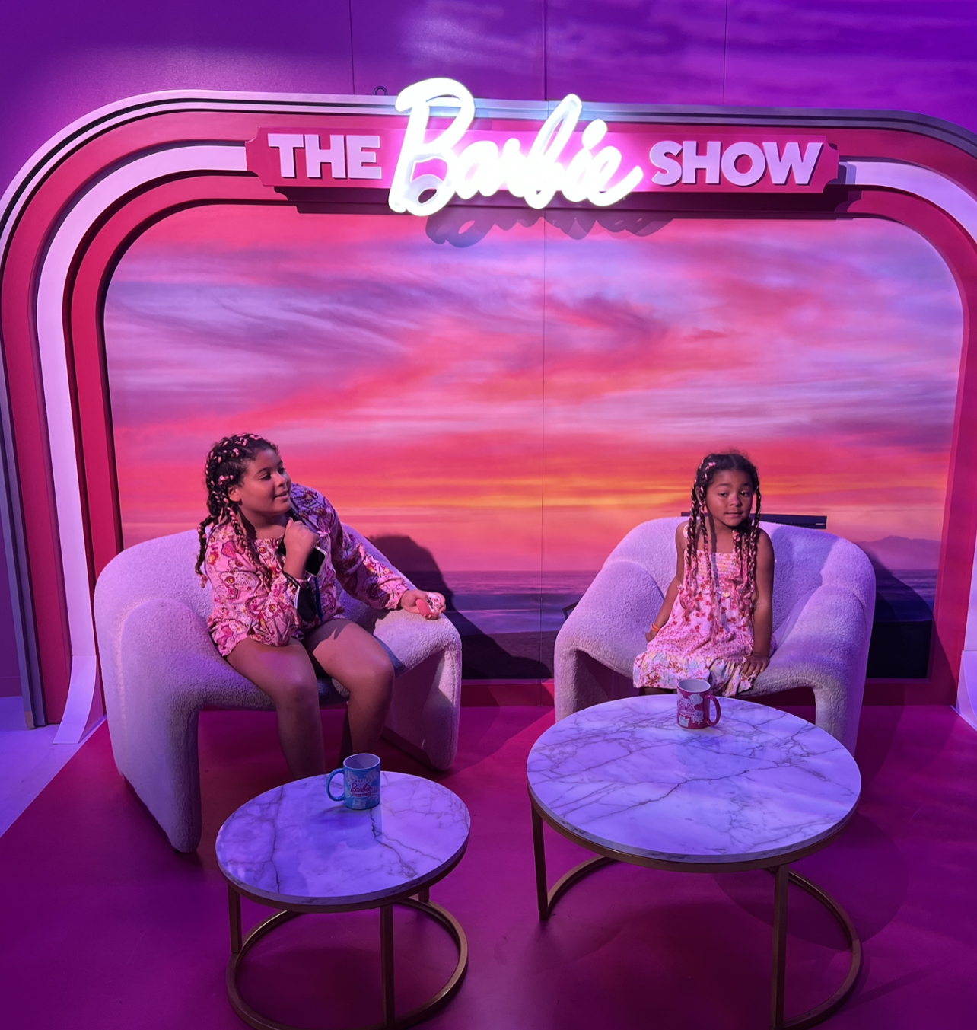

Slide 6
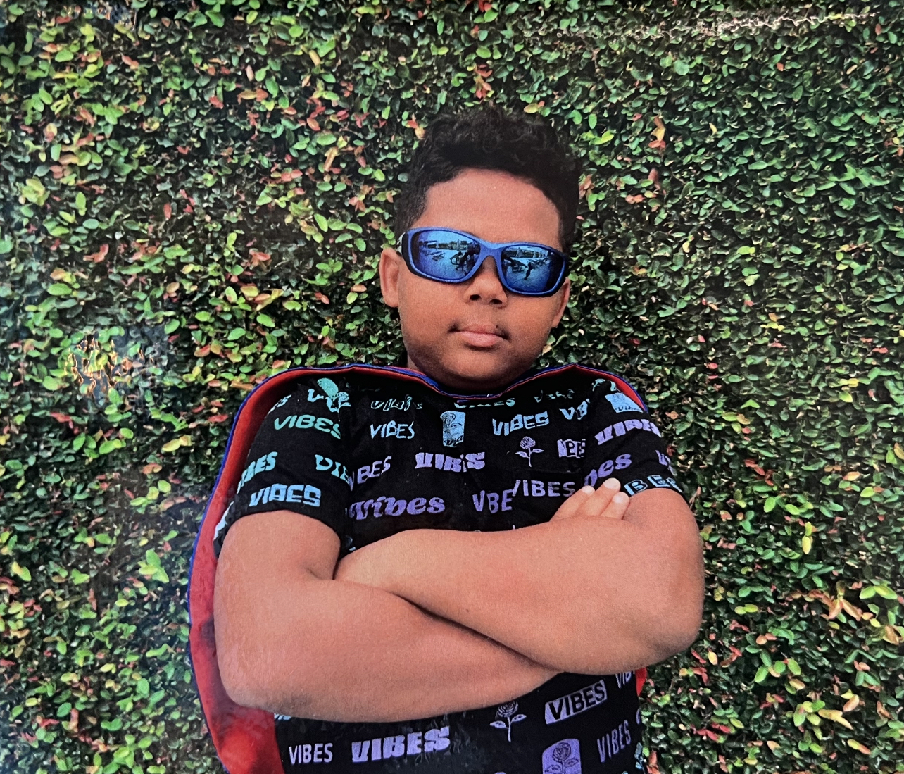
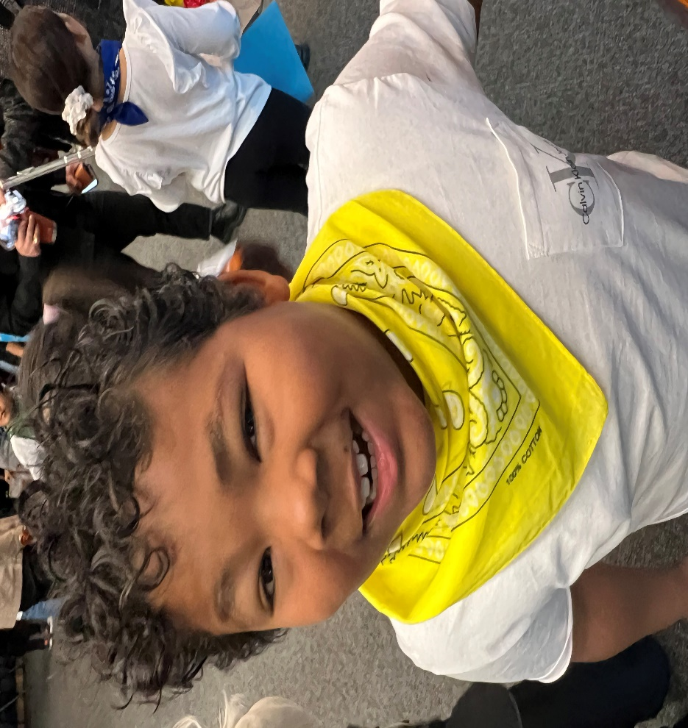

Slide 7
Year in Review and what to expect for 2024….
Making Sense of the U.S. Supreme Court’s 2023 decisions in Warhol, Jack Daniels and Gonzalez and cases pending in 2024
What’s clear and what’s up for debate about generative AI law in 2024
The CPRA and other privacy, Adtech and security breach class action litigation - trends, court opinions, and compliance lessons for transactional lawyers
The First Amendment, service providers and children - law, lawsuits and coming US Supreme Court cases
Wire tap scams, mass arbitration and what your TOS, ToU or EULAs should provide for in 2024
Data reuse and AI - the law and liability issues surrounding machine learning test sets
New trademark, copyright, CDA and other court opinions
Moderation issues in an era of sustained hostility toward tech companies
The latest case law, trends and litigation and transactional strategies involving Internet and mobile Terms of Use, mass arbitration, privacy, IP law and AI
Abitron Austria GmbH v. Hetronic International, Inc., 600 U.S. 412 (2023) (the Lanham Act sections prohibiting the unauthorized use in commerce of a protected trademark when that use is likely to cause confusion do not apply extraterritorially)
SAS Institute, Inc. v. World Programming Ltd., 64 F.4th 1319 (Fed. Cir. 2023) (p bears the burden of proof in the filtration stage in establishing protectable elements in a copyright suit)
Cases to watch
  Vidal v. Elster, 143 S. Ct. 2579 (2023), granting cert., 26 F.4th 1328 (Fed. Cir. 2022) (holding that that the Lanham Act provision prohibiting registration of a trademark that consisted of or comprised the name of particular living individual without written consent violated the First Amendment as applied to Elster’s application to register “TRUMP TOO SMALL” for use on T-shirts)

Slide 8
GENERATIVE ai law: what is clear and what is up for debate

Slide 9
Generative AI: What’s clear and what’s up for debate
IP protection for the output of generative AI
Liability for inputs: using content and data sets to train algorithms for ML/AI/Generative AI
  Your own content or data
  Content or data freely available for use
  Content or data licensed for training
  Third party content or data that may be accessible but not freely available
    The owner may claim proprietary rights (under IP or other laws)
    Third party data may be incomplete (due to privacy opt-out laws))
Privacy laws, including state laws governing automated decision making (and opt out, access and notice rights)
Ethical Issues
Using AI in your legal practice
  Mata v. Avianca, Inc., _ F. Supp. 3d _, 2-23 WL 4114965 (S.D.N.Y. 2023)
Potential regulation in the U.S. and E.U.
  Compare: Japan
AI is only as good as the test set data used to train the algorithms

Slide 10
USING THIRD PARTY CONTENT AND DATA FOR TRAINING ALGORITHMS AND GENERATIVE ai

Slide 11
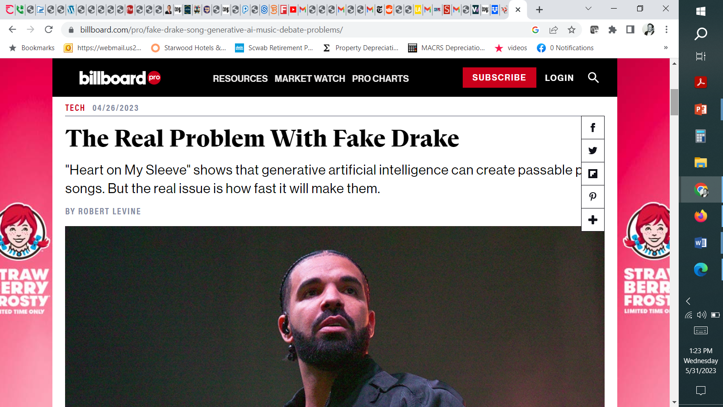

Slide 12
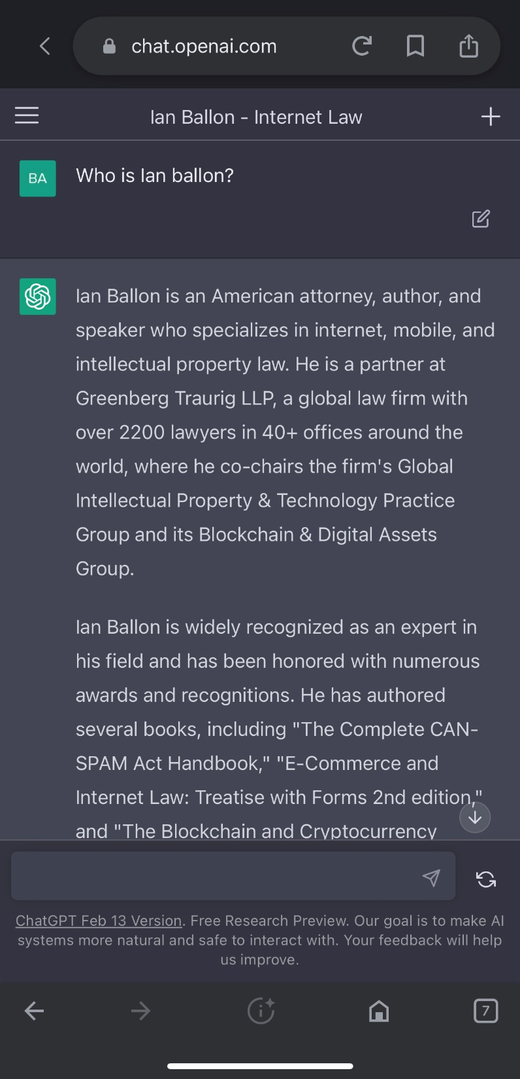

Slide 13
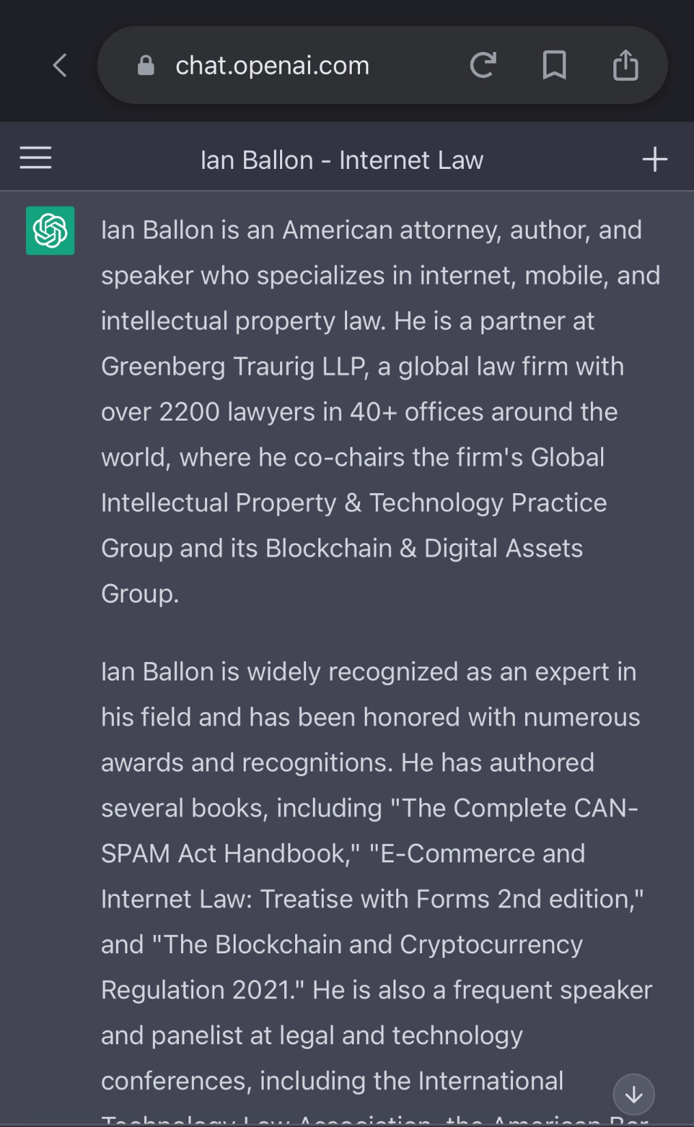

Slide 14
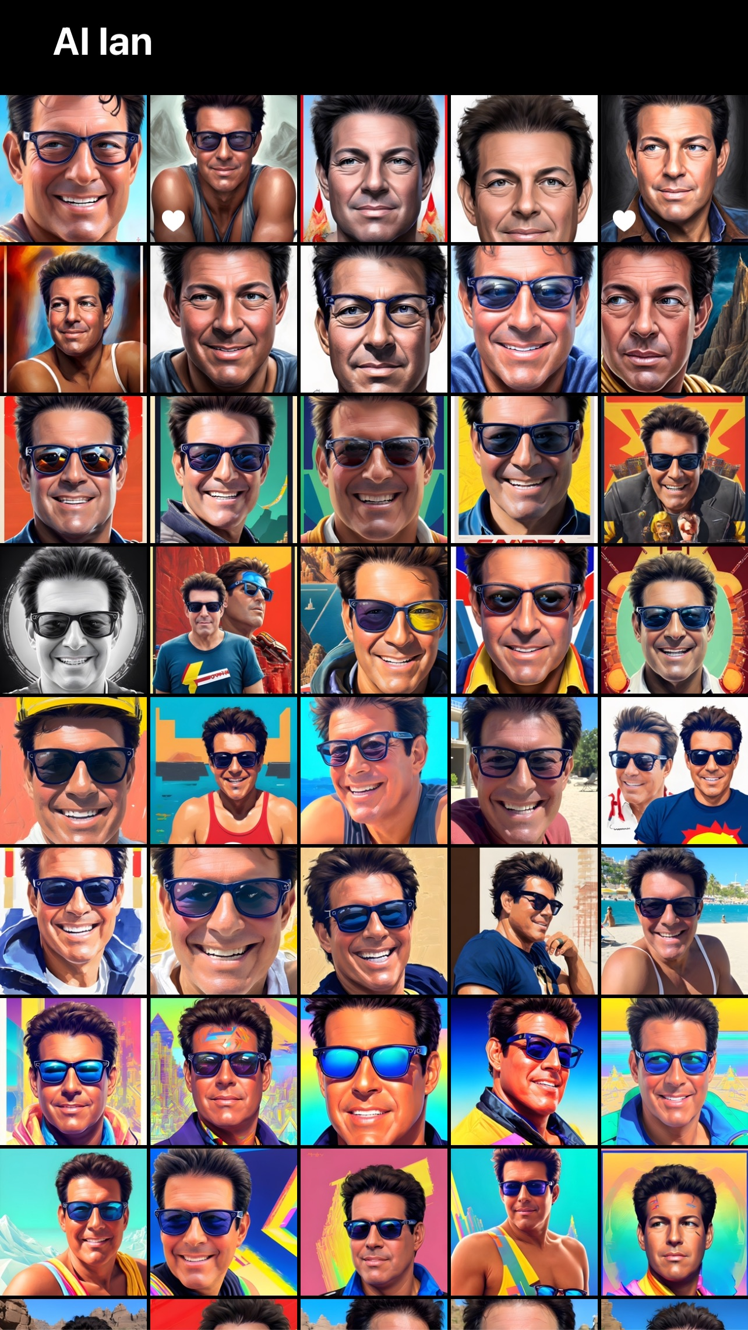

Slide 15
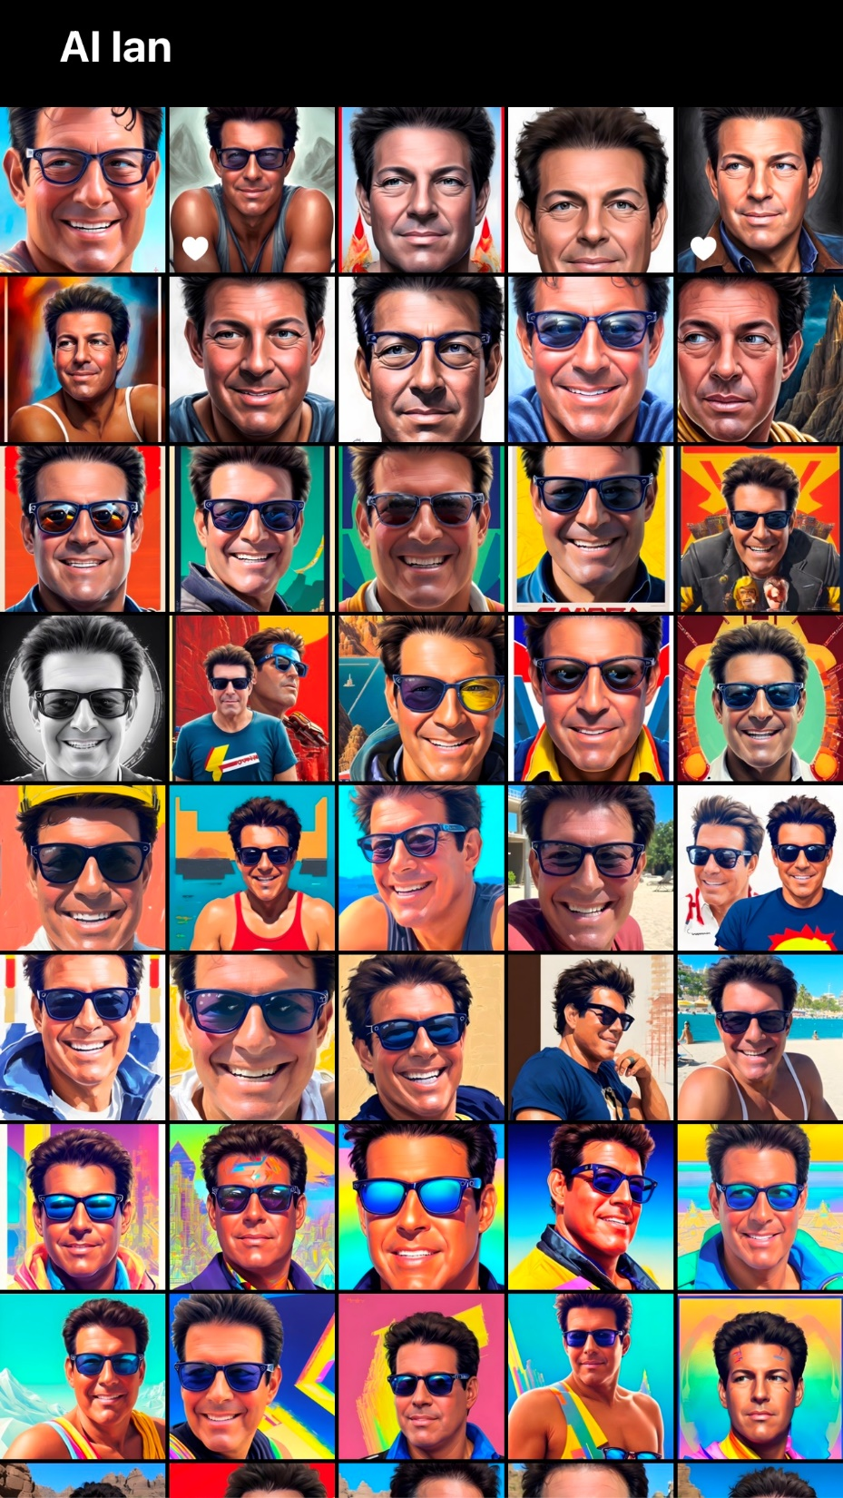

Slide 16

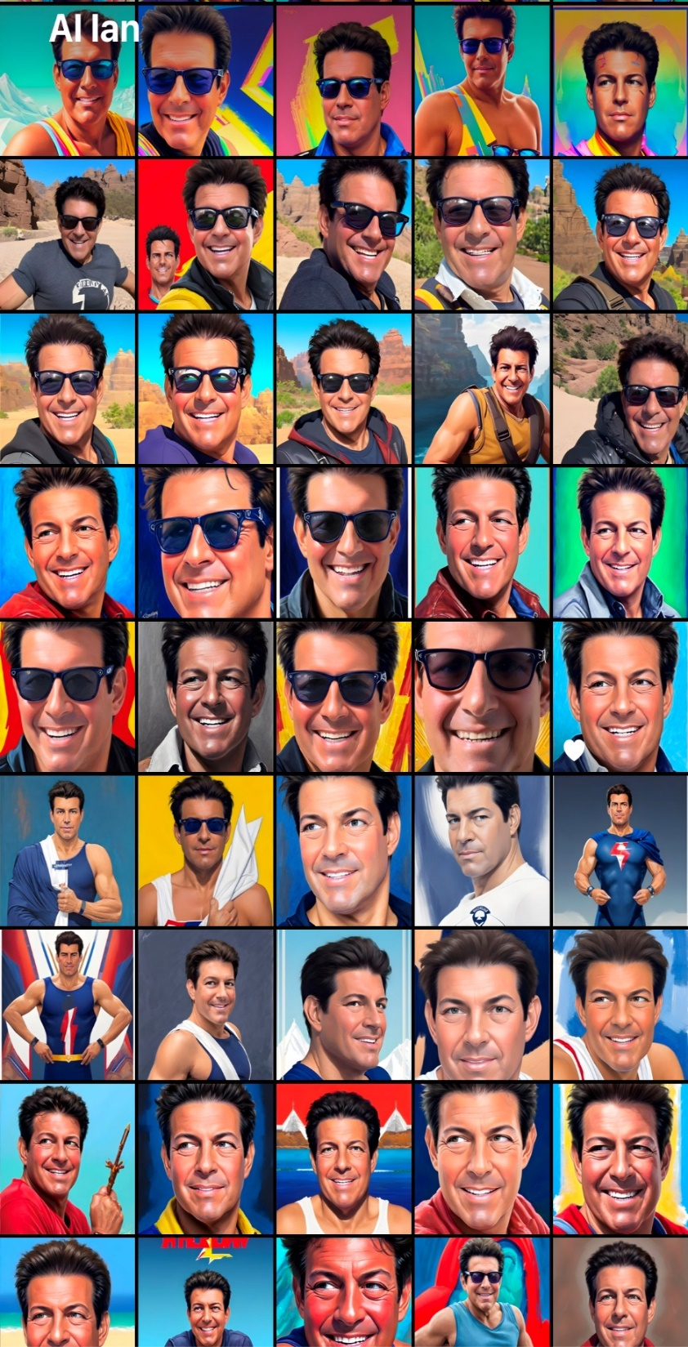
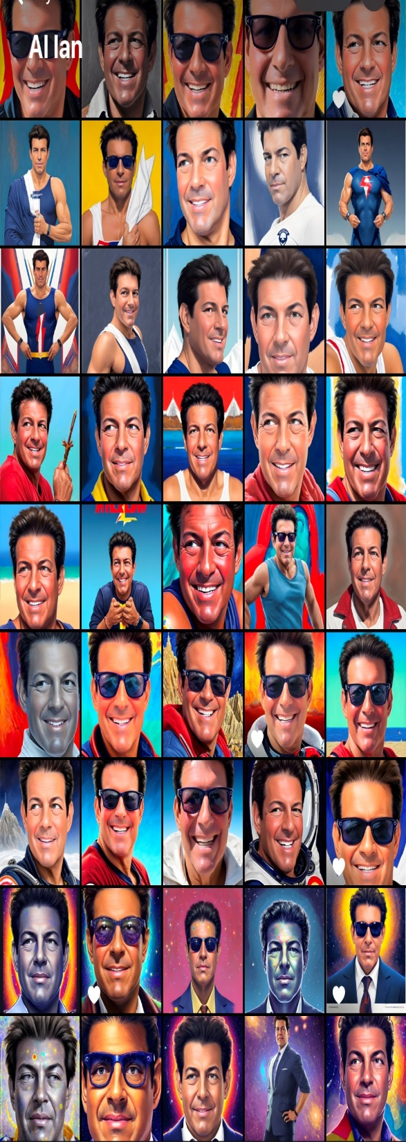

Slide 17
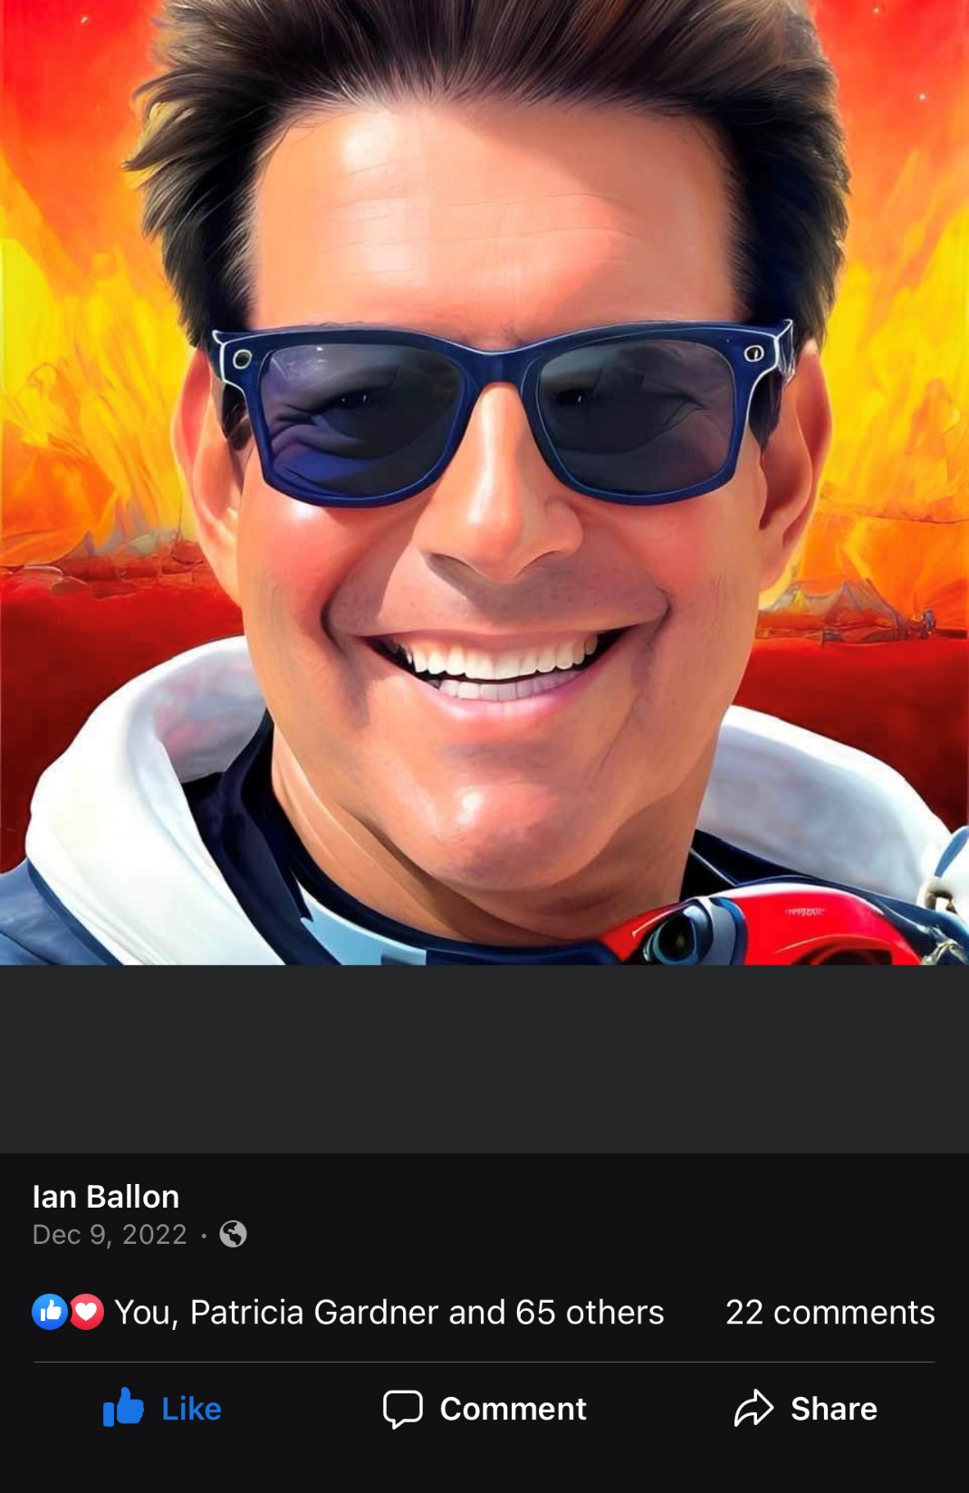

Slide 18


Slide 19


Slide 20
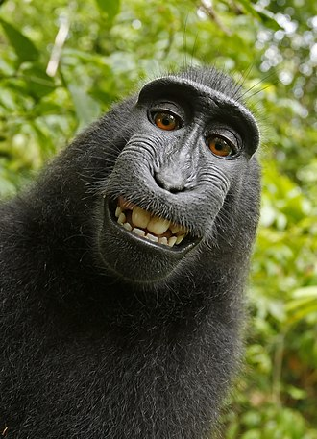
AI -- Copyrightability and Patent Law
Machines can’t obtain patents
Machines can’t create works
  Copyright Office position
  Naruto v. Slater, 888 F.3d 418, 426 (9th Cir. 2018)
  (holding that “animals other than humans . . . lack
  statutory standing to sue under the Copyright Act.”)
Can the output of generative AI result in liability? (i.e., can “works” created by machines be infringing or a fair use?)
  Look at the algorithm and the content or data used to train it
  How many photos/songs/other creative works are used to train the algorithm
  Does the algorithm replicate a specific creator's style?
  What if the algorithm is so good that it independently creates a work that appears to be infringing?

Slide 21
Copyright damages for the Use of AI
  Copyright owners may elect actual or statutory damages at any time prior to a jury verdict
    The amount of damages is determined by the jury if a jury trial is selected
  Statutory damages (1 award per work infringed):
    Usual range: $750-$30,000
    Increased to $150,000 if plaintiff proves willfulness
    Decreased to $200 if the defendant proves innocence
  Actual Damages:
    Actual damages suffered as a result of the infringement and, to the extent not duplicative,
    Defendant’s wrongful profits attributable to the infringement
      May include indirect (or noninfringing) profits attributable to the infringement.
  Timely Registration:
    Statutory damages and attorneys fees are not recoverable if a plaintiff failed to timely register its work (but actual damages and injunctive relief may be available)
      A registration certificate is deemed sufficient even if it contains inaccurate information unless (a) the inaccurate information was included on the application with knowledge that it was inaccurate, and (b) the inaccuracy, if known, would have caused the Registrar of Copyrights to refuse registration. Unicolors, Inc. v. H&M Hennes & Mauritz, LP, 595 U.S. 178 (2022)
  Timing – Damages for 3 years prior to filing suit
    Petrella v. Metro-Goldwyn-Mayer, Inc., 572 U.S. 663 (2014).
    Except where the discovery rule applies: Starz Entertainment, LLC v. MGM Domestic Television Distribution, LLC, 39 F.4th 1236 (9th Cir. 2022); Nealy v. Warner Chappell Music, Inc., _ F.4th _, 2023 WL 2230267 (11th Cir. Feb. 27, 2023)
  Attorneys’ fees:
    Reasonable attorneys’ fees, where a copyright has been timely registered, may be awarded to the prevailing party as part of the costs of a case; the decision to award fees is in the sound discretion of the court
    Fogerty v. Fantasy, Inc., 510 U.S. 517, 543 n.19 (1994)
      Frivolousness
      Motivation
      Objective unreasonableness (both in the factual and legal components of a case)
      The need in particular circumstances to advance considerations of compensation and deterrence
    Kirtsaeng v. John Wiley & Sons, Inc., 579 U.S. 197 (2016)
      A court should give substantial weight to the objective reasonableness of the losing party’s position (while an important factor it is not controlling)
      A district court may not award fees to a prevailing plaintiff as a matter or course
      A district court may not treat prevailing plaintiffs and prevailing defendants differently (both should be encouraged to litigate meritorious claims or defenses)
      A court must look at the totality of the circumstances of a case

Slide 22
AI, Copyright fair use AND THE WARHOL CASE

Slide 23
Copyright Fair Use
Multipart balancing test available when a work is used “for purposes such as criticism, comment, news reporting, teaching . . . Scholarship or research”
  Courts must consider:
    The purpose and character of the use, including whether it is of a commercial nature or is for nonprofit educational purposes;
      Commercial
      Transformative
    The nature of the work (creative works are closer to the core of intended copyright protection than informational or functional works)
    The amount and substantiality of the portion used in related to the copyrighted work as a whole
    The effect of the use upon the potential market for or value of the copyrighted work
  Courts may consider other criteria
  VCR recordings
    Sony Corp. of America v. Universal City Studios, Inc., 464 U.S. 417 (1984)
  For security research: Apple Inc. v. Corellium, LLC, 510 F. Supp. 3d 1269, 1285-92 (S.D. Fla. 2020)
  Data mining/ Google books
    Author’s Guild, Inc. v. HathiTrust, 755 F.3d 87 (2d Cir. 2014)
    Author’s Guild, Inc. v. Google Inc., 804 F.3d 202 (2d Cir. 2015), cert. denied, 578 U.S. 941 (2016)
  Use in connection with criticism
    Katz v. Google, Inc., 802 F.3d 1178 (11th Cir. 2015)
Google LLC v. Oracle America, Inc., 141 S. Ct. 1183 (2021) (6-2) (Breyer)
  Google’s reimplementation of 37 of 166 of Java SE application programming interfaces (APIs) in the Android mobile operating system was a fair use
  Declined to address software copyrightability but provided some guidance
Andy Warhol Foundation for the Visual Arts, Inc. v. Goldsmith, 598 U.S. 508 (2023)

Slide 24
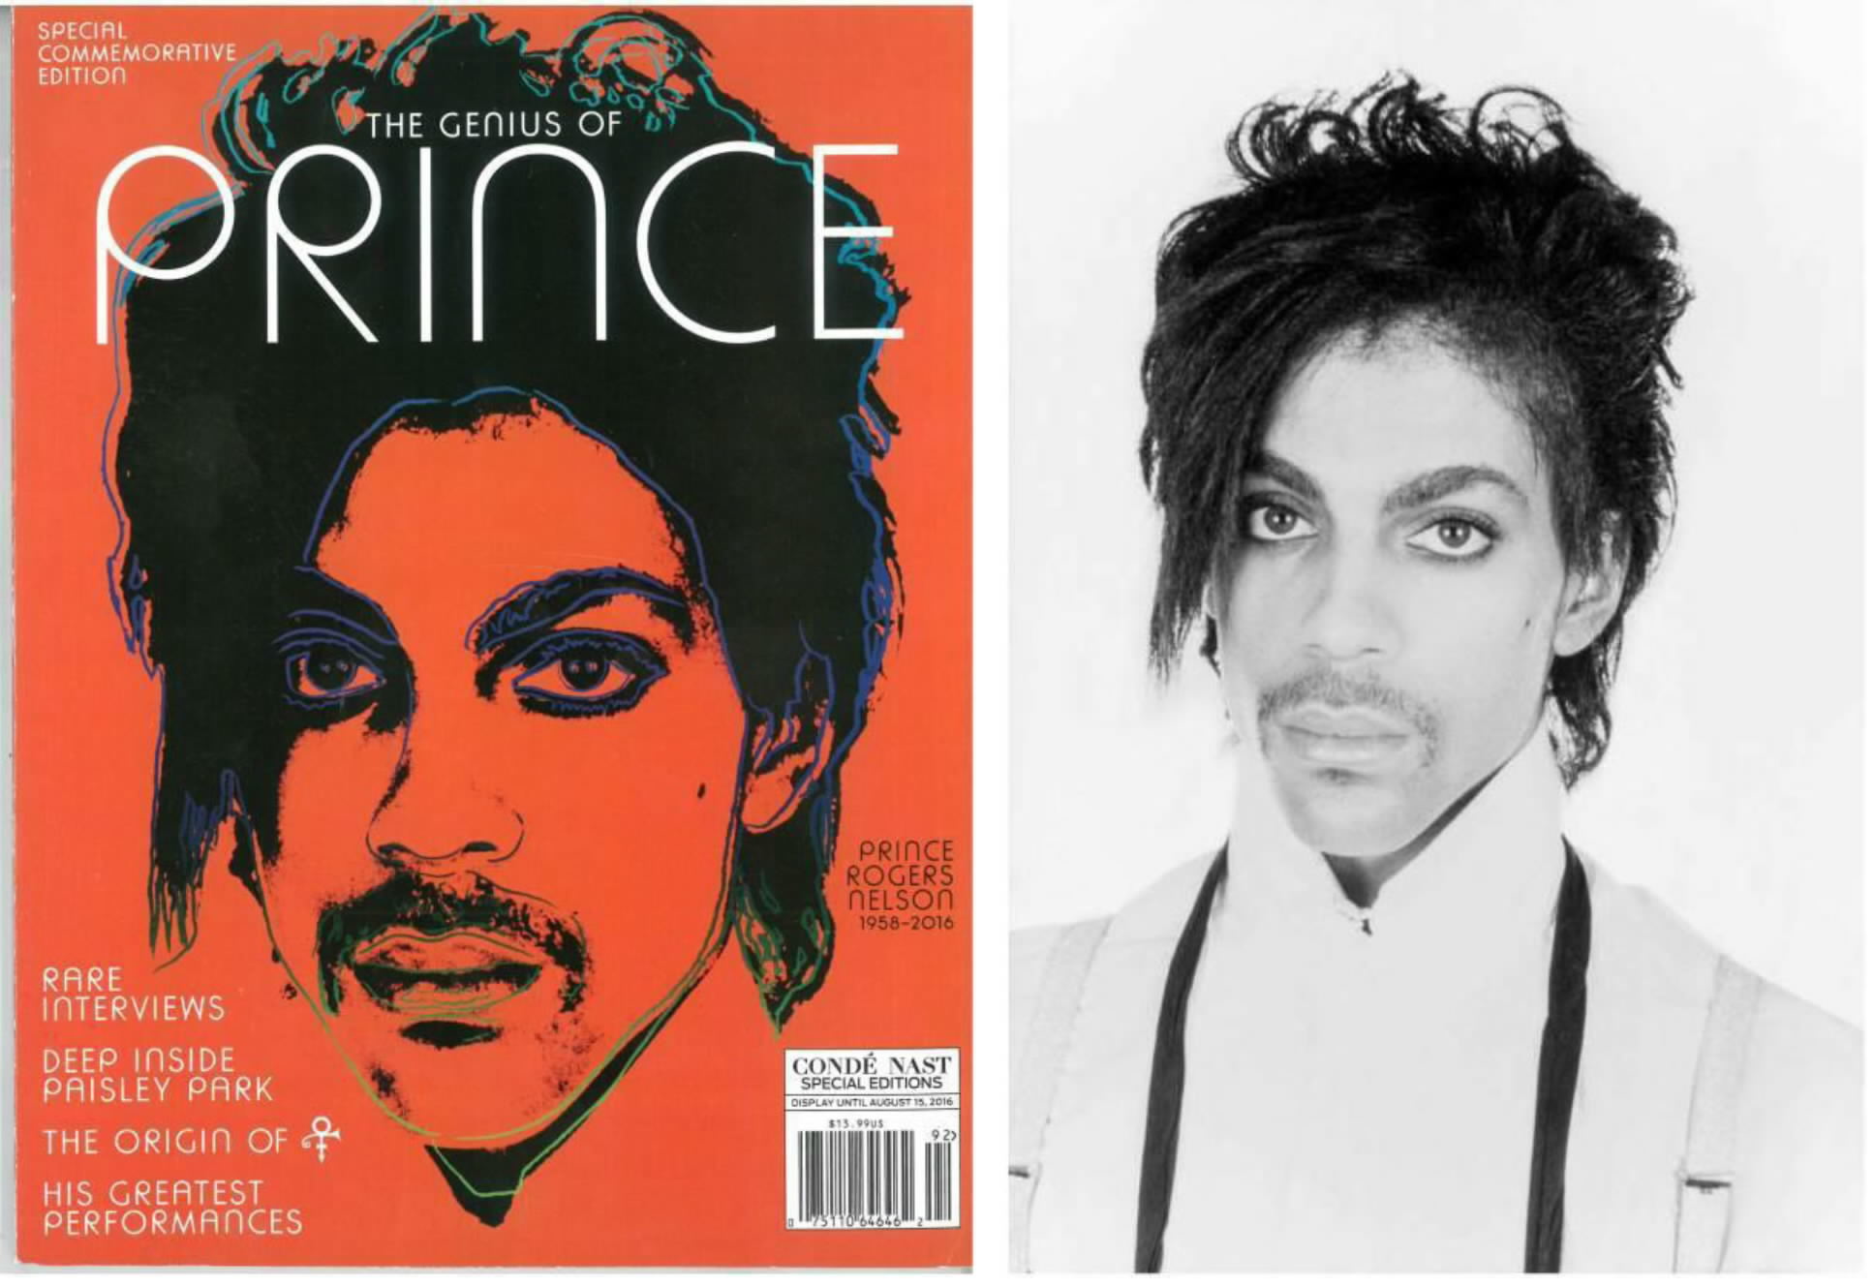
Andy Warhol Foundation for the Visual Arts, Inc. v. Goldsmith,
598 U.S. 508 (2023)

Slide 25
Andy Warhol Foundation for the Visual Arts, Inc. v. Goldsmith,
598 U.S. 508 (2023) (7-2) (Sotomayor)
The purpose and character of Warhol’s use of Goldsmith’s photo in commercially licensing Orange Prince to Conde Nast was not a fair use
  The court only addressed the first factor – not whether the use was fair overall
    The central question is whether a use merely supersedes the original creation (supplanting the original) or adds something new, with a further purpose or different character (purpose & character judged by an objective inquiry)
    NEW: As most copying has some further purpose and many secondary uses add something new, the first factor asks whether and to what extent the secondary use has a purpose or character different from the original. The larger the difference, the more likely the use is fair.
    Transformativeness is a matter of degree – to preserve the copyright holder’s right to prepare derivative works the degree of transformation must go beyond that required to qualify as a derivative work
    Stated differently, if an original work and secondary use share the same or highly similar purposes, and the secondary use is commercial, the first factor is likely to weigh against fair use absent some other justification for copying
    The purpose the court focused on was use of the image to illustrate a magazine article, not the painting itself. Even assuming that Warhol’s purpose was to portray Prince as iconic, that difference was not significant enough for purposes of using one work or the other to illustrate a magazine article
      Likewise Warhol’s purpose of commenting on the dehumanizing nature of celebrity was not substantial enough as it was not focused specifically on the Goldstein photo that was used (as opposed to any image of Prince) (analogy to parody)
      Because the use was commercial, a more substantial justification was required
  The majority went to great lengths to limit its holding to the facts of the case – competitive commercial licensing, emphasizing that other uses of the Goldstein photo for Orange Prince (such as to display in a museum) could be fair
  Nevertheless, the decision seems to import the fourth factor – impact on the market – as relevant to the first factor, much in the same way that Justice Breyer in Google found transformativeness to be relevant to all four factors.
  The creative nature of the works – and their competitive use for magazine cover licensing – greatly impacted the decision
  But if an Andy Warhol painting is not fair use, what is?
    The decision seems to elevate visual impression over other aspects of whether a secondary use has a further purpose or different character than the original, which is “a matter of degree” (see Kagan dissent)
    The degree of difference must be weighed against other considerations, like whether the use is commercial
    New expression, meaning or message may be relevant, but is not, without more, dispositive
Gorsuch (joined by Jackson) concurred (examine the purpose of the particular use challenged, not the artistic purpose of the underlying use)
Kagan (joined by Chief Justice Roberts) dissented (sharp departure from Campbell and Google; this opinion will stifle creativity because a license is not always available)

Slide 26
AI/ Screen Scraping/ Data Portability
    Contract/TOU/PP restrictions
      Meta Platforms, Inc. v. BrandTotal Ltd., _ F. Supp. 3d _, 2022 WL 1990225 (N.D. Cal. 2022) (automated access violated TOU)
    Copyright protection (statutory damages and potentially attorneys’ fees if a work is timely registered)
      Facts vs creative expression
        Feist Publications, Inc. v. Rural Telephone Service Co., 499 U.S. 340, 350 (1991)
      Protection for compilations if originality in the selection, arrangement or organization of a database (but thin protection)
      Data mining as a transformative fair use: Author’s Guild, Inc. v. HathiTrust, 755 F.3d 87 (2d Cir. 2014)
      Kadrey v. Meta Platforms, Inc., 2023 WL 8039640 (N.D. Cal. Nov. 20, 2023)
      Andersen v. Stability AI Ltd., 2023 WL 7132064 (N.D. Cal. Oct. 30, 2023)
    Common law claims, such as misappropriation to the extent not preempted by 17 U.S.C. § 301
      International News Service v. Associated Press, 248 U.S. 215 (1918)
      National Basketball Ass'n v. Motorola, Inc., 105 F.3d 841 (2d Cir. 1997)
    Interference with contract or prospective economic advantage
    Unfair competition
    Trespass and Conversion
      trespass to chattels may be based on unauthorized access (plus damage)
        Intel Corp. v. Hamidi, 30 Cal. 4th 1342, 1 Cal. Rptr. 3d 32 (2003)
      conversion usually requires a showing of dispossession or at least substantial interference
    Computer Fraud and Abuse Act - Federal anti-trespass computer crimes statute
      Must establish $5,000 in damages to sue
      Exceeding authorized access may not be based on use (vs. access) restrictions: Van Buren v. United States, 141 S. Ct. 1648 (2021)
      hiQ Labs, Inc. v. LinkedIn Corp., 31 F.4th 1180 (9th Cir. 2022) (affirming an injunction prohibiting LinkedIn from blocking hiQ's access, copying or use of public profiles on LinkedIn's website (information which LinkedIn members had designated as public) or blocking or putting in place technical or legal mechanisms to block hiQ's access to these public profiles, in response to LinkedIn’s C&D letter)
    Anti-circumvention provisions of the DMCA, 17 U.S.C. §§ 1201 et seq.
    Removing, altering or falsifying copyright management information (CMI) - 17 U.S.C. § 1202
    California BOT Law - Cal. Bus. & Prof. Code §§ 17940 et seq. prohibits the undisclosed use of bots to communicate or interact with a person in California online, with the intent to mislead the other person about the artificial identity of the bot, to incentivize a purchase or sale of goods or services in a commercial transaction or to influence a vote in an election
Notes:
26

Slide 27
AI/ Screen Scraping/ Data Portability
    Direct Liability
      If you directly scrape or otherwise copy third party data you could be held liable under the theories noted on the prior slide
    Secondary Liability
      Secondary liability may arise if you pay a third party to access the data or acquire data that has been obtained in breach of an agreement or violation of law
      Secondary liability theories could be used to seek to impose individual liability, regardless of the corporate form
      Secondary liability exists under IP laws and to a lesser extent under other laws but may be harder to establish absent strong documentary evidence (emails, text messages, slack), especially if scraping is done offshore
        Contibutory copyright liability
        Vicarious copyright liability
        Inducing copyright liability
        Secondary liability under the anti-circumvention provisions of the Digital Millennium Copyright Act
        No secondary liability for breach of contract (but potentially interference with contract)
        Potential direct liability for unfair competition
        In extreme cases, fraud
Notes:
27

Slide 28
Practical Rules of Thumb for Using Third Party Content, Data and Information to train AI
Legal analysis. Ask:
  What was copied?
  How was it accessed?
  How was it used?
  How long will it be retained?
Fair Use. Ask:
  How much was copied?
  Is the material factual/ functional or artistic/ highly creative?
  What is it being used for (to train competitive algorithms? For a commercial purpose? For research or scholarship?)
  Was an intermediate copy made?
    If so, how long will it be retained?
Practical business considerations

Slide 29
FIRST AMENDMENT LIMITATIONS ON Lanham act ENFORCEMENT AND THE JACK DANIELS CASE

Slide 30
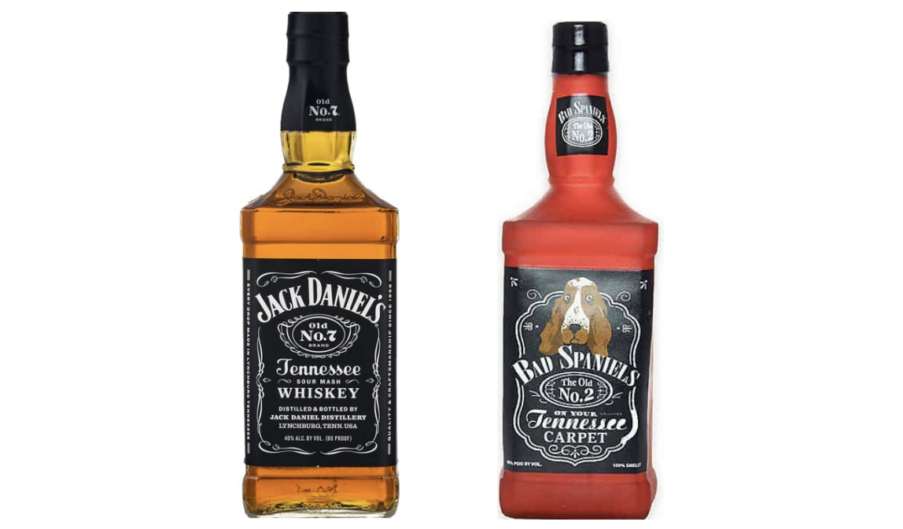
VIP Productions LLC v. Jack Daniel's Properties, Inc., 599 U.S. 140 (2023)

Slide 31
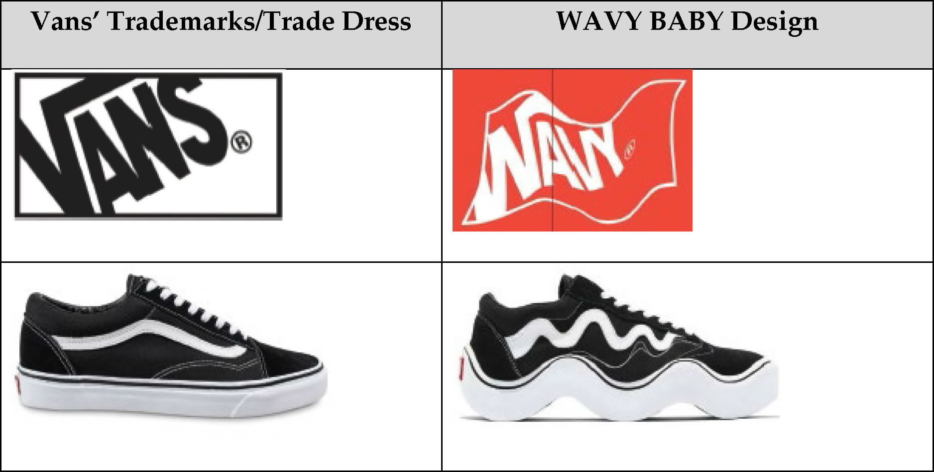
VIP Productions LLC v. Jack Daniel's Properties, Inc., 599 U.S. 140 (2023)
The Supreme Court sidestepped the circuit split over how to apply Rogers v. Grimaldi, holding merely that the Rogers test is not appropriate when the accused infringer has used a trademark to designate the source of its own goods
Trademark fair use still could be applicable where the defendant uses the plaintiff’s mark as a source identifier
Vans, Inc. v. MSCHF Product Studio, Inc., 88 F.4th 125 (2d Cir. 2023)

Slide 32
Lanham Act Fair Use and the First Amendment
Artistic, creative and expressive uses:
  Rogers v. Grimaldi, 875 F.2d 994 (2d Cir. 1989)
  Dr. Seuss Enterprises, L.P. v. ComicMix LLC, 983 F.3d 443 (9th Cir. 2020), cert. denied, 141 S. Ct. 2803 (2021)
  VIP Productions LLC v. Jack Daniel's Properties, Inc., 953 F.3d 1170, 1174-76 (9th Cir. 2020), cert. granted, 143 S. Ct. 476 (Nov. 21, 2022)
  Twentieth Century Fox Television v. Empire Distribution, Inc., 875 F.3d 1192, 1196-1200 (9th Cir. 2017)
  Punchbowl, Inc. v. AJ Press LLC, 52 F.4th 1091 (9th Cir. 2022)
  If applicable (i.e., expressive or creative use), the test asks –
    (1) Does the junior user’s use have some artistic relevance to the mark?
    (2) Does the secondary use “explicitly mislead as to the source or the content of the work”?
    If yes/no suit will be dismissed without consideration of Sleekcraft/ Polaroid factors

Slide 33
Is the plaintiff’s mark used as part of an expressive work protected by the First Amendment?
No
Yes
Does the secondary use have some artistic relevance
No
Yes
Is the use explicitly misleading? *
Yes
No
Apply traditional trademark/dilution/unfair competition analysis
The secondary use is protected by the First Amendment
Courts consider:
The degree to which the junior user uses the mark in the same way as the senior user
The degree to which the junior has added his or her own expressive content to the work beyond the mark itself
Dr. Seuss Enterprises, L.P. v. ComicMix LLC, 983 F.3d 443, 463 (9th Cir. 2020), cert. denied, 141 S. Ct. 2803 (2021)

Slide 34


Punchbowl, Inc. v. AJ Press, 52 F.4th 1091(9th Cir. 2022)

Slide 35
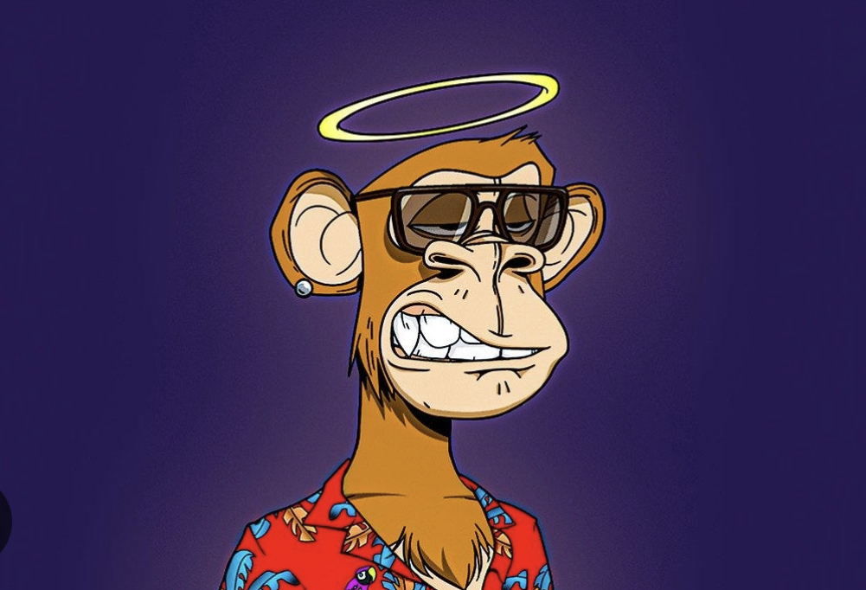
NFTs

Slide 36
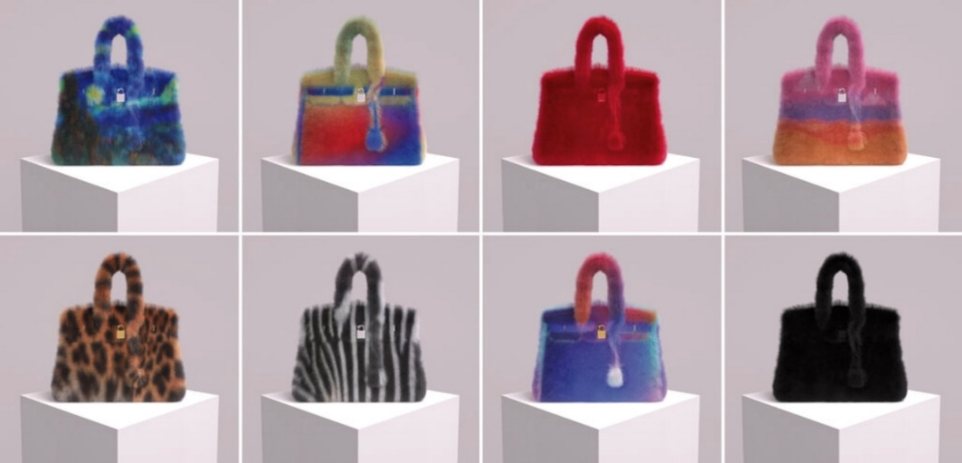
NFTs and IP law
An NFT may be reproduced, distributed or publicly displayed, implicating copyright rights
If you buy an NFT you don’t necessarily acquire underlying IP rights to exploit the work (beyond being able to resell the NFT)
Miramax, LLC v. Tarantino, Case No. 2:21-cv-08979 (C.D. Cal.) (contract dispute over rights to pulp fiction; Quentin Tarantino issued NFTs containing portions of the handwritten version of the screenplay; Tarantino assigned all rights to Miramax but retained rights to the print version)
Yuga Labs, Inc. v. Ripps, Case No. CV 22-4355-JFW(JEMx), 2023 WL 3316748 (C.D. Cal. Apr. 21, 2023) (Bored Ape Yacht Club)
Nike, Inc. v. StockX, 22-CV-00983 (VEC)(SN) (S.D.N.Y.)
Hermes Int’l v. Rothschild, _ F. Supp. 3d _, 2022 WL 1564597 (S.D.N.Y. 2022) (denying MTD claims that defendant’s NFTs of Birkin handbags infringed plaintiff’s trademarks)
  Hermes Int’l v. Rothschild, 590 F. Supp. 3d 647 (S.D.N.Y. 2022) (denying motion for interlocutory appeal)
  Jury trial (Feb. 2023):
    MetaBirkin NFTs - not protected speech
    $133,000 damages
  Permanent injunction
    Hermes Int’l v. Rothschild, _ F. Supp. 3d _,
    2023 WL 4145518 (S.D.N.Y. June 23, 2023)

Slide 37
SECONDARY IP LIABILITY AND THE CDA

Slide 38
Secondary IP Liability
Copyright Litigation
DMCA
  Copyright Office Section 512 Report (May 2020)
CASE Act small claims resolution
  $30,000 cap per proceeding (plus fees and costs)
  Voluntary but bound if you fail to opt-out within 60 days
Trademark Litigation
Counterfeiting –
  A counterfeit is “identical with, or substantially indistinguishable from, a registered mark”
  While all counterfeits infringe a trademark, not all trademarks are counterfeits
Direct Infringement
  Print-on-Demand: Ohio State University v. Redbubble, Inc., 989 F.3d 435 (6th Cir. 2021)
Contributory and vicarious liability
YYGM SA v. Redbubble, Inc., 75 F.4th 995 (9th Cir. 2023)
  willful blindness that gives rise to contributory liability for trademark infringement requires the defendant to have specific knowledge of infringers or instances of infringement
  without specific knowledge of infringers or instances of infringement, there is no duty to look for trademark infringement by others on one's property
Publisher’s exemption - 15 U.S.C. § 1114(2)(B)-(C)
No DMTA, but courts generally require notice and takedown
  Tiffany (NJ) Inc. v. eBay Inc., 600 F.3d 93 (2d Cir.), 562 U.S. 1082 (2010)
Patent Litigation
Blazer v. eBay, Inc., Case No. 1:15-CV-01059-KOB, 2017 WL 1047572 (N.D. Ala. 2017)
The Communications Decency Act
47 U.S.C. § 230 (the Communications Decency Act) and IP claims
  230(c)(1): No provider or user of an interactive computer service shall be treated as the publisher or speaker of any information provided by another information content provider
  Preempts inconsistent state laws (including defamation, privacy) and some federal claims
  Excludes: FOSTA/SESTA
  Excludes: federal criminal claims; claims under ECPA or “any similar state law”; “any law pertaining to intellectual property.”
    State right of publicity, trademark trade secret and other IP claims?

Slide 39
230 & Related Speech Cases
Twitter, Inc. v. Taamneh, 598 U.S. 471 (2023)
Gonzalez v. Google LLC, 598 U.S. 617 (2023)
G.G. v. Salesforce, Inc., 76 F.4th 544 (7th Cir. 2023)
Rigsby v. GoDaddy Inc., 59 F.4th 998 (9th Cir. 2023) (CDA applied to a domain name registrar)
  Doe v. Snap, Inc., _ F.4th _, 2023 WL 8705665 (5th Cir. Dec. 18, 2023) (denying en banc review, affirming dismissal)
In re: Social Media Adolescent Addiction/ Personal Injury/ Products Liability Litigation, _ F. Supp. 3d _, 2023 WL 7524912 (N.D. Cal. Nov. 14, 2023) (holding design defect product liability claims not related to publication of third party content outside the scope of the CDA, while claims related to publication were preempted)
Plaintiff friendly (9th and 10th Circuits and maybe the 7th Circuit):
  Fair Housing Council v. Roommate.com, LLC, 521 F.3d 1157 (9th Cir. 2008) (en banc)
  FTC v. Accusearch Inc., 570 F.3d 1187 (10th Cir. 2009)
Defendant friendly (1st, 2d, 4^{th,} 5th, 6th and D.C. Circuits):
  Doe No. 1 v. Backpage.com, LLC, 817 F.3d 12 (1st Cir. 2016)
  Nemet Chevrolet, Ltd. v. Consumeraffairs.com, Inc., 591 F.3d 250 (4th Cir. 2009) (affirming dismissal)
  Doe v. Snap, Inc., _ F.4th _, 2023 WL 8705665 (5th Cir. Dec. 18, 2023) (denying en banc review, affirming dismissal)
  Jones v. Dirty World Entertainment Recordings LLC, 755 F.3d 398 (6th Cir. 2014)
  Force v. Facebook, Inc., 934 F.3d 53 (2d Cir. 2019)
  Marshall’s Locksmith Service, Inc., 925 F.3d 1263 (D.C. Cir. 2019)
Conduct as content
  Gonzalez v. Google LLC, 2 F.4th 871, 890 (9th Cir. 2021), vacated, 598 U.S. 617 (2023)
    Claims brought under Justice Against Sponsors of International Terrorism Act (JASTA) were barred by the CDA
    CDA didn’t bar claim based on sharing ad revenue, but plaintiff failed to state a claim
    Concurrences argued that courts should limit who is a publisher or Congress should take action
  Force v. Facebook, Inc., 934 F.3d 53 (2d Cir. 2019) (victims of Hamas)
  Dyroff v. Ultimate Software Group, Inc., 934 F.3d 1093 (9th Cir. 2019) (No development where the decedent used defendant’s neutral tools to discuss drug use and meet up with a dealer who sold him fentanyl laced heroin)
  Herrick v. Grindr LLC, 765 F. App’x 586 (2d Cir. 2019) (product liability – app)
Preventing Online Censorship, Executive Order No. 13,925 of May 28, 2020, 85 Fed. Reg. 34079 (June 2, 2020), revoked by, Revocation of Certain Presidential Actions and Technical Amendment, Executive Order 14029 of May 14, 2021, 86 Fed. Reg. 27025 (May 19, 2021)

Slide 40
230 – Intellectual Property/ FOSTA-SESTA
47 U.S.C. § 230 (the Communications Decency Act) and IP claims
  230(c)(1): No provider or user of an interactive computer service shall be treated as the publisher or speaker of any information provided by another information content provider
  Preempts inconsistent state laws (including defamation, privacy) and some federal claims
  Excludes: FOSTA/SESTA; Does 1-6 v. Reddit, Inc., 51 F.4th 1137 (9th Cir. 2022) (a website’s own conduct, not that of a user, must violate child trafficking laws, for the exception to apply).
    But see G.G. v. Salesforce, Inc., 76 F.4th 544 (7th Cir. 2023)
    Woodhull Freedom Foundation v. United States, 72 F.4th 1286 (D.C. Cir. 2023) (upholding FOSTA-SESTA)
  Excludes: federal criminal claims; claims under ECPA or “any similar state law”; “any law pertaining to intellectual property.”
  What is a law “pertaining to intellectual property”?
    Perfect 10, Inc. v. Ccbill, 488 F.3d 1102 (9th Cir. 2007) (right of publicity preempted)
    Enigma Software Group, LLC v. Malwarebytes, Inc., 946 F.3d 1040 (9th Cir. 2019)
    (Lanham Act false advertising - not a law “pertaining to intellectual property”), cert. denied, 140 S. Ct. 2761 (2020)
    Hepp v. Facebook, Inc., 14 F.4th 204 (3d Cir. 2021) (right of publicity claim not preempted)
    Doe v. Friendfinder Network, Inc., 540 F. Supp. 2d 288 (D.N.H. 2008)
    Atlantic Recording Corp. v. Project Playlist, Inc., 603 F. Supp. 2d 690 (S.D.N.Y. 2009) (Chin)
    Ratermann v. Pierre Fabre USA, Inc., 651 F. Supp. 3d 657 (S.D.N.Y. 2023) (right of publicity)
    Marshall’s Locksmith Service Inc. v. Google, LLC, 925 F.3d 1263 (D.C. Cir. 2019) (affirming dismissal of Lanham Act false advertising claims, where liability was premised on third party content (from the scam locksmiths) and defendants merely operated neutral map location services that listed companies based on where they purported to be located)
  Defend Trade Secrets Act – not a “law pertaining to intellectual property”
  Orrin G. Hatch–Bob Goodlatte Music Modernization Act of 2018: 17 U.S.C. § 1401(a) is a “law pertaining to intellectual property” within the meaning of 47 U.S.C. § 230(e)(2)

Slide 41
Marketplaces
Amazon.com, Inc. v. McMillan, 2 F.4th 525 (5th Cir. 2021) (Amazon was not a “seller” under Texas product liability law because sellers using its marketplace don’t relinquish title to their products; relying on Amazon.com, Inc. v. McMillan, 625 S.W.3d 101, 103-04 (Tex. 2021) (holding that “potentially liable sellers are limited to those who relinquished title to the product at some point in the distribution chain.”))
State Farm Fire and Casualty Co. v. Amazon Services, Inc., 835 F. App’x 213 (9th Cir. 2020) (holding Amazon could not be held liable for damages caused by explosion of batteries, because it was not “seller” of the hoverboards which had been purchased on its site)
Erie Insurance Co. v. Amazon.com, Inc., 925 F.3d 125, 141-44 (4th Cir. 2019) (holding that, where Amazon did not obtain title to the headlamp shipped to its warehouse by Dream Light and Dream Light (the seller) set the price, designed the product description, paid Amazon for fulfillment services, and ultimately received the purchase price paid by the seller, Amazon was not a seller — one who transfers ownership of property for a price — and therefore did not have liability under Maryland law as a seller; “when Amazon sells its own goods on its website, it has the responsibility of a ‘seller,’ just as any other retailer, . . . But when it provides a website for use by other sellers of products and facilitates those sales under its fulfillment program, it is not a seller, and it does not have the liability of a seller.”)
Fox v. Amazon.com, Inc., 930 F.3d 415, 422-25 (6th Cir. 2019) (holding that Amazon was not a seller within the meaning of the Tennessee Products Liability Act – which the court defined as “any individual regularly engaged in exercising sufficient control over a product in connection with its sale, lease, or bailment, for livelihood or gain” – where Amazon.com “did not choose to offer the hoverboard for sale, did not set the price of the hoverboard, and did not make any representations about the safety or specifications of the hoverboard on its marketplace.”)
Oberdorf v. Amazon.com, Inc., 930 F.3d 136 (3d Cir. 2019), vacated, 936 F.3d 182 (3d Cir. 2019) (vacating the opinion and granting en banc review)
Loomis v. Amazon.com, LLC, 63 Cal. App. 5th 466, 277 Cal. Rptr. 3d 769 (2d Dist. 2021)
Bolger v. Amazon.com, LLC, 53 Cal. App. 5th 431 (4th Dist. 2020) (imposing strict product liability on a platform, rejecting the applicability of the CDA)
Stiner v. Amazon.com, Inc., 162 Ohio St. 3d 128, 131-35, 164 N.E.3d 394, 397-401 (Ohio 2020) (Amazon was not a “supplier” within meaning of the Products Liability Act)

Slide 42
State Laws to Restrict Social Media Speech
The U.S. Supreme Court will evaluate Florida and Texas laws that regulate speech by social media companies
  NetChoice, LLC v. Paxton, 142 S. Ct. 1715 (2022) (staying enforcement of Texas H.B. 20) (Alito, Thomas and Gorsuch, dissenting) (“This application concerns issues of great importance that will plainly merit this Court's review. Social media platforms have transformed the way people communicate with each other and obtain news. At issue is a ground-breaking Texas law that addresses the power of dominant social media corporations to shape public discussion of the important issues of the day.”)
  NetChoice, LLC v. Paxton, 49 F.4th 439 (5th Cir. 2022)
  NetChoice LLC v. Attorney General of Florida, 34 F.4th 1196 (11th Cir. 2022) (affirming in part preliminarily injunction enjoining Fla. Stat. Ann. §§ 106.072 to 501.2041, which the district court had characterized as legislation that imposed “sweeping requirements on some but not all social-media providers”)
    platforms were likely to succeed on claim that prohibitions against deplatforming candidates, deprioritizing and “shadow-banning” content, and censoring “journalistic enterprises” violated First Amendment;
    platforms were likely to succeed on claim that requiring them to apply their standards in consistent manner, and to allow users to opt out of their algorithms, and limiting changes to their user agreements violated First Amendment;
    7 platforms failed to establish likelihood of success on claim that requiring them to publish their standards, inform users about changes, provide users with view counts, and inform candidates about free advertising violated First Amendment; and
    8 platforms were likely to succeed on claim that requirement that they provide notice and detailed justification for every content-moderation action was unduly burdensome.
X Corp. v. Bonta, 2023 WL 8948286 (E.D. Cal. Dec. 28, 2023) (upholding the Constitutionality of AB 587, which requires social media companies to post their ToS for users and submit twice yearly ToS reports to the Attorney General containing their current ToS and describing their content moderation practices with respect to hate speech and racism, extremism or radicalization, disinformation or misinformation, harassment, and foreign political interference)
Free Speech Coalition v. Colmenero, _ F. Supp. _, 2023 WL 5655712 (W.D. Tex. 2023) (striking down a Texas law imposing age-verification and warning requirements on porn sites harmful to minors)
Utah child screening and curfew law (3/1/24)
California child protection law – AB 2273
  NetChoice v. Bonta

Slide 43
Can public officials block users from their social media accounts?
Garnier v. O'Connor-Ratcliff, 41 F.4th 1158 (9th Cir. 2022), cert. granted sub nom. O’Connor-Ratcliff v. Garnier, _ U.S. _, 2023 WL 3046119 (Apr. 24, 2023)
  The Ninth Circuit held that school board members could not block critics from spamming their personal accounts where they posted information about their work on the school board
  Issue: Whether a public official engages in state action subject to the First Amendment by blocking an individual from the official’s personal social-media account, when the official uses the account to feature their job and communicate about job-related matters with the public, but does not do so pursuant to any governmental authority or duty
Lindke v. Freed, 37 F.4th 1199 (6th Cir. 2022), cert. granted, 2023 WL 3046121 (Apr. 24, 2023)
  The Sixth Circuit held that a city manager's conduct in deleting social media user's comments and blocking the user did not constitute “state action” such that he could be liable under § 1983
  Issue: Whether a public official’s social media activity can constitute state action only if the official used the account to perform a governmental duty or under the authority of his or her office
Earlier case:
  Knight First Amendment Institute v. Trump, 928 F.3d 226 (2d Cir. 2019)
    Holding that President Trump’s Twitter account was a public forum
    Trump, as President, acted in a government capacity in blocking users, which amounted to unconstitutional viewpoint discrimination
  Biden v. Knight First Amendment Institute, 141 S. Ct. 1220, 1221 (2021) (Thomas, J. concurring in denying cert. due to mootness) (“applying old doctrines to new digital platforms is rarely straightforward. Respondents have a point, for example, that some aspects of Mr. Trump's account resemble a constitutionally protected public forum. But it seems rather odd to say that something is a government forum when a private company has unrestricted authority to do away with it.” )

Slide 44
CPRA AND RELATED DATA PRIVACY, CYBERSECURITY BREACH & AdTech PUTATIVE CLASS ACTION LITIGATION

Slide 45
CPRA/Security Breach Class Action Litigation: How to Mitigate the Risks and Win or Favorably Settle Claims
Claims
  Anatomy of a CPRA claim and how defendants can use the elements to their advantage
  Other claims typically joined with CPRA claims
  Trends: kitchen sink complaints vs narrow claims for negligence and unfair competition
Defense strategies
  Who are the plaintiffs and their lawyers?
  What motions to bring – and when to bring them?
  When to fight and when to settle
Privilege and confidentiality issues
  Problems that arise when nonlitigators respond to security incidents
Class certification issues and the problem of mass arbitration
A deep dive on settlement strategies, structures and terms
  Common mistakes, including panicking at the prospect of $750 class claims
  Individual vs action class settlements
Ways to mitigate risk
  The importance of considering litigation in a company’s compliance program
  Online and mobile contract formation
  Arbitration clauses – enforceability and how to deal with mass arbitration
The next frontier
  CPPA litigation under other provisions of the CPRA
  Washington state’s My Health My Data Act (signed into law 4/27/23), which includes a private right of action

Slide 46
Cybersecurity/Data Privacy Class Action Litigation
Cybersecurity claims
  Breach of contract (if there is a contract)
  Breach of the covenant of good faith and fair dealing (if the contract claim isn’t on point)
  Breach of implied contract (if there is no express contract)
  Breach of fiduciary duty, Negligence, Fraud, unfair competition
    Tamraz v. Bakotic Pathology Associates, LLC, 2022 WL 16985001 (S.D. Cal. Nov. 16, 2022) (datasecurity not part of bargained for exchange
  State cybersecurity statutes (especially those that provide for statutory damages and attorneys’ fees)
  California (and potentially Oregon) IoT Law, CPRA
Securities fraud
  In re Alphabet, Inc. Securities Litigation, 1 F.4th 687 (9th Cir. 2021)
  In re Facebook, Inc. Securities Litigation, 477 F. Supp. 3d 980 (N.D. Cal. 2020) (dismissing plaintiffs' amended complaint for lack of causation and reliance)
Data privacy claims
  Electronic Communications Privacy Act
    Wiretap Act
    Stored Communications Act
  Computer Fraud and Abuse Act
    $5,000 minimum injury
    Van Buren v. United States, 141 S. Ct. 1648 (2021)
  Video Privacy Protection Act
  State laws
    Illinois Biometric Information Privacy Act (recently adopted in other states)
    Michigan’s Preservation of Personal Privacy Act
    California laws including the California Privacy Rights Act (CPRA)
      Other claims are preempted by the CPRA only if based on a violation of the CPRA
  Breach of contract/ privacy policies
    Bass v. Facebook, Inc., 394 F. Supp. 3d 1024, 1037-38 (N.D. Cal. 2019) (dismissing claims for breach of contract, breach of implied contract, breach of the implied covenant of good faith and fair dealing, quasi contract, and breach of confidence in a putative data security breach class action suit, where Facebook’s Terms of Service included a limitation-of-liability clause)
  Regulatory enforcement – the FTC and the California Privacy Protection Agency (CPPA)
    Coordinate litigation and regulatory enforcement (usually confidential)

Slide 47
Defense Strategies for Data Privacy & Cybersecurity litigation
Can you compel arbitration?
If there are multiple suits – is MDL consolidation possible or desirable?
  Security breach cases are often consolidated in the district where the defendant is located
  In re Dickey’s Barbecue Restaurants, Inc., Customer Data Security Breach Litigation, 521 F. Supp. 3d 1355 (J.P.M.D.L. 2021) (denying consolidation)
Motions to Dismiss
  Rule 12(b)(1) standing – circuit split - 6th, 7th, 9th, DC vs. high threshold: 2d, 4th, 8th (3d)
  Rule 12(b)(6) motion to dismiss for failure to state a claim
Summary judgment
Class Certification
  In re Marriott International, Inc., 78 F.4th 677 (4th Cir. 2023) (vacating class certification order over class action waiver for failure to consider a choice of law and venue class prior to certification)
Work Product and other privileges
  In re: Capital One Consumer Data Security Breach Litig., MDL No. 1:19md2915, 2020 WL 3470261 (E.D. Va. June 25, 2020) (Ordering production of the Mandiant Report)
    Applied the 4th Circuit’s “driving force” test – (1) was the report prepared when the litigation was a real likelihood (yes); (2) would it have been created anyway in the absence of litigation (yes)
    Capital One had a preexisting contractual relationship with Mandiant for similar reports and could not show that, absent the breach, the report would have been any different in addressing business critical issues (and the report was widely distributed to 50 employees, 4 different regulators and an accountant)
    Footnote 8: use different vendors, scopes of work and/or different investigation teams
  In re: Capital One Consumer Data Security Breach Litig., MDL No. 1:19md2915, 2020 WL 5016930 (E.D. Va. Aug. 21, 2020) (Price Waterhouse – not produced)
  The Ninth Circuit does not weigh motivations where documents may be used both for business purposes and litigation: In re Grand Jury Subpoena, 357 F.3d 900, 908 (9th Cir. 2004)
    Cf. In re Grand Jury Subpoena, 13 F.4th 710 (9th Cir. 2021)
Settlement

Slide 48
Cybersecurity Breach Class Action Litigation - Standing
Circuit split on Article III standing: Low threshold: 6th, 7th, 9th, DC vs. higher: 2d, 4th, 8th, 11th (3d)
TransUnion LLC v. Ramirez, 594 U.S. 413 (2021)
Remijas v. Neiman Marcus Group, 794 F.3d 688 (7th Cir. 2015)
Lewert v. P.F. Chang’s China Bistro Inc., 819 F.3d 963 (7th Cir. 2016)
Galaria v. Nationwide Mut. Ins. Co., 663 F. App’x 384 (6th Cir. 2016) (2-1)
Reilly v. Ceridian Corp., 664 F.3d 38 (3d Cir. 2011), cert. denied, 566 U.S. 989 (2012)
Beck v. McDonald, 848 F.3d 262 (4th Cir. 2017)
  Allegation that data breaches created an enhanced risk of future identity theft was too speculative
    Rejected evidence that 33% of health related data breaches result in identity theft
    Rejected the argument that offering credit monitoring services evidenced a substantial risk of harm (rejecting Remijas)
  Mitigation costs in response to a speculative harm do not qualify as injury in fact
Whalen v. Michael’s Stores, Inc., 689 F. App’x. 89 (2d Cir. 2017)
  The theft of plaintiff’s credit card numbers was not sufficiently concrete or particularized to satisfy Spokeo (name, address, PIN not exposed)
  credit card was presented for unauthorized charges in Ecuador, but no allegation that fraudulent charges actually were incurred
McMorris v. Carlos Lopez & Associates, LLC, 995 F.3d 295 (2d Cir. 2020)
  Plaintiffs may establish Article III standing based on an increased risk of identity theft or fraud following the unauthorized disclosure of their data, but employee was not at substantial risk of future identity theft
Attias v. Carefirst, Inc., 865 F.3d 620 (D.C. Cir. 2017), cert. denied, 583 U.S. 1115 (2018)
  following Remijas v. Neiman Marcus Group, LLC in holding that plaintiffs, whose information had been exposed but who were not victims of identity theft, had plausibly alleged a heightened risk of future injury because it was plausible to infer that a party accessing plaintiffs’ personal information did so with “both the intent and ability to use the data for ill.”
In re U.S. Office of Personnel Management Data Security Breach Litig., 928 F.3d 42 (D.C. Cir. 2019) (21M records)
In re SuperValu, Inc., Customer Data Security Breach Litig., 870 F.3d 763 (8th Cir. 2017)
  Affirming dismissal for lack of standing of the claims of 15 of the 16 plaintiffs but holding that the one plaintiff who alleged he suffered a fraudulent charge on his credit card had standing
  Rejected cost of mitigation (Clapper) (Cf. P.F. Chang’s)
In re Zappos.com, Inc., 888 F.3d 1020 (9th Cir. 2018), cert. denied, 139 S. Ct. 1373 (2019)
  Merely having personal information exposed in a security breach constitutes sufficient harm to justify Article III standing in federal court, regardless of whether the information in fact is used for identity theft or other improper purposes
  Bootstrapping - Because other plaintiffs alleged that their accounts or identities had been commandeered by hackers, the court concluded that the appellants in Zappos – who did not allege any such harm – could be subject to fraud or identity theft
Tsao v. Captiva MVP Restaurant Partners, LLC, 986 F.3d 1332 (11th Cir. 2021)
  No Article III standing for mitigation injuries (lost time, lost reward points, lost access to accounts) or potential future injury, where plaintiff’s credit card was exposed when a restaurant’s point of sale system was breached

Slide 49
Illinois Biometric Information Privacy Act
A private cause of action for "any person aggrieved by a violation" of BIPA
  Rosenbach v. Six Flags Entertainment Corp., 129 N.E.3d 1197 (Ill. 2019) (holding that a person need not have sustained actual damage beyond violation of his or her rights under the statute to be aggrieved by a violation)
  A separate claim accrues under the Act each time a private entity scans or transmits an individual’s biometric identifier or information in violation of the Act. Cothron v. White Castle Systems, Inc., 216 N.E.3d 918 (Ill. 2023); Cothron v. White Castle Systems, Inc., 79 F.4th 894 (7th Cir. 2023)
  A plaintiff may recover the greater of
    (1) actual damages or
    (2) $1,000 in liquidated damages for negligent violations or $5,000 if intentional or reckless
  The statute also authorizes recovery of attorneys' fees
Patel v. Facebook, 932 F.3d 1264 (9th Cir. 2019) (affirming certification of a class of Illinois users of Facebook’s website for whom the website created and stored a face template during the relevant time period) (petition for cert. filed Dec. 4, 2019)
In re: Facebook Biometric Information Privacy Litigation, No. 21-15553, 2022 WL 822923 (9th Cir. Mar. 17, 2022) (affirming a $650 Million settlement, approved after the district court had earlier rejected a $550 Million settlement, over objections to the $97.5 Million attorneys fee award)
Johnson v. Mitek Systems, Inc., 55 F.4th 1122 (7th Cir. 2022) (declining to compel arbitration where HyreCar, an intermediary between people who own vehicles and other people who would like to drive for services such as Uber and GrubHub, provided personal information to Mitek for background verification where plaintiff’s contract with HyreCar required arbitration “with a long list of entities” including “all authorized or unauthorized users or beneficiaries of services or goods provided under the Agreement.”)
Standing arguments
2022: 90 opinions referencing BIPA. Approved class settlements ranged from $250,000 to $100 Million (Rivera v. Google). First jury trial resulted in a $228 Million verdict (Rogers v. BNSF Ry. Co.)
New trend: Suits under the Illinois Genetic Information Privacy Act (suits against employers over disclosure of family medical history).
  Bridges v. Blackstone, Inc., 66 F.4th 687 (7th Cir. 2023)

Slide 50
AdTech Cases Involving Replay Software and Chat
California law
  Massie v. General Motors LLC, Civil Action No. 21-787-RGA2022 WL 534468 (D. Del. Feb. 17, 2022) (dismissing plaintiffs’ Wiretap Act and CIPA claims, arising out of GM's use of Decibel's Session Replay software on GM's websites, for lack of Article III standing)
    Massie v. General Motors LLC, 2021 WL 2142728 (E.D. Cal. May 26, 2021) (dismissing and transferring the case to the District of Delaware)
  Saleh v. Nike, Inc., _ F. Supp. 3d _, 2021 WL 4437734, at *12-14 (C.D. Cal. Sept. 27, 2021) (dismissing plaintiff’s CIPA section 635 claim, alleging use of FullStory session replay software, because “[c]ontrary to Plaintiff's argument, § 635 does not prohibit the ‘implementation’ or ‘use’ of a wiretapping device; instead, it prohibits the manufacture, assembly, sale, offer for sale, advertisement for sale, possession, transport, import, or furnishment of such device” and ruling, by analogy to ECPA, that a private cause of action may not be premised on mere possession and therefore plaintiff lacked Article III standing)
  Graham v. Noom, Inc., No. 3:20-cv-6903, 2021 WL 1312765, at *7-8 (N.D. Cal. Apr. 8, 2021) (dismissing plaintiffs’ 635(a) CIPA claim because plaintiffs could not allege eavesdropping where FullStory merely provided a cloud-based software tool and acted as “an extension of Noom[,]” and thus there could be no section 635 violation and plaintiffs lacked Article III standing)
  Yale v. Clicktale, Inc., No. 3:20-cv-7575, 2021 WL 1428400, at *3 (N.D. Cal. Apr. 15, 2021) (applying Noom to reach the same result); Johnson v. Blue Nile, Inc., No. 3:20-cv-8183, 2021 WL 1312771, at *3 (N.D. Cal. Apr. 8, 2021) (applying Noom to reach the same result)
Florida law
  Jacome v. Spirit Airlines Inc., No. 2021-000947-CA-01, 2021 WL 3087860, at *2 (Fla. Cir. June 11, 2021) (holding that sections 934.03(1)(a) and 934.03(1)(d) of the Florida Security of Communications Act’s purpose was “to address eavesdropping and illegal recordings regarding the substance of communications or personal and business records . . . and not to address the use by a website operator of analytics software to monitor visitors' interactions with that website operator's own website. . . . [T]he FSCA does not cover Plaintiff's claims seeking to penalize Spirit's use of session replay software on its Website.”)

Slide 51
AdTech Cases Involving Ad pixels and forms
  Expansive definition of interception under Pennsylvania law
    Popa v. Harriet Carter Gifts, Inc., 52 F.4th 121 (3d Cir. 2022)
      Holding that under Pennsylvania law, as predicted by the 3d Circuit, there was no direct-party exception to liability under the Wiretapping and Electronic Surveillance Control Act (WESCA), 18 Pa. Cons. Stat. Ann. § 5702, meaning anyone could “intercept” communications, including people who acquired a text message or chat sent directly to them because the Pennsylvania legislature had a prototype for a direct-party exception in the Federal Wiretap Act, 18 U.S.C.A. § 2511(2)(d), but it codified only a law-enforcement exception, in effect limiting any direct-party exception to that context.
      But see, e.g., Pena v. Gamestop, Inc., _ F. Supp. 3d _, 2-23 WL 3170047 (C.D. Cal. 2023) (CIPA)
  No retroactive consent
    Javier v. Assurance IQ, LLC, No. 21-16351, 2022 WL 1744107 (9th Cir. 2022)
      Interpreting CIPA section 631(a) to require the prior consent of all parties to a communication. “Here, Javier has sufficiently alleged that he did not provide express prior consent to ActiveProspect’s wiretapping of his communications with Assurance. According to the complaint, neither Assurance nor ActiveProspect asked for Javier’s consent prior to his filling out the insurance questionnaire online, even though ActiveProspect was recording Javier’s information as he was providing it. Javier has therefore alleged sufficient facts to plausibly state a claim that, under Section 631(a), his communications with Assurance were recorded by ActiveProspect without his valid express prior consent.”
  Pen register claims
    Greenley v. Kochava, Inc., _ F. Supp. 3d _, 2023 WL 4833466 (S.D. Cal. 2023)
      Kochava, a data broker alleged to have provided a software developer kit (SDK) to app developers that “surreptitiously intercept[ed] location data” from app users to sell to clients in “customized data feeds” to “assist in advertising and analyzing foot traffic at stores or other locations.”
      The court denied Kochava’s MTD claims for invasion of privacy under the California Constitution, California Computer Data Access and Fraud Act (CDAFA), Cal. Penal Code § 502(c) (no consent), California Invasion of Privacy Act (CIPA), Cal. Penal Code § 638.51 (which prohibits installation of a pen register without first obtaining a court order), and CIPA section 631 (wiretapping0 (holding that location data constitutes the contents of communications)
      A pen register is defined as “a device or process that records or decodes dialing, routing, addressing, or signaling information transmitted by an instrument or facility from which a wire or electronic communication is transmitted, but not the contents of a communication.” Id. § 638.50(b). For purposes of stating a claim, the court held that a private company’s surreptitiously embedded software installed in a telephone may constitute a pen register.
      The court dismissed eavesdropping (CIPA 632), UCL and unjust enrichment claims
  Strateiges for troll suits
    Settle vs. figst
    Confidential claim vs. arbitration claim vs. state suits vs. federal suit
  Mitigation – pop up (just in time) disclosures

Slide 52
LITIGATION UNDER THE California Privacy Rights and Enforcement Act of 2020 (CPRA)

Slide 53
CPRA Putative Class Action Litigation
The private right of action narrowly applies only to security breaches and the failure to implement reasonable measures, not other CPRA provisions
  Regulatory enforcement of the rest of the Act is by the California Privacy Protection Agency (CPPA).
  Sephora (August 2022) ($1.2 M penalty, 2 years of compliance monitoring)
But plaintiffs may recover statutory damages of between $100 and $750
The CPRA creates a private right of action for [1] consumers [2] “whose nonencrypted or nonredacted [3] personal information [within the meaning of Cal. Civ. Code §§ 1798.150(a)(1) and 1798.81.5] . . . [4] is subject to an unauthorized access and exfiltration, theft, or disclosure [5] as a result of the business’s [6] violation of the duty to implement and maintain reasonable security procedures and practices . . . .”
What is reasonable will be defined by case law
$100 - $750 “per consumer per incident or actual damages, whichever is greater, injunctive or declaratory relief, and any other relief that a court deems proper.”
30 day notice and right to cure as a precondition to seeking statutory damages (modeled on the Consumer Legal Remedies Act)
  If cured, a business must provide “an express written statement” (which could later be actionable)
  Notice and an opportunity to cure only applies for private litigation, not regulatory enforcement by the California Privacy Protection Agency (CPPA)
In assessing the amount of statutory damages, the court shall consider “any one or more of the relevant circumstances presented by any of the parties to the case, including, but not limited to, the nature and seriousness of the misconduct, the number of violations, the persistence of the misconduct, the length of time over which the misconduct occurred, the willfulness of the defendant’s misconduct, and the defendant’s assets, liabilities, and net worth”
CPRA claims typically are joined with other cybersecurity breach or data privacy claims in civil litigation

Slide 54
Defense Strategies for CPRA & Other Cybersecurity litigation
Many “CPRA claims” aren’t actually actionable under the CPRA
The CPRA creates a private right of action for
  [1] consumers
  [2] “whose nonencrypted or nonredacted
  [3] personal information [within the meaning of Cal. Civ. Code §§ 1798.150(a)(1) and 1798.81.5] . . .
  [4] is subject to an unauthorized access and exfiltration, theft, or disclosure
  [5] as a result of the business’s
  [6] violation of the duty to implement and maintain reasonable security procedures and practices . . . .”
Cal. Civ. Code § 1798.150(c) (“Nothing in this title shall be interpreted to serve as the basis for a private right of action under any other law.”)
Should you respond to a CPRA 30 day cure notice and if so how?
Court opinions
  Rahman v. Marriott International, Inc., Case No. SA CV 20-00654-DOC-KES, 2021 WL 346421 (C.D. Cal. Jan. 12, 2021) (dismissing CCPA, breach of contract, breach of implied contract, unjust enrichment and unfair competition claims, for lack of Article III standing, in a suit arising out of Russian employees accessing putative class members’ names, addresses, and other publicly available information, because the sensitivity of personal information, combined with its theft, are prerequisites to finding that a plaintiff adequately alleged injury in fact)
  Gardiner v. Walmart Inc., Case No. 20-cv-04618-JSW, 2021 WL 2520103, at *2-3 (N.D. Cal. Mar. 5, 2021) (dismissing plaintiff’s CCPA claim for failing to allege that the breach occurred after January 1, 2020, when the CCPA took effect, and failing to adequately allege the disclosure of personal information as defined by the statute)
  Gershfeld v. Teamviewer US, Inc., 2021 WL 3046775 (C.D. Cal. June 24, 2021) (dismissing claim)
  Silver v. Stripe Inc., 2021 WL 3191752 (N.D. Cal. July 28, 2021) (no UCL claim based on CCPA)
  In re Blackbaud, Inc., Customer Data Breach Litig., 2021 WL 3568394, at *4-6 (D.S.C. Aug. 12, 2021) (denying motion to dismiss where plaintiff adequately alleged d a business)
  Atkinson v. Minted, Inc., 2021 WL 6028374 (N.D. Cal. Dec. 17, 2021)
  Kostka v. Dickey’s Barbecue Restaurants, Inc., 2022 WL 16821685 (N.D. Tex. Oct. 14, 2022)

Slide 55
Defense Strategies for CPRA & Other Cybersecurity litigation
The CPRA creates a private right of action for
  [1] consumers
  [2] “whose nonencrypted or nonredacted
  [3] personal information [within the meaning of Cal. Civ. Code §§ 1798.150(a)(1) and 1798.81.5] . . .
  [4] is subject to an unauthorized access and exfiltration, theft, or disclosure
  [5] as a result of the business’s
  [6] violation of the duty to implement and maintain reasonable security procedures and practices . . . .”
Class certification
Settlement
Trial
More court opinions
  Wynne v. Audi of America, Case No. 21-cv-08518-DMR, 2022 WL 2916341 (N.D. Cal. July 25, 2023) (denying motion to remand, finding Article III standing; “To the extent that Shift Digital contends that an alleged violation of the CCPA alone is sufficient to confer standing, TransUnion expressly rejected such an argument, holding that “[u]nder Article III, an injury in law is not an injury in fact. Only those plaintiffs who have been concretely harmed by a defendant's statutory violation may sue that private defendant over that violation in federal court.” . . . However, the injury that gives rise to the alleged violation of the CCPA—that is, the “invasion of [Wynne's] privacy interests” that occurred as a result of the theft of her PII, is a concrete injury that establishes Article III standing.”)
  Florence v. Order Express, Inc., _ F. Supp. 3d. , 2023 WL 3602248 (N.D. Ill. May 23, 2023) (denying defendant’s motion to dismiss plaintiff’s CPRA claim based on the notice and cure provision where plaintiff alleged it sent a notice and defendant’s response advising that it had enhanced its security was insufficient to defeat a claim because “[t]he implementation and maintenance of reasonable security procedures and practices ... following a breach does not constitute a cure with respect to that breach.” Cal. Civ. Code § 1798.150(b))

Slide 56
MITIGATING RISK

Slide 57
Litigation - Risk Mitigation
    Businesses that seek to limit their liability to consumers may be able to do so to the extent an end user must sign on to a website or access an App to operate a device, at which point the user may be required to assent to Terms of Use, including potentially a binding arbitration agreement
    Where there is no privity of contract, a business cannot directly limit its potential exposure to consumers, but it may --
      seek indemnification from others
      contractually require that a business partner make it an intended beneficiary of an end user agreement (including an arbitration agreement), or
      obtain insurance coverage
    If there is no enforceable contract, a business may be unable to avoid class action litigation in the event of a security breach, system failure, or alleged privacy violation, through binding arbitration, except in narrow circumstances where equitable estoppel may apply
    The best way to mitigate the risk of class action litigation is to have an enforceable arbitration agreement (or be an intended beneficiary of a party that does) --
      You must have an enforceable online or mobile contract (or be an intended beneficiary of one)
      You must have an enforceable arbitration provision (or be an intended beneficiary of one)
      You should review your contract formation and arbitration provisions (or those of your business partners) every 6-12 months

Slide 58

CPRA/Security Breach Class Action Litigation: How to Mitigate the Risks and Win or Favorably Settle Claims
Regulatory enforcement and litigation brought by the CPPA

Slide 59
ONLINE AND MOBILE CONTRACT FORMATION

Slide 60
Online and Mobile Contract Formation
Trend: Continued hostility to implied contracts
  Edmundson v. Klarna, Inc., 85 F.4th 695 (2d Cir. 2023) (reversing order denying MTC arbitrationbecause under the totality of the circumstances Klarna’s checkout widget provided reasonably conspicuous notice of contractual terms, including arbitration)
  Oberstein v. Live Nation Entertainment, Inc., 60 F.4th 505 (9th Cir. 2023) (affirming MTC arbitration because California law does not require that corporate parties to a contract use their full legal names & Live Nation’s ToS included repeated references to its common trade names such that a reasonable user could have identified Ticketmaster’s full legal name)
  Jackson v. Amazon.com, Inc., 65 F.4th 1093 (9th Cir. 2023) (denying MTC arbitration per an amended TOS where notice allegedly was provided by an email to drivers not produced in the litigation)
  Berman v. Freedom Financial Network, LLC, 30 F.4th 849 (9th Cir. 2022)
    Sifuentes v. Dropbox, Inc., 2021 WL 2673080 (N.D. Cal. June 29, 2022)
  Emmanuel v. Handy Technologies, Inc., 992 F.3d 1 (1st Cir. 2021) (enforcing ToS and arbitration provision under Mass law where plaintiff selected ‘Accept’ in a mobile app)
  Nguyen v. Barnes & Noble Inc., 763 F.3d 1171, 1175-79 (9th Cir. 2014)
    declining to enforce an arbitration clause
    “where a website makes its terms of use available via a conspicuous hyperlink on every page of the website but otherwise provides no notice to users nor prompts them to take any affirmative action to demonstrate assent, even close proximity of the hyperlink to relevant buttons users must click on—without more—is insufficient to give rise to constructive notice”
    Wilson v. Huuuge, Inc., 944 F.3d 1212 (9th Cir. 2019) (declining to enforce arbitration clause in mobile ToS)
  Nicosia v. Amazon.com, Inc., 834 F.3d 220 (2d Cir. 2016)
    Reversing the lower court's order dismissing plaintiff's complaint, holding that whether the plaintiff was on inquiry notice of contract terms, including an arbitration clause, presented a question of fact where the user was not required to specifically manifest assent to the additional terms by clicking "I agree" and where the hyperlink to contract terms was not "conspicuous in light of the whole webpage."
  Meyer v. Uber Technologies, Inc., 868 F.3d 66 (2d Cir. 2017)
    (1) Uber’s presentation of its Terms of Service provided reasonably conspicuous notice as a matter of California law and (2) consumers’ manifestation of assent was unambiguous
    “when considering the perspective of a reasonable smartphone user, we need not presume that the user has never before encountered an app or entered into a contract using a smartphone. Moreover, a reasonably prudent smartphone user knows that text that is highlighted in blue and underlined is hyperlinked to another webpage where additional information will be found.”
    “[T]here are infinite ways to design a website or smartphone application, and not all interfaces fit neatly into the clickwrap or browsewrap categories.”
  Cullinane v. Uber Technologies, Inc., 893 F.3d 53 (1st Cir. 2018)
    Displaying a notice of deemed acquiescence and a link to the terms is insufficient to provide reasonable notice to consumers
    Ways to make future amendments enforceable

Slide 61
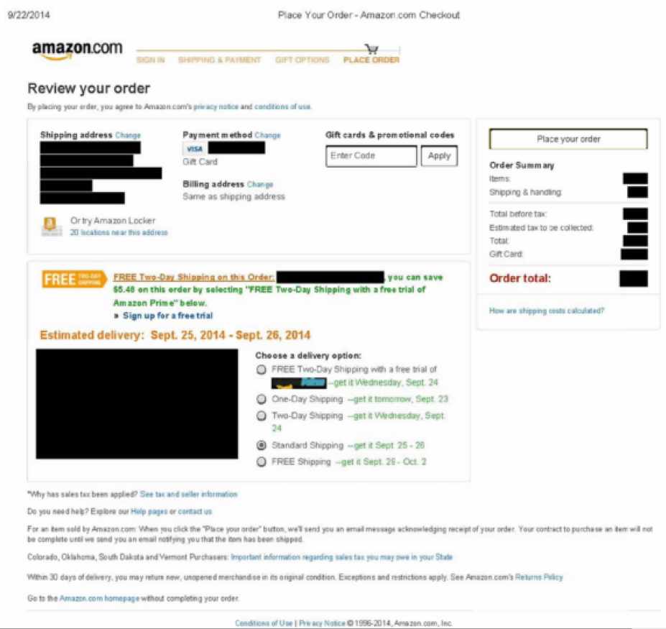

Slide 62
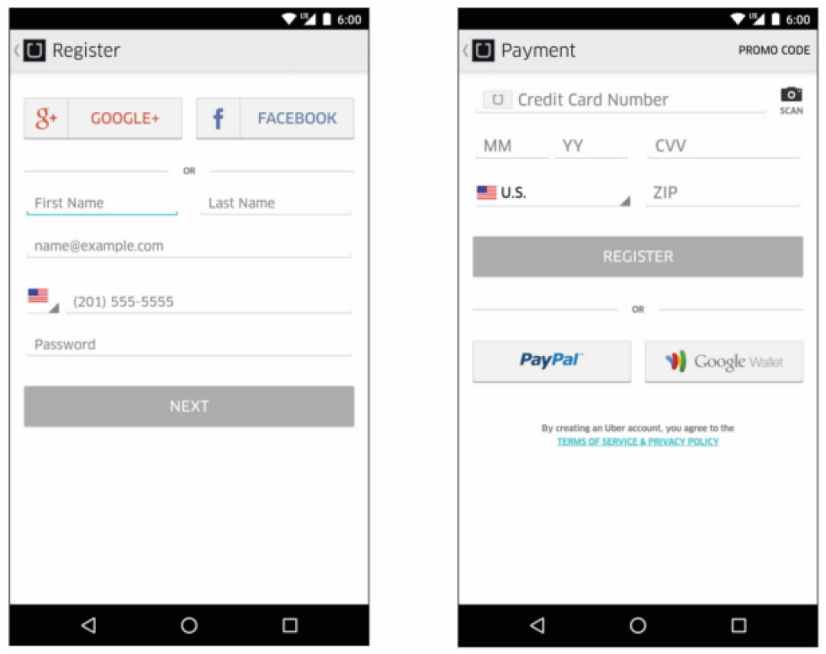

Slide 63
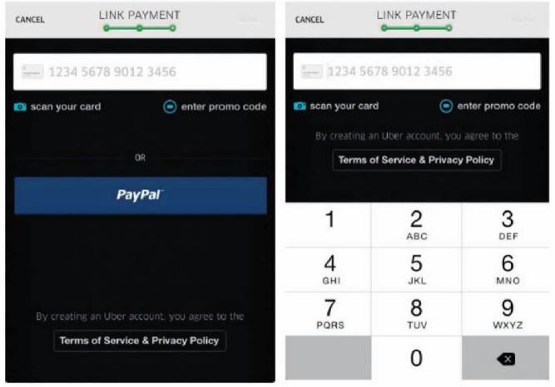

Slide 64
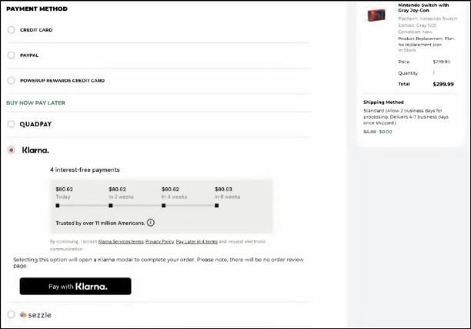

Slide 65
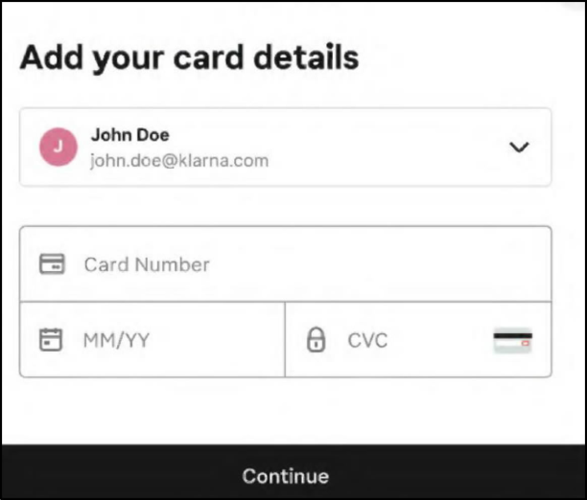

Slide 66
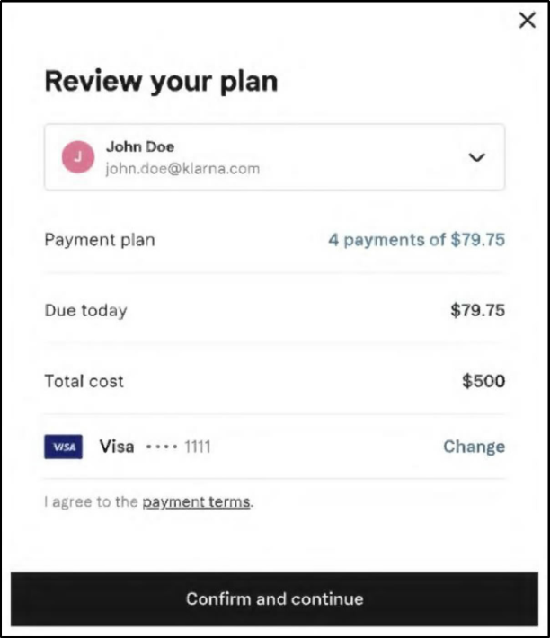

Slide 67
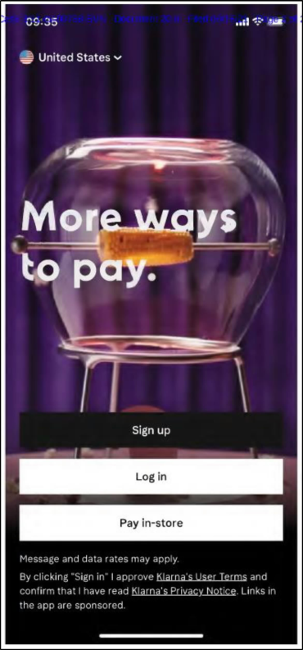

Slide 68
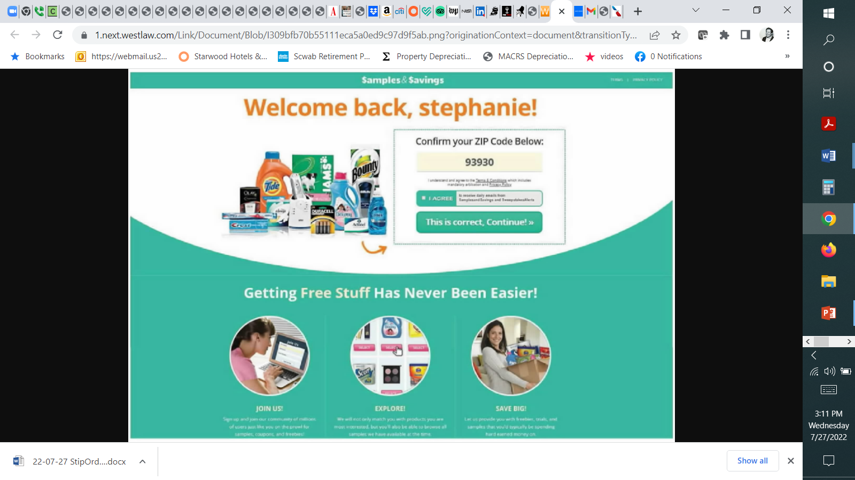

Slide 69
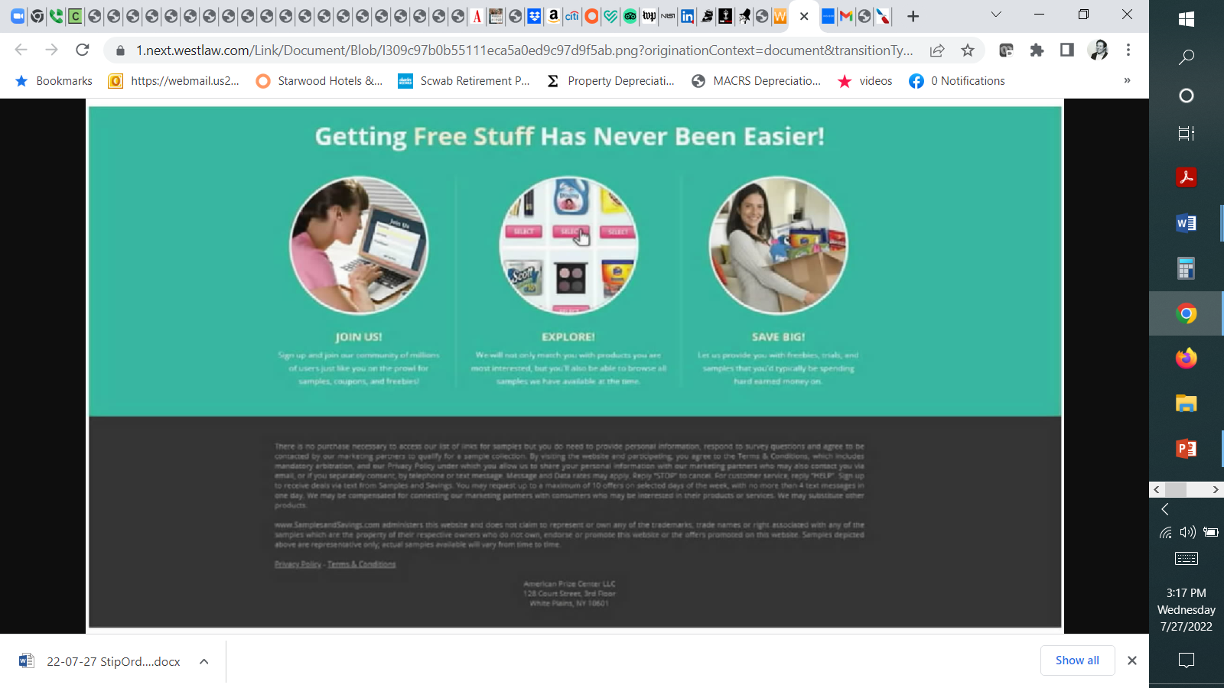

Slide 70
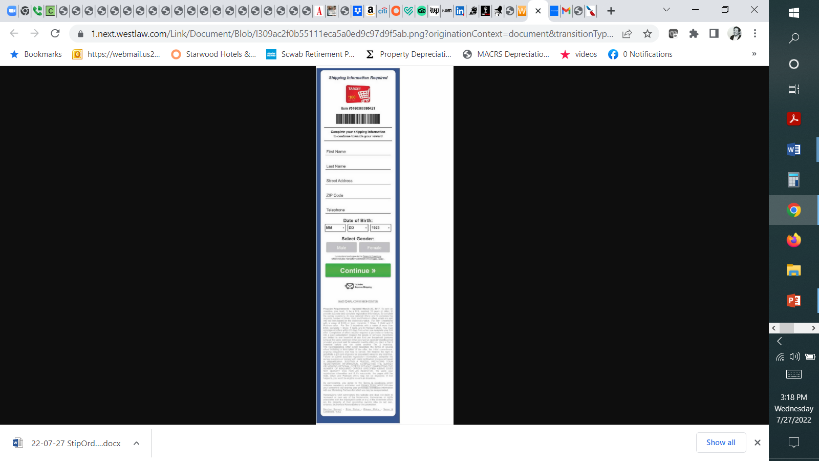

Slide 71
Online and Mobile Contract Formation
Trend: Continued hostility to implied contracts
  Edmundson v. Klarna, Inc., 85 F.4th 695 (2d Cir. 2023) (reversing order denying MTC arbitrationbecause under the totality of the circumstances Klarna’s checkout widget provided reasonably conspicuous notice of contractual terms, including arbitration)
  Oberstein v. Live Nation Entertainment, Inc., 60 F.4th 505 (9th Cir. 2023) (affirming MTC arbitration because California law does not require that corporate parties to a contract use their full legal names & Live Nation’s ToS included repeated references to its common trade names such that a reasonable user could have identified Ticketmaster’s full legal name)
  Jackson v. Amazon.com, Inc., 65 F.4th 1093 (9th Cir. 2023) (denying MTC arbitration per an amended TOS where notice allegedly was provided by an email to drivers not produced in the litigation)
  Berman v. Freedom Financial Network, LLC, 30 F.4th 849 (9th Cir. 2022)
    Sifuentes v. Dropbox, Inc., 2021 WL 2673080 (N.D. Cal. June 29, 2022)
  Emmanuel v. Handy Technologies, Inc., 992 F.3d 1 (1st Cir. 2021) (enforcing ToS and arbitration provision under Mass law where plaintiff selected ‘Accept’ in a mobile app)
  Nguyen v. Barnes & Noble Inc., 763 F.3d 1171, 1175-79 (9th Cir. 2014)
    declining to enforce an arbitration clause
    “where a website makes its terms of use available via a conspicuous hyperlink on every page of the website but otherwise provides no notice to users nor prompts them to take any affirmative action to demonstrate assent, even close proximity of the hyperlink to relevant buttons users must click on—without more—is insufficient to give rise to constructive notice”
    Wilson v. Huuuge, Inc., 944 F.3d 1212 (9th Cir. 2019) (declining to enforce arbitration clause in mobile ToS)
  Nicosia v. Amazon.com, Inc., 834 F.3d 220 (2d Cir. 2016)
    Reversing the lower court's order dismissing plaintiff's complaint, holding that whether the plaintiff was on inquiry notice of contract terms, including an arbitration clause, presented a question of fact where the user was not required to specifically manifest assent to the additional terms by clicking "I agree" and where the hyperlink to contract terms was not "conspicuous in light of the whole webpage."
  Meyer v. Uber Technologies, Inc., 868 F.3d 66 (2d Cir. 2017)
    (1) Uber’s presentation of its Terms of Service provided reasonably conspicuous notice as a matter of California law and (2) consumers’ manifestation of assent was unambiguous
    “when considering the perspective of a reasonable smartphone user, we need not presume that the user has never before encountered an app or entered into a contract using a smartphone. Moreover, a reasonably prudent smartphone user knows that text that is highlighted in blue and underlined is hyperlinked to another webpage where additional information will be found.”
    “[T]here are infinite ways to design a website or smartphone application, and not all interfaces fit neatly into the clickwrap or browsewrap categories.”
  Cullinane v. Uber Technologies, Inc., 893 F.3d 53 (1st Cir. 2018)
    Displaying a notice of deemed acquiescence and a link to the terms is insufficient to provide reasonable notice to consumers
    Ways to make future amendments enforceable

Slide 72
Arbitration & Mass Arbitration
Arbitration and Class Action Waivers
  AT&T Mobility LLC v. Concepcion, 563 U.S. 333 (2011)
  Henry Schein, Inc. v. Archer & White Sales, Inc., 139 S. Ct. 524 (2019)
  American Express Co. v. Italian Colors Restaurant, 570 U.S. 228 (2013)
  Tompkins v. 23andMe.com. Inc., 840 F.3d 1016 (9th Cir. 2016)
    Abrogating or limiting earlier Ninth Circuit cases that applied pre-Concepcion California unconscionability case law, which had treated arbitration clauses differently from other contracts
    Venue selection, bilateral attorneys’ fee and IP carve out provisions not unconscionable
    Enforcing delegation clause
Mass Arbitration
  Adams v. Postmates, Inc., 823 F. App’x 535 (9th Cir. 2020) (affirming the district court’s holding that the issue of whether mass arbitration claims violated the class action waiver provision of Postmates’ arbitration agreement was an issue that had been delegated to the arbitrator);
  Postmates Inc. v. 10,356 Individuals, CV 20-2783 PSG, 2020 WL 1908302 (C.D. Cal. 2020) (denying injunctive relief)
  MacClelland v. Cellco Partnership, 609 F. Supp. 3d 1024 (N.D. Cal. 2022) (holding unconscionable a mass arbitration clause that provided that if 25 or more customers initiated dispute notices raising similar claims or brought by the same or coordinated counsel the claims would be arbitrated in tranches of 5 bellwether cases at a time, which the court concluded could take 156 years to resolve all claims at issue given the average time of 7 months to resolution of AAA claims)
  Heckman v. Live Nation Entertainment, Inc., _ F. Supp. 3d _, 2023 WL 5505999 (C.D. Cal. 2023) (holding an amended arbitration provision changing the rules for mass arbitration to be procedurally and substantively unconscionable)
Public Injunctions (Include? Exclude? Delegation)
  Capriole v. Uber Technologies, Inc., 7 F.4th 854 (9th Cir. 2021) (holding that injunctive relief seeking reclassification of plaintiff Uber drivers’ status from “independent contractors” to “employees” was not public injunctive relief)
  DiCarlo v. MoneyLion, Inc., 988 F.3d 1148, 1152-58 (9th Cir. 2021)
  McGill v. Citibank, N.A., 2 Cal. 5th 945, 216 Cal. Rptr. 3d 627, 393 P.3d 85 (2017)
  CPRA amendment
Strategies – mass vs. individual arbitration
Drafting Tips
  Rent-A-Center, West, Inc. v. Jackson, 561 U.S. 63 (2010)
    Challenge to the enforceability of an agreement (arbitrable) vs. challenge to the agreement to arbitrate
    Clause: arbitrator, not a court, must resolve disputes over interpretation, applicability, enforceability or formation, including any claim that the agreement or any part of it is void or voidable
  Rahimi v. Nintendo of America, Inc., 936 F. Supp. 2d 1141 (N.D. Cal. 2013)
  Mondigo v. Epson America, Inc., 2020 WL 8839981 (C.D. Cal. Oct. 13, 2020)
  Henry Schein, Inc. v. Archer & White Sales, Inc., 139 S. Ct. 524 (2019)
  Lamps Plus, Inc. v. Varela, 139 S. Ct. 1407 (2019) (holding that ambiguity in an arbitration agreement does not provide sufficient grounds for compelling classwide arbitration)
  AAA – registration requirement
  Address “mass arbitration” – JAMS vs AAA vs. FedArb vs. Others
  Review and update frequently

Slide 73
BALLON’S 2024 ANNUAL ACC BRIEFING: INTERNET, AI and privacy law year in review
Ian Ballon, JD, LLM, CIPP/US
Co-Chair, Global IP & Technology Practice Group
Greenberg Traurig LLP
(650) 289-7881 (310) 586-6575 (202) 331-3138
Ballon@GTLaw.com
Facebook, Threads, LinkedIn, Bluesky: Ian Ballon
www.IanBallon.net

Slide 74
Linking and framing revisited

Slide 75
Links, Frames, and In-line and Embedded Links
Perfect 10, Inc. v. Amazon.com, Inc., 508 F.3d 1146 (9th Cir. 2007) (reproduction, distribution and public display of photos)
  The server test: merely creating a link to another website does not create a copy within the meaning of MAI v. Peak and cannot result in direct liability for copyright infringement (although it plausibly could lead to secondary infringement based on the direct infringement of a user, if any)
Flava Works, Inc. v. Gunter, 689 F.3d 754 (7th Cir. 2012)
  Granting summary judgment for the defendant where its video bookmarking service, which created in-line links to videos on third party websites via frames, could not support a claim for contributory infringement because merely creating links is not a material contribution (and stating in dicta that direct liability could not be imposed because creating an in-line link to videos via frames from the defendant's website did not amount to a public performance)
Live Nation Motor Sports, Inc. v. Davis, 81 U.S.P.Q.2d 1826, 2007 WL 79311 (N.D. Tex. Jan. 9, 2007) (holding that a link to a stream of a live webcast of motor races that were shown in real time constituted a public performance or display because those terms encompass "each step in the process by which a protected work wends its way to the audience"). Definition of fixation is broader for public performances than for other copyright rights
More recently, some district courts have held that a prima facie case for direct infringement may be made (subject to potentially applicable defenses) where in-line or embedded links create public displays of photographs
  Goldman v. Breitbart News Network, LLC, 302 F. Supp. 3d 585 (S.D.N.Y. 2018) (holding that that an image displayed via embedded links in various publications, from the Twitter feed where it had been posted, constituted a public display under the Copyright Act; granting partial summary judgment to the plaintiff)
  The Leader’s Institute, LLC v. Jackson, Civil Action No. 3:14-CV-3572-B, 2017 WL 5629514, at *10 (N.D. Tex. Nov. 22, 2017) (denying plaintiff’s motion for summary judgment on defendant’s counterclaim for copyright infringement, holding that plaintiff publicly displayed copyrighted content from defendant’s website by framing it on its own website; distinguishing framing from ordinary linking)
  Sinclair v. Ziff Davis, LLC, 2020 WL 3450136 (S.D.N.Y. June 24, 2020) (denying MTD on reconsideration; by agreeing to Instagram's Terms of Use, plaintiff authorized Instagram to grant API users, such as Mashable, a sublicense to embed her public Instagram content, but the complaint failed to establish that Instagram exercised that right)
  McGucken v. Newsweek LLC, 464 F. Supp. 3d 594 (S.D.N.Y. 2020), reconsideration denied, No. 19 Civ. 9617 (KPF), 2020 WL 6135733 (S.D.N.Y. Oct. 19, 2020)
    McGucken v. Pub Ocean Ltd., 42 F.4th 1149 (9th Cir. 2022)
  Nicklen v. Sinclair Broadcast Group, Inc., 551 F. Supp. 3d 188 (S.D.N.Y. 2021)
  Free Speech Systems, LLC v. Menzel, 390 F. Supp. 3d 1162, 1172 (N.D. Cal. 2019) (reading Perfect 10 as limited to search engines) (Orrick)
    Hunley v. Instagram, LLC, Case No. 21-cv-03778-CRB, 2021 WL 4243385 (N.D. Cal. Sept. 17, 2021) (dismissing complaint) (Breyer)
    Hunley v. Instagram, LLC, Case No. 21-cv-03778-CRB, 2022 WL 298570 (N.D. Cal. Feb. 1, 2022) (amended complaint) (appeal pending)
    Bell v. Wilmott Storage Services, LLC, 12 F.4th 1065 (9th Cir. 2021) (applying the server test to a public display of a photograph where the image wasn’t indexed)
Defenses – DMCA, fair use, implied license, de minimis infringement, Sony safe harbor
  Boesen v. United Sports Publications, Ltd., 20-CV-1552 (ARR) (SIL), 2020 WL 6393010 (E.D.N.Y. Nov. 2, 2020) (dismissing a photographer’s claim against a sports news publisher, which had included an embedded link to an Instagram post by professional tennis player Caroline Wozniacki, announcing her retirements (which included a low-resolution, cropped version of a photograph taken by the plaintiff), in an article it published about Wozniacki’s career, which also quoted the text of the Instagram post)
  Walsh v. Townsquare Media, Inc., 464 F. Supp. 3d 570 (S.D.N.Y. 2020) (dismissing, as fair use, a Paparazzi photographer’s copyright infringement claim, brought against the publisher of XXL magazine, which had embedded a link to an Instagram post by hip hop artist Cardi B, which included a photograph taken by plaintiff of Cardi B at a Tom Ford fashion show, in an article entitled Cardi B Partners with Tom Ford for New Lipstick Shade, which was focused on the event and referenced the Cardi B Instagram post which featured the photograph).
    Walsh v. Townsquare Media, Inc., 19-CV-4958 (VSB), 2022 WL 1302216 (S.D.N.Y. May 2, 2022) (awarding attorneys’ fees)

Slide 76
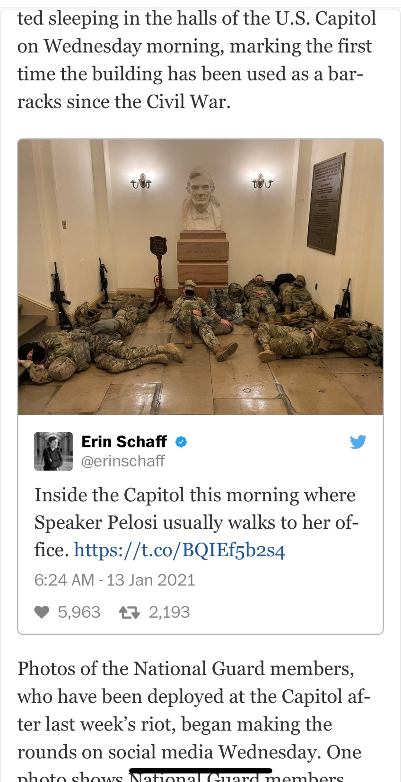

Slide 77
Use of #hashtags

Slide 78
The Use of #Hashtags
Khaled v. Bordenave, 18 Civ. 5187 (PAE), 2019 WL 1894321, at *6 (S.D.N.Y. Apr. 29, 2019) (allowing DJ Khaled and ATK Entertainment to amend their complaint to add allegations concerning uses by defendants of plaintiffs’ WE THE BEST mark, including #WETHEBEST and #WETHEBESTBRANDS, as hashtags to advertise products in social media; rejecting the argument that use of a mark in hashtags could not amount to trademark infringement)
Chanel, Inc. v. WGACA, LLC, 18 Civ. 2253 (LLS), 2018 WL 4440507, at *2-3 (S.D.N.Y. Sept. 14, 2018) (denying motion to dismiss and rejecting nominative fair use defense, holding that the owner of the CHANEL trademark plausibly alleged that WGACA’s use of the hashtag #WGACACHANEL infringed Chanel’s trademarks (and supported a claim for false advertising) by alleging that WGACA conjoined its acronym with the Chanel trademark to create the impression that WGACA was affiliated with Chanel or was an authorized Chanel retailer, where WGACA’s social media pages included quotations of Coco Chanel, photographs of Chanel-branded products, and photographs of models and public-opinion influencers wearing or carrying Chanel handbags, including previous Chanel ads)
Juul Labs, Inc. v. 4X PODS, Civil Action No. 18-15444 (KM) (MAH), 2020 WL 2029327 (D.N.J. Apr. 28, 2020) (denying defendant’s motion to dismiss, holding that plaintiff plausibly stated a claim and that hashtags are not per se always fair use)
  Juul Labs, Inc. v. 4X PODS, 509 F. Supp. 3d 52, 63 (D.N.J. 2020) (finding the defendant unlikely to prevail on its nominative fair use defense, in connection with entering a TRO in favor of the plaintiff; “[o]ne post with Juul hashtags among many unoffending posts could be written off, but that is not the case here. Given how many Juul-related hashtags were used and in how many posts, Eonsmoke stretched its usage of the Juul wordmark beyond nominative fair use.”)
Pasadena Tournament of Roses Association v. City of Pasadena, Case No. 2:21-CV-01051-AB-JEMx, 2021 WL 3553499, at *5-6 (C.D. Cal. July 12, 2021) (dismissing claims of trademark infringement, unfair competition, false association, false endorsement, and false designation of origin under the Lanham Act and California unfair competition, holding that defendant’s use of ROSE BOWL on the Instagram account of the City of Pasadena, where the Rose Bowl typically is played, including as a hashtag, was a nominative fair use)

Slide 79
Lanham Act Fair Use
Trademark – anything that identifies goods or services
  Use “other than as a mark” under 15 U.S.C. 1115(b)(4)
    KP Permanent Make-Up, Inc. v. Lasting Impressions I, Inc., 543 U.S. 111 (2004)
    A defendant is entitled to a fair use defense under this provision if it establishes that it used the allegedly infringing term (1) other than as a mark, (2) in a descriptive sense, and (3) in good faith
      Kelly-Brown v. Winfrey, 717 F.3d 295, 308 (2d Cir. 2013)
      Hard Candy, LLC v. Anastasia Beverly Hills, Inc., 921 F.3d 1343, 1363-64 (11th Cir. 2019)
  Dilution defenses
    “Any fair use, including a nominative or descriptive fair use, or facilitation of such fair use, of a famous mark by another person other than as a designation of source for the persons own goods or services, including use in connection with” (i) comparative advertising or (ii) parody, criticism or commentary
    All forms of news reporting and commentary
    Noncommercial use of a mark
  Nominative fair use
    New Kids on the Block v. News America Publishing, Inc., 971 F.2d 302 (9th Cir. 1992)
      a use will be deemed fair if (1) the goods or services identified are not readily identifiable without use of the mark; (2) only so much of the mark or marks are used as is reasonably necessary to identify the product or service; and (3) the user does nothing that would, in conjunction with the mark, suggest sponsorship or endorsement by the trademark holder
      Playboy Enterprises, Inc. v. Welles, 279 F.3d 796 (9th Cir. 2002)
      Volkswagenwerk Aktiengesellschaft v. Church, 411 F.2d 350, 352 (9th Cir. 1969)
      Sen v. Amazon.com, Inc., Case No.: 3:16-CV-01486-JAH-JLB, 2018 WL 4680018, at *4 (S.D. Cal. Sept. 28, 2018) (granting summary judgment for Amazon.com on claims for contributory and vicarious trademark infringement under the Lanham Act, where plaintiff's mark appeared in an online product review posted by a user on the defendant's platform)
    Century 21 Real Estate Corp. v. Lendingtree, Inc., 425 F.3d 211 (3d Cir. 2005)
      whether: (1) the use of plaintiff's mark is necessary to describe (a) plaintiff's product or service, and (b) defendant's product or service; (2) only so much of the plaintiff's mark used as is necessary to describe plaintiff's products or services; and (3) the defendant's conduct or language reflect the true and accurate relationship between the plaintiff and defendant's products or services

