Slide 1
Made in America
Fact and Fiction
Francis A. Citera | citeraf@gtlaw.com | 312.456.8413

Slide 2
The Surveys Say!
What do Americans say and believe about Made in USA?
Americans say they love U.S.-made goods.
They are less enthusiastic, however, about paying a premium for them.

Slide 3
2015 Consumer Reports Survey
According to a 2015 Consumer Reports survey, almost 8 in 10 American consumers say they would rather buy an American-made product than an imported one.
And more than 60 percent say they’re even willing to pay 10 percent more for it.

Slide 4
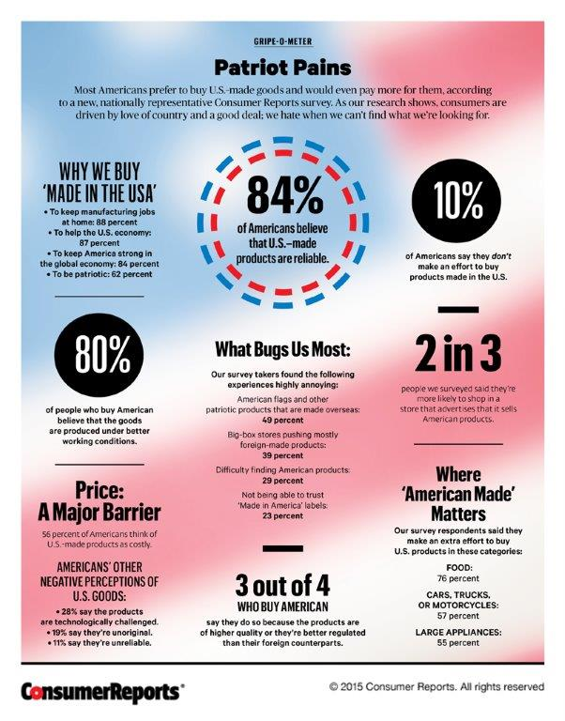

Slide 6
More recently, a poll conducted May 24-31, 2017 on behalf Thomson Reuters found 70 percent of Americans think it is “very important” or “somewhat important” to buy U.S.-made products.
Despite this sentiment, 37 percent said they would refuse to pay more for U.S.-made goods. Twenty six percent said they would only pay up to 5 percent more to buy American, and 21 percent capped the premium at 10 percent.

Slide 7
For the poll, a sample of roughly 2,857 adults age 18+ was interviewed online in English.
The sample includes 1,257 Democrats, 1,004 Republicans, and 354 Independents.
The poll included 593 adults who made less than $25,000 per year, 1,283 who said they earned between $25,000 and $74,999, and 805 people who earned more than $75,000.
Interestingly, the poll showed that lower income Americans were the most enthusiastic about buying U.S. goods.

Slide 8
The good news for U.S. manufacturers is that the poll demonstrates that Americans like the quality of many domestic goods.
Thirty-one percent in the poll said American-made cars are the best in the world.
German cars were voted best by 23 percent of respondents.
And thirty-eight percent said U.S.-made clothes were best.

Slide 9
The Legal Landscape

Slide 10
With a few notable exceptions, no law requires manufacturers and marketers to disclose the extent to which their products are made in the United States.
The exceptions are textile and wool products, fur products and Automobiles, which by law must disclose where they were made:
Textile Fiber Products Identification Act and Wool Products Labeling Act.
The Fur Products Labeling Act.
The American Automobile Labeling Act requires that automobiles manufactured on or after October 1, 1994 for sale in the United States bear a label disclosing where the car was assembled, the percentage of equipment that originated in the United States and Canada and the country of origin of the engine and transmission.

Slide 11
However, manufacturers and marketers who choose to make claims about the amount of U.S. content in their products must comply with the FTC’s Made in USA policy.
The Federal Trade Commission (FTC) is charged with preventing deception and unfairness in the marketplace.
The FTC Act gives the Commission the power to bring enforcement actions against false or misleading claims that a product is of U.S. origin.

Slide 12
Traditionally, the Commission has required that a product advertised as Made in USA be “all or virtually all” made in the U.S.
After a comprehensive review of Made in USA and other U.S. origin claims in product advertising and labeling, the Commission announced in December 1997 that it would retain the “all or virtually all” standard.
The Commission also issued an Enforcement Policy Statement on U.S. Origin Claims to provide guidance to marketers who want to make an unqualified Made in USA claim under the “all or virtually all” standard and those who want to make a qualified Made in USA claim.

Slide 13
What factors does the FTC consider to determine whether a product is “all or virtually all” made in the U.S.A.?
The product’s final assembly or processing must take place in the U.S. The Commission then considers other factors, including how much of the product’s total manufacturing costs can be assigned to U.S. parts and processing, and how far removed any foreign content is from the finished product.

Slide 14
The FTC’s Policy Statement prohibits advertising a product as “Made in USA” (or equivalent statements) unless “all or virtually all” labor and materials are domestic.
Under the FTC Policy Statement, no more than a “negligible” amount of foreign content or processing is allowed for a product advertised as “Made in USA.”

Slide 15
“All or virtually all” means that all significant parts and processing that go into the product must be of U.S. origin. That is, the product should contain no – or negligible – foreign content.
The permissible amount of foreign content is not defined by the FTC. But the approach remains at least theoretically viable where a product’s foreign content is truly de minimis.

Slide 16
However, the Policy Statement does allow a seller to use a limited or “qualified” form of claim to signal when part of the labor and material in a product is domestic and part is not.
An example might be to advertise that a fashion product is sewn in the United States using imported fabric.
Information about what kinds of claims are allowed or not allowed can be found at www.business.ftc.gov/documents/bus03-complying-made-usa-standard.
Some manufacturers are leery of this approach since the FTC’s guidance on what types of “qualified” claims are permissible is not always clear.

Slide 17
A qualified Made in USA claim is appropriate for products that include U.S. content or processing but don’t meet the criteria for making an unqualified Made in USA claim.
A qualified Made in USA claim, like an unqualified claim, must be truthful and substantiated.

Slide 18
A Made in USA claim can be express or implied.
Examples of express claims:
Made in USA.
“Our products are American-made.”
“USA.”

Slide 19
In identifying implied claims, the Commission focuses on the overall impression of the advertising, label, or promotional material.
Depending on the context, U.S. symbols or geographic references may convey a claim of U.S. origin either by themselves, or in conjunction with other phrases or images.
Examples:
U.S. flags,
Outlines of U.S. maps,
References to U.S. locations of headquarters or factories

Slide 20
In contrast, California had previously enacted a statute which, read literally, prohibited using a “Made-in-the-USA” claim if any part of the product is foreign-sourced. Cal. Bus. & Prof. Code § 17533.7.

Slide 21
On Sept. 1, 2015, California amended its statute. The new statute allows a manufacturer to advertise a product as "Made in the USA" as long as:
(1) the foreign components of the product do not "constitute more than 5% of the final wholesale value" of the product, or
(2) the manufacturer can show that it cannot obtain the foreign components of the product in the U.S. and those components "constitute not more than 10% of the final wholesale value" of the product
The amended statute took effect January 1, 2016.

Slide 22
The amended California statute is now more in line with the FTC guidelines, which allow a product to be advertised as “Made in the USA” where “all or virtually all” the labor and materials in the product are domestic.
In other words, both the state and federal standards allow a bit of flexibility for small amounts of foreign content to be present in a product manufactured and marketed as “Made in the USA.”

Slide 23
A key difference, however, is that the FTC guidelines do not quantify the permissible amount of foreign content. Many commentators have interpreted the FTC guidelines to allow only a truly de minimis amount of foreign content, which, ironically, now may be less than California’s 5 percent and 10 percent levels.
Plus, it is not clear how to determine what the California statute means by 5 percent or 10 percent of "wholesale value," though the most straightforward approach would be to compare the manufacturer’s cost for the foreign component(s) to the price the manufacturer charges to sell the completed product.

Slide 24
As a practical matter, many domestic manufacturers of products with mixed foreign and domestic content are likely to continue the current practice of softening or “qualifying” their “Made in USA” claims by disclosing, for example, that the product is made in the U.S. with foreign and domestic materials.
Doing so is generally regarded as acceptable under both federal and state laws and avoids the need to worry about quantifying the exact amount of foreign content.

Slide 25
The FTC can punish violators by initiating administrative lawsuits or investigating companies and demanding remedial measures.
The number of investigations regarding “Made in USA” claims appears to be on the rise.
The Commission issues an administrative complaint when it has “reason to believe” that the law has been or is being violated, and it appears to the Commission that a proceeding is in the public interest.
When the Commission issues a consent order on a final basis, it carries the force of law with respect to future actions.
Each violation of such an order may result in a civil penalty of up to $40,654.

Slide 26
Following public comment periods in two separate cases, the Federal Trade Commission in April approved final consent orders settling charges that iSpring Water Systems, LLC, a Georgia-based distributor of water filtration systems, and Block Division, Inc., a Texas-based distributor of pulley block systems, made misleading Made-in-the-USA claims.
The FTC’s complaint against iSpring alleged that the company’s unqualified claims that its products are built in the United States deceived consumers.
In many instances – despite iSpring’s false, misleading or unsupported claims – its products either are wholly imported or are made using a significant amount of inputs from overseas, according to the complaint.

Slide 27
The FTC’s complaint against Block Division alleged that for a period of several years, the company’s pulleys featured imported steel plates that were stamped “Made in USA” before they entered the United States.
The complaint also alleged that Block Division used unqualified “Made in USA” claims in advertising to represent that these pulley blocks, other products, and the parts used to make them, were all or virtually all made in the United States.
In fact, the complaint states, the company’s products include significant imported parts that are essential to their function.

Slide 28
Closing Letter – An Example
As we have discussed, unqualified “Made in USA” or “Built in USA” claims likely suggest to consumers that products are “all or virtually all” made in the United States.
The Commission may analyze a number of different factors to determine whether a product is “all or virtually all” made in the United States, including:
The proportion of the product’s total manufacturing costs attributable to U.S. parts and processing,
How far removed any foreign content is from the finished product,
And the importance of the foreign content or processing to the overall function of the product.

Slide 29
In this case, the Company sources significant inputs to many of its products overseas.
For example, 100% of the cost of materials used to make certain watches is attributable to imported materials.
Similarly, more than 70% of the cost of the materials used to make certain belts is attributable to imported materials such as decorative buckles.
Additionally, xxxxxx sources the steel used to make certain bicycle forks overseas.

Slide 30
Accordingly, to avoid deceiving consumers, xxxxxx implemented a remedial action plan to account for this significant imported content by qualifying its representations.
Among other things, this plan includes:
(1) applying corrective hangtags and information cards to watches, bicycles, and other affected products to alert consumers to the fact that those products include significant imported content;
(2) redesigning watch casebacks;
(3) updating embossed claims in affected leather goods;
(4) updating Internet and hardcopy advertising materials to qualify claims;

Slide 31
Among other things, this plan includes (continued):
(5) updating employee training materials;
(6) updating advertising materials distributed to third-party retailers;
(7) transitioning away from the Company's "Where American is Made“ slogan;
And (8) developing enhanced policies and procedures, including additional legal review, to avoid future deception or mislabeling.

Slide 32
Though the FTC has taken a hard stance on “Made in USA” claims, some courts do not view “Made in USA” labels as written warranties under the Magnuson-Moss Warranty Act:
“Sears maintains that the phrase ‘Made in USA’ does not constitute a ‘written warranty’ because it does not affirm or promise that the material or workmanship is defect-free or will perform at a specified level over a specified time. We agree. The phrase is a product description that does not inform consumers that the tools are defect-free or make any representation about performance at a specified level over a specified time.”

Slide 33
Thank You.

