Slide 1
Featured Items
GT Website and Biographies Training Module
Sam Ballen | ballens@gtlaw.com | 973.443.3280

Slide 2
What are Featured Items?

Slide 3
What are Featured Items?
News, Insights, or Events that are designated to be displayed under the “Featured” tab in the “News, Insights & Events” section of capabilities, offices, firm pages, and attorney bios.
This tool allows us to curate News, Insights, and Events so they are not displayed in chronological order.
Featured items feed from website bios to standard Qorus bios (Only Featured Items appear on standard Qorus bios).

Slide 4

Where Will Featured Items Appear?
The Featured tab displays by default when website pages are loaded.
This includes Biographies, Capabilities, Office, and Firm pages.

Slide 5
Where Will Featured Items Appear?
If no items are selected as “Featured,” the Featured tab does not display when the page loads, and “News” opens by default instead.
Each tab in this section only appears if there are items to populate it.
Featured items also appear under their regular tab.

Slide 6
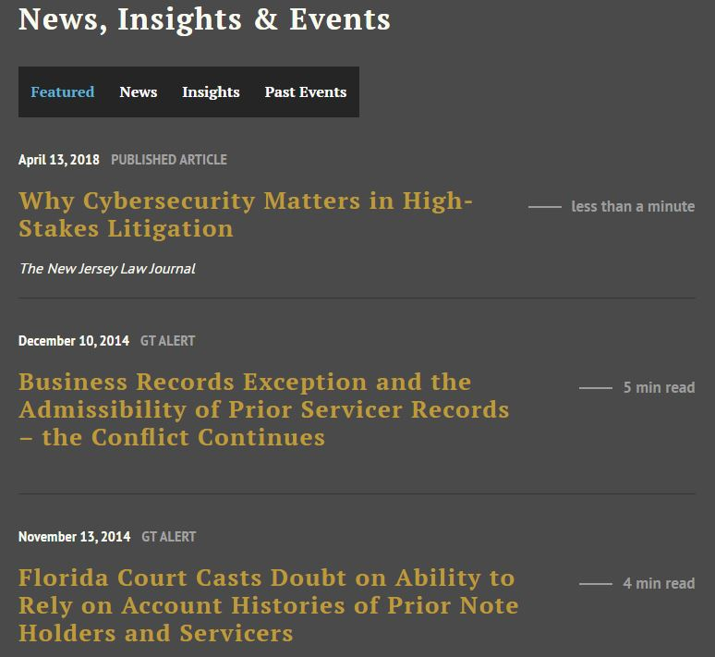

Slide 7
What Should Be Featured?
Pick items that are relevant or interesting to potential clients, with a focus on what’s recent.
For biographies, capabilities pages, and office pages, work with attorneys to determine which items best position them as a thought leaders in their fields.
Featured items can be displayed in any order, and they can be added or removed at any time by contacting the Biographies Team or Content Team.
Any number of items can be added to the Featured tab, but the system works best when approximately 5-15 items are chosen.
The Content/Biographies Teams will ask if an item should be featured when it is added.

Slide 8
Keeping Featured Items Fresh
Periodically review and refresh featured items so they stay recent and relevant.
Regional and practice teams should monitor their pages and their attorneys’ biographies to determine when featured items should be added or removed.
Review at every attorney bio that you are responsible for at least once a year. Look at office at office and capability pages more often.

Slide 9
How Do Featured Items Display On Qorus Bios?
All items are sorted into their respective categories on Qorus bios. They are not displayed in a separate “Featured” section the way they are online.
Standard Bios: Only Featured News/Insights/Events items display on an attorney’s Standard Qorus biography.
  Items chosen as featured are the only ones that appear when a standard attorney/professional bio is pulled from Qorus for a pitch or an RFP.
Short Bios: No News/Insights/Events items display on Short Form Qorus biographies. The “Experience” section is also omitted.
Long Bios: All items (except Future/Upcoming Events and GT press releases) display on Long Form Qorus biographies.

Slide 10
Remember:
Check attorney bios and other pages regularly to keep Featured Items up to date.

Slide 11
Questions?

